Slide 1
APPA Town Hall: Impact of COVID 19 – Dedensifying Your Spaces
University of Nebraska-Lincoln’s “Forward to Fall”
Jim Jackson, Associate Vice Chancellor, University Operations
Bill Nunez, Vice Chancellor, Business and Finance

Slide 2
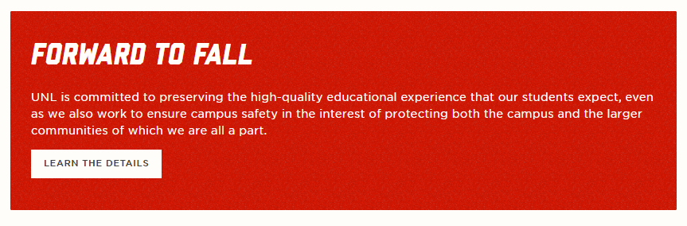
APPA Town Hall – COVID-19 and UNL’s Forward to Fall
Discussion Topics
Academics (Bill Nunez)
Operations (Jim Jackson)

Slide 3
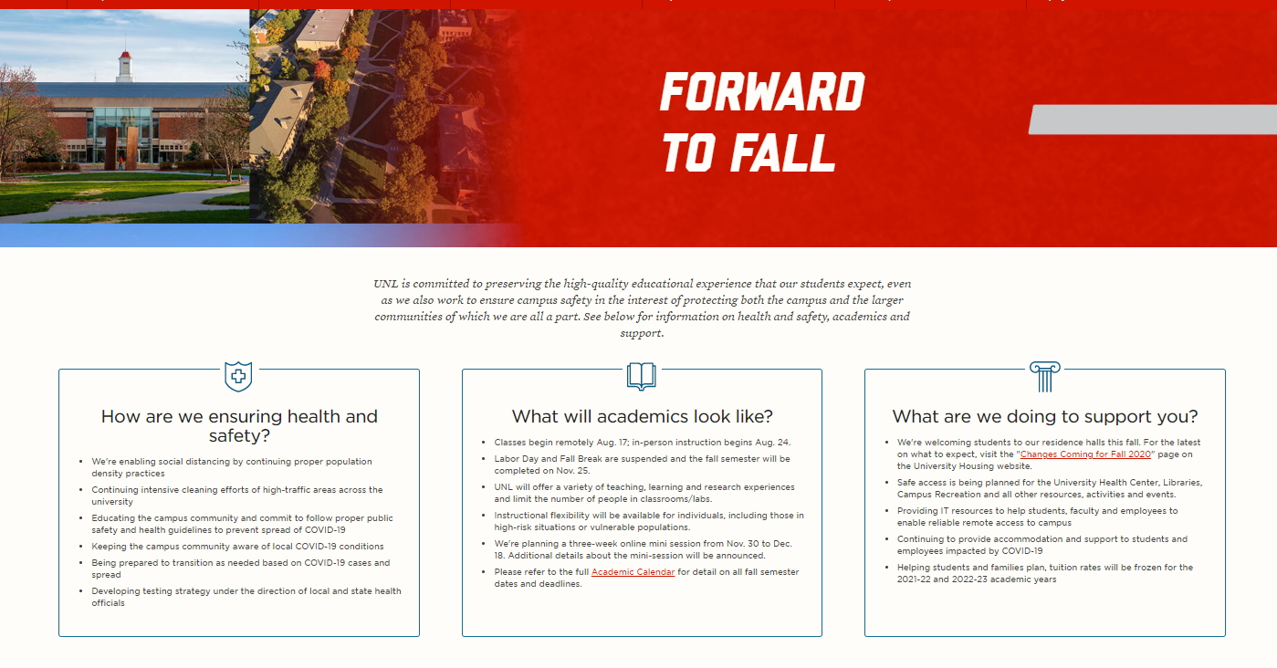
APPA Town Hall

Slide 4
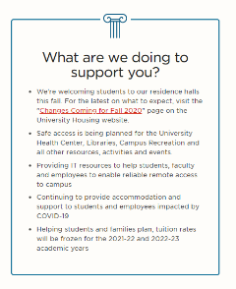
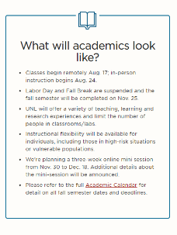
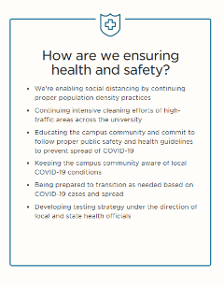
APPA Town Hall
Academics
  University Leadership Coordination and Support
  Academic Course Delivery
  Commitment to Health and Safety

Slide 5
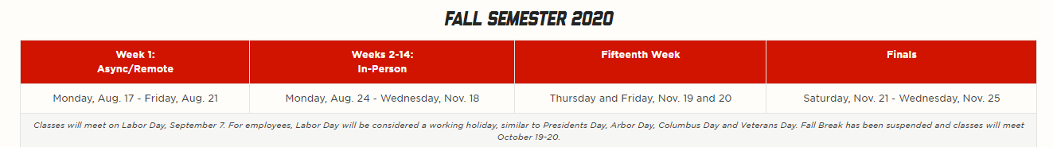
APPA Town Hall
Academics-Classroom Process
  Modeled 6 feet physical distance polygons in CAD/Archibus of UNL’s 340 classrooms, over 9300 classes
  Distributed data to academic units - Instructed to plan for 31% of seating capacity based off CAD modeling
  Coordinated and scheduled physical distance verification “walk through” with academic unit representatives
  Walk through verification of 340 classroom spaces resulted in 35% of seating capacity
  Lab capacities in the 50% range – Auditorium style seating in the 20-25% range

Slide 6
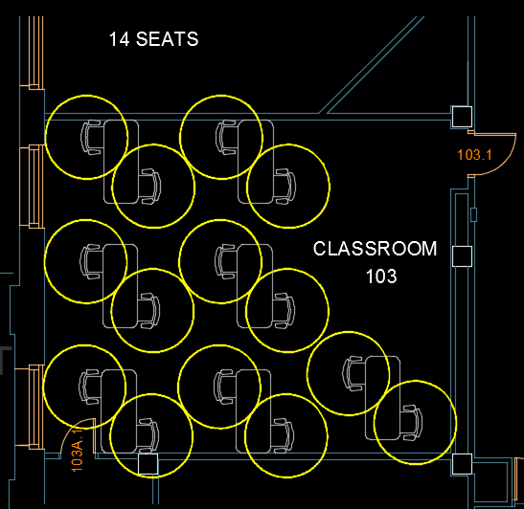
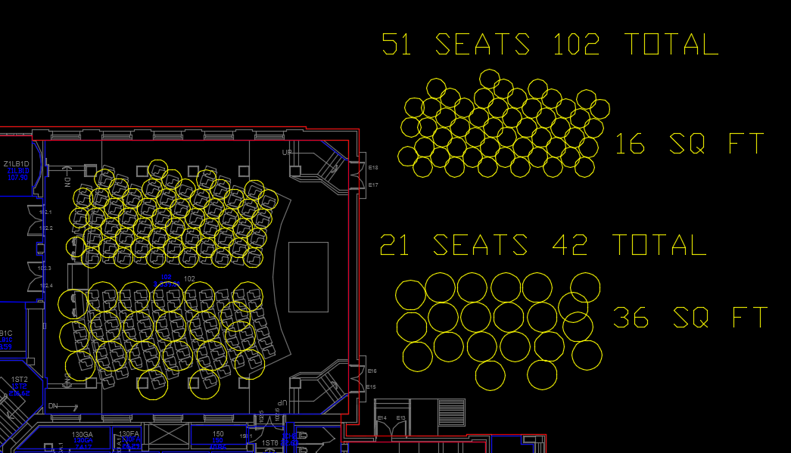
APPA Town Hall
Running multiple modeling scenarios in CAD

Slide 7
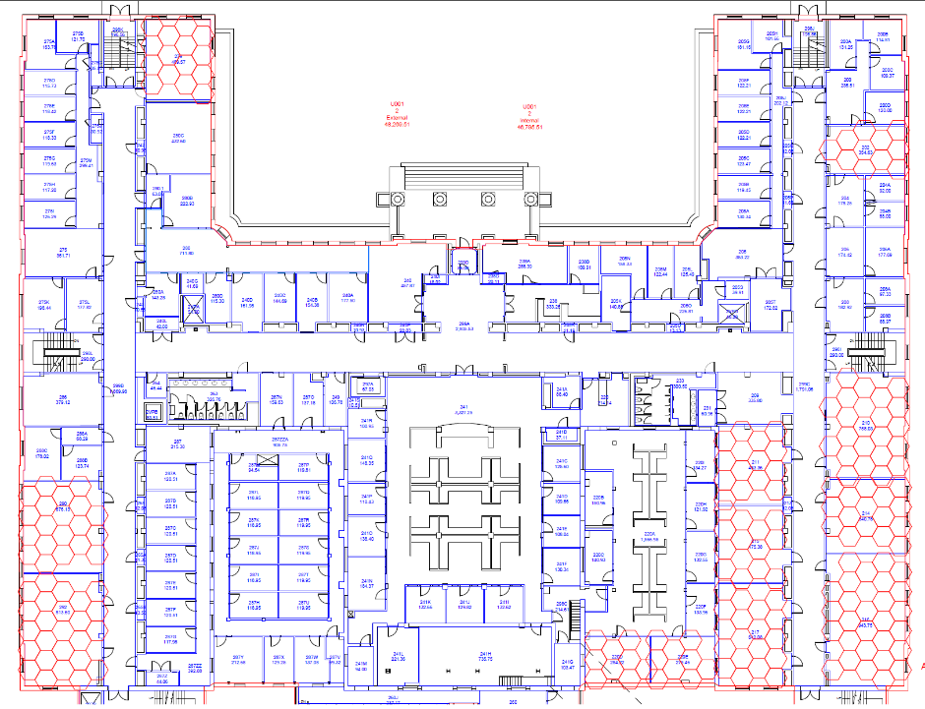
APPA Town Hall
Final 6 feet physical distance polygon modeling format in CAD

Slide 8
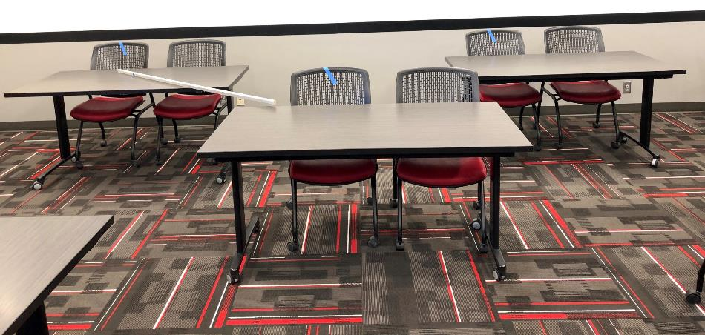
APPA Town Hall
Mockup

Slide 9
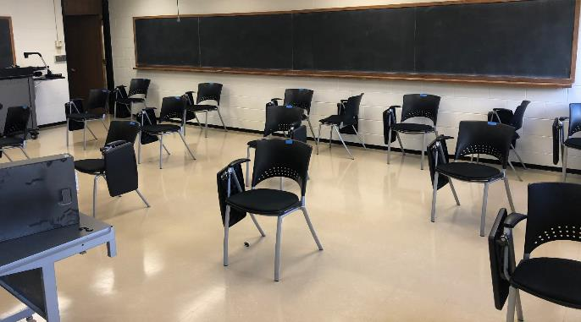
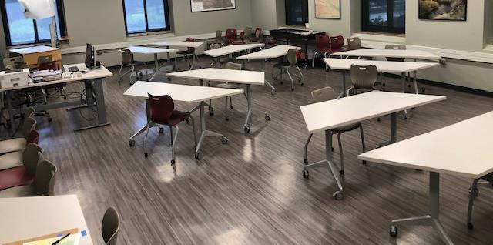
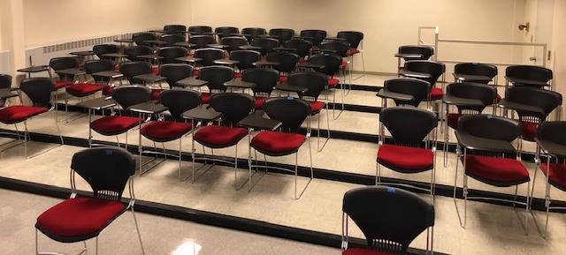
APPA Town Hall
Examples

Slide 10
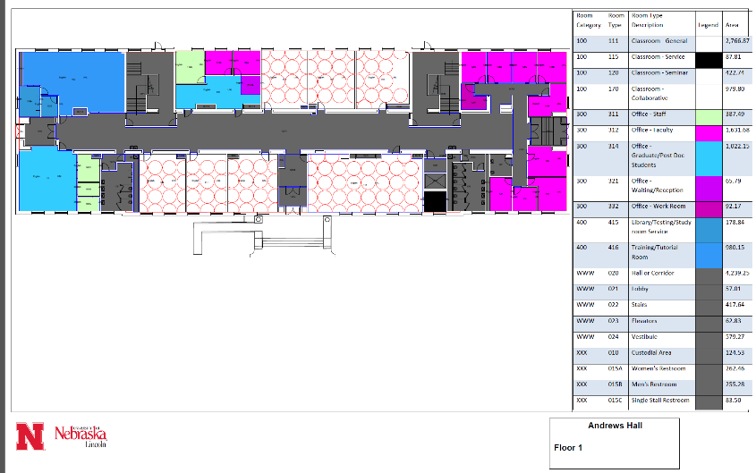
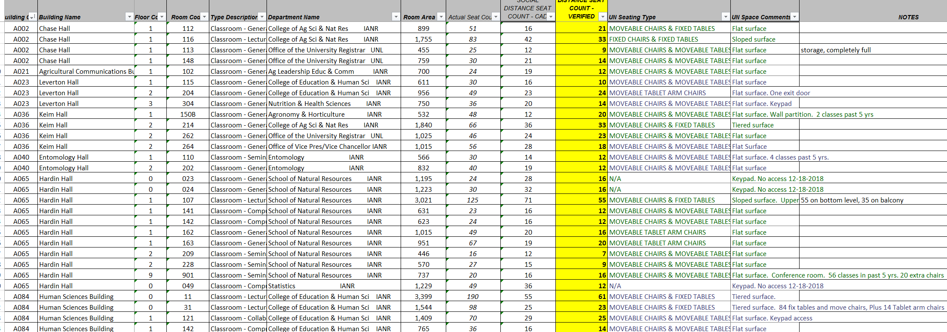
APPA Town Hall
Data Sent to Colleges

Slide 11


APPA Town Hall
  Lessons “Learning”
  Ongoing Considerations and Unknowns

Slide 12

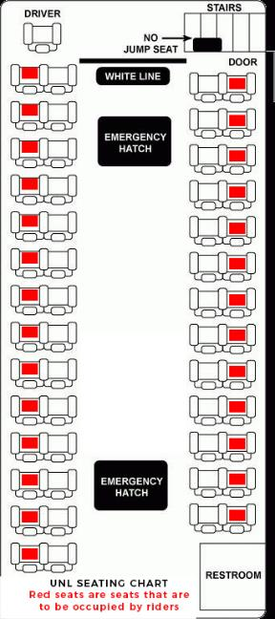
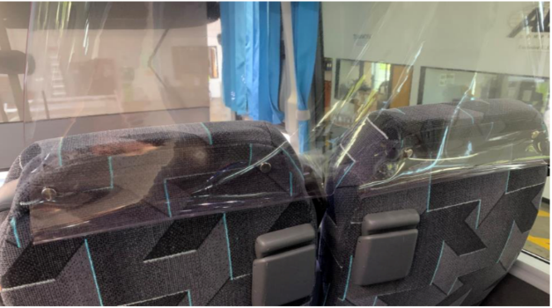
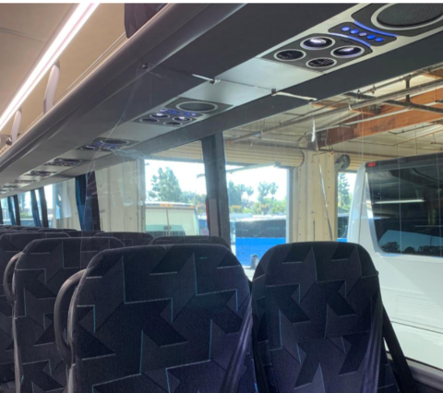
APPA Town Hall
University Operations: Mobility Issues-University Shuttle

Slide 13
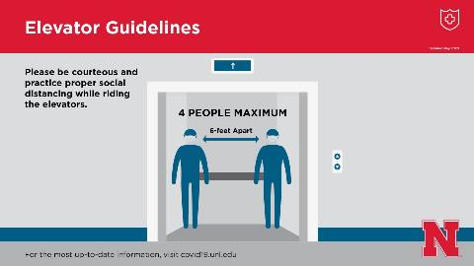
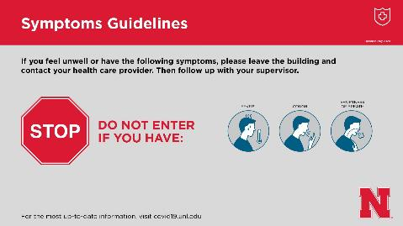
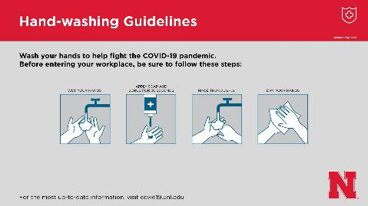
APPA Town Hall
Posters and Signs

Slide 14

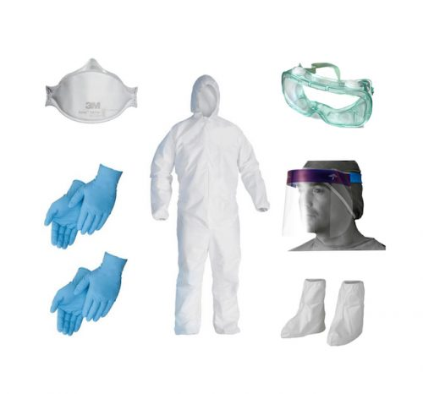
APPA Town Hall
Institutional and System alignment
Sourcing health and wellness supplies
Strategically locating health and wellness supplies

Slide 15
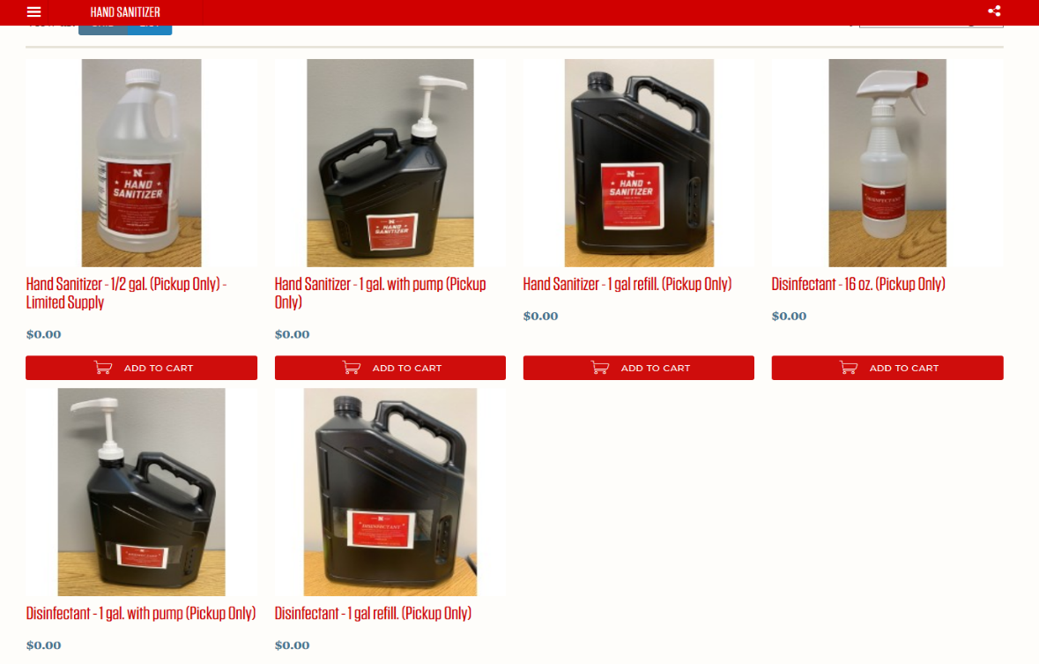
APPA Town Hall
    COVID health and wellness product Catalog

Slide 16
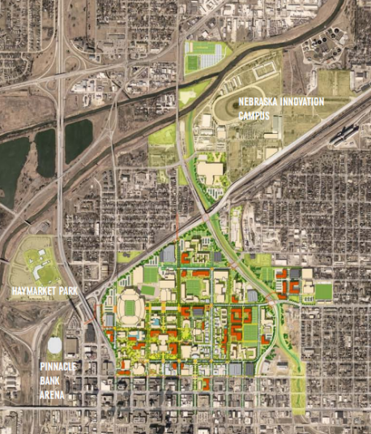
APPA Town Hall
  Energy setbacks
  Reopening Buildings
  Ongoing Considerations and Unknowns

