Slide 1
Classroom Spaces
Classrooms, Seminar Rooms, and Lecture Halls

Slide 2
Cullen Building

Slide 3
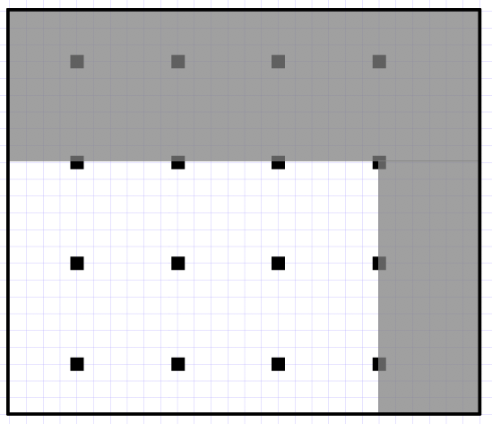

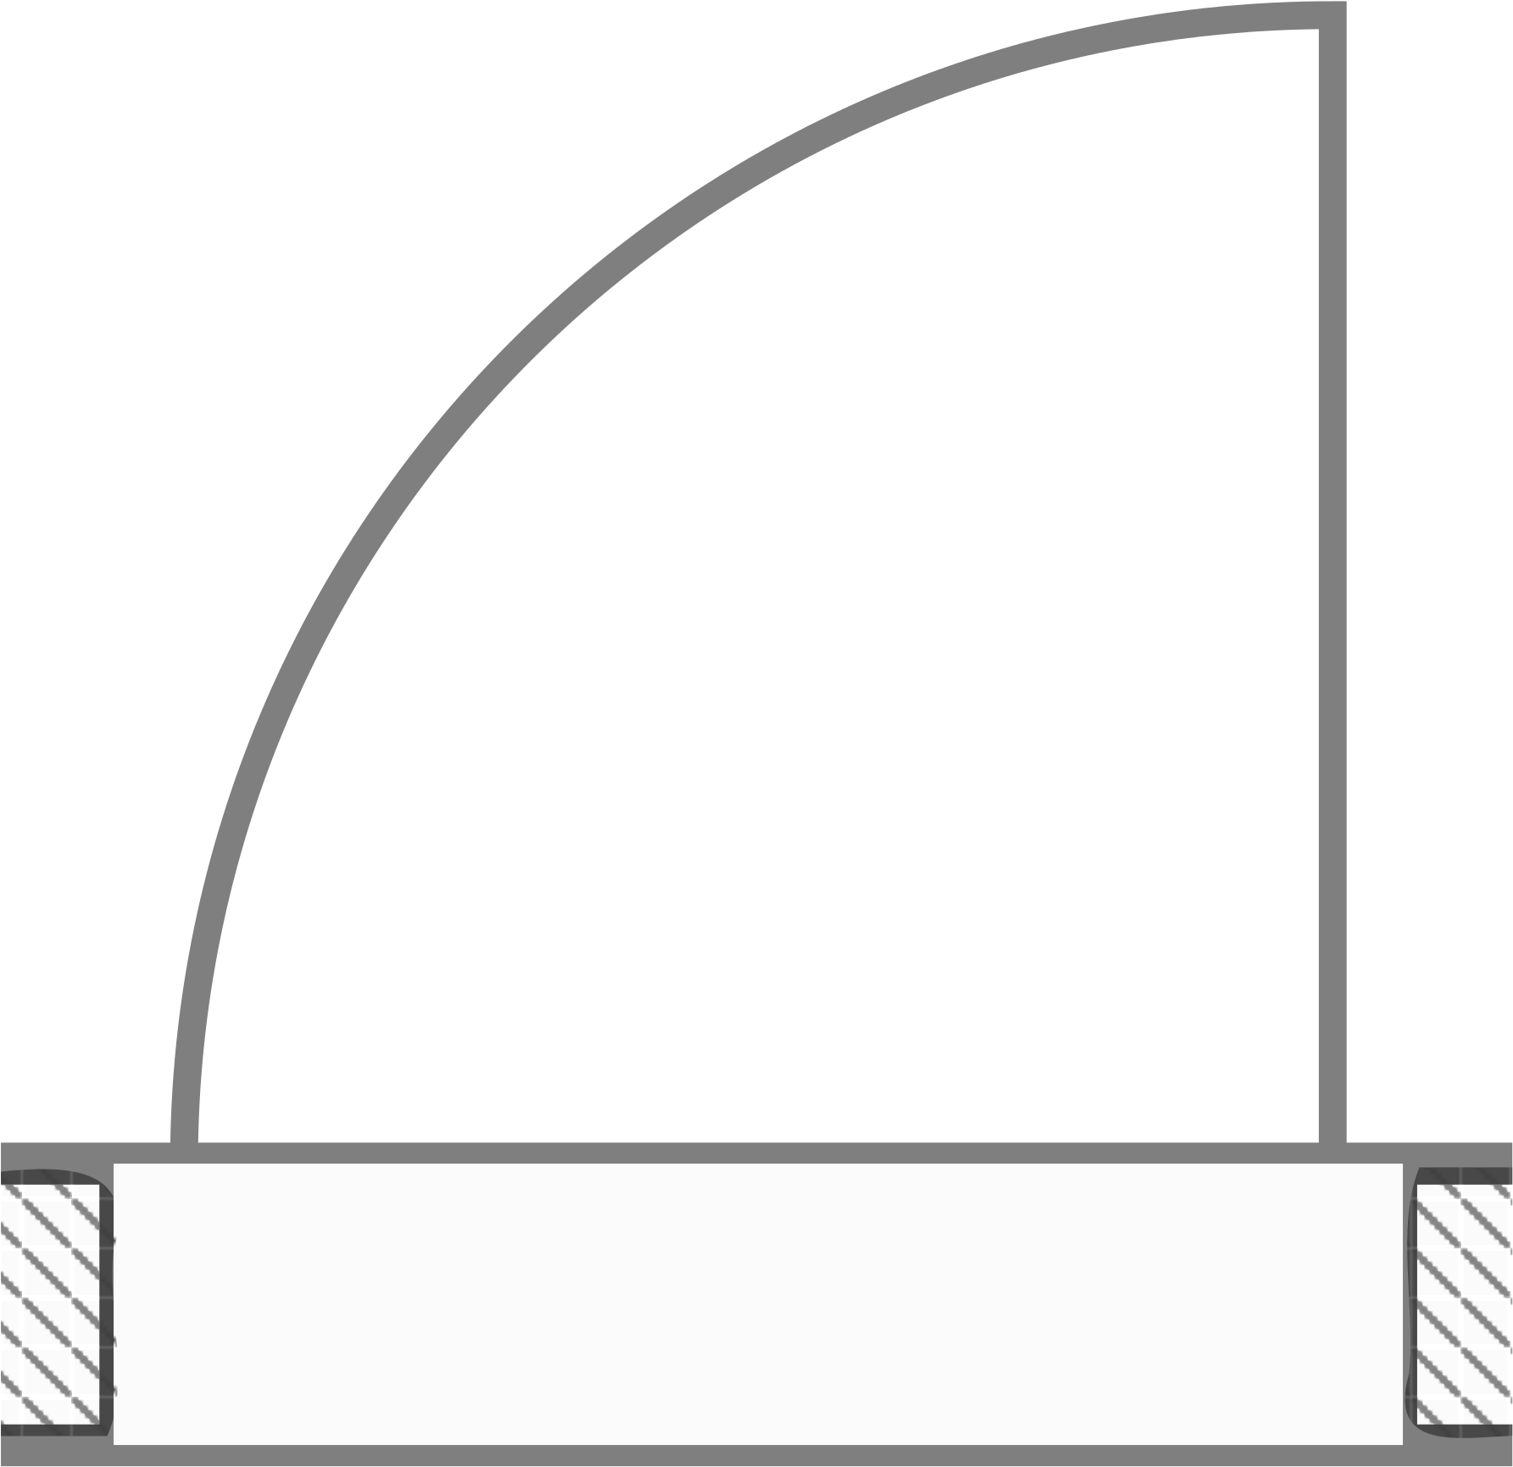
CULLEN
300
28’ x 25’
A = 700 sq ft
CAPACITY
12
28’
25’
Notes:
35 Desks

Slide 4
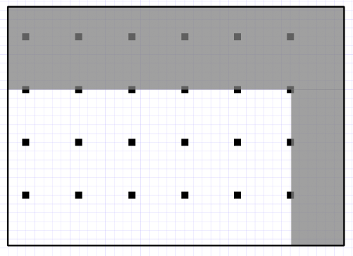
CULLEN
310
38’ x 27’
A = 1026 sq ft
CAPACITY
18
38’
27’
Notes:
43 Desks

Slide 5
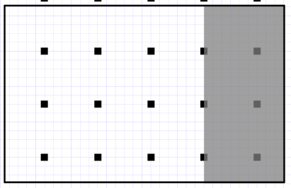
CULLEN
320
31.5’ x 20’
A = 630 sq ft
CAPACITY
12
31.5’
20’
Notes:
4.5 x 10 Tables (2)

Slide 6
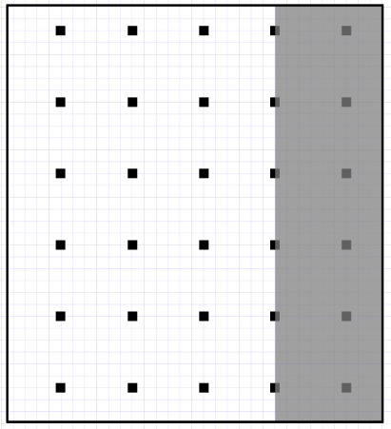
CULLEN
321
31.5’ x 35’
A = 1103 sq ft
CAPACITY
24
31.5’
35’
Notes:
43 Desks

Slide 7
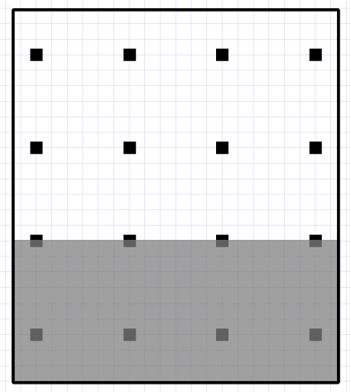
CULLEN
330
30’ x 27’
A = 810 sq ft
CAPACITY
12
27’
30’
Notes:
48 Desks

Slide 8
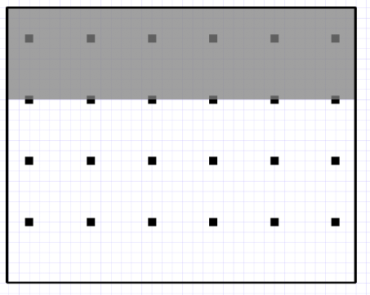
CULLEN
360
34’ x 27’
A = 918 sq ft
CAPACITY
18
27’
34’
Notes:
2.5 x 5 Tables (18)

Slide 9
CULLEN
370
34’ x 27’
A = 918 sq ft
CAPACITY
18
27’
34’
Notes:
38 Desks

Slide 10
Fine Arts Building

Slide 11
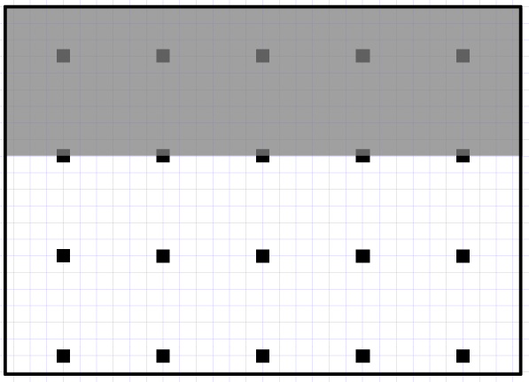
FAB
148
31’ x 22’
A = 682 sq ft
CAPACITY
15
31’
22’
Notes:
36 Desks

Slide 12
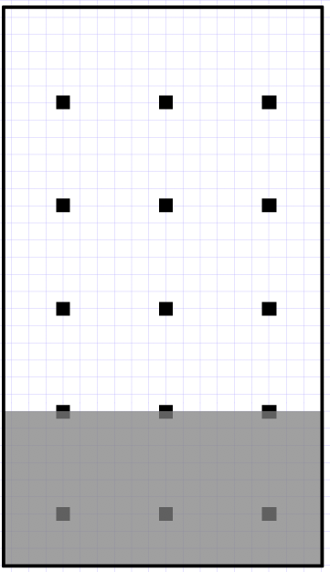
FAB
166
32.5’ x 18.5’
A = 601 sq ft
CAPACITY
12
18.5’
32.5’
Notes:
6x2 tables (10)

Slide 13
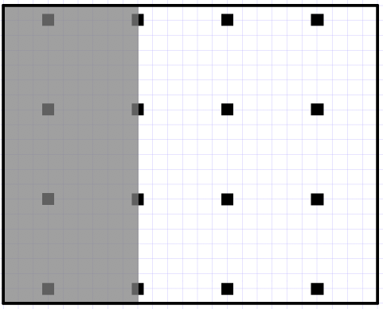
FAB
235
20’ x 25’
A = 500 sq ft
CAPACITY
12
25’
20’
Notes:
5 x 2.5 tables (12)

Slide 14
Fondren Jones

Slide 15
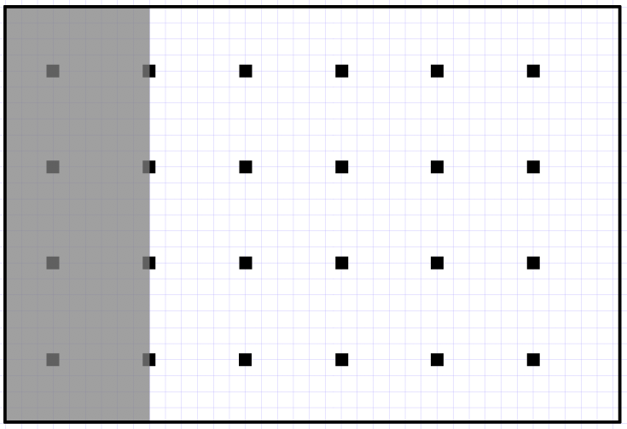
FJS
100
26’ x 38.5’
A = 1001 sq ft
CAPACITY
20
38.5’
26’
Notes:
5’ circle tables (8)

Slide 16
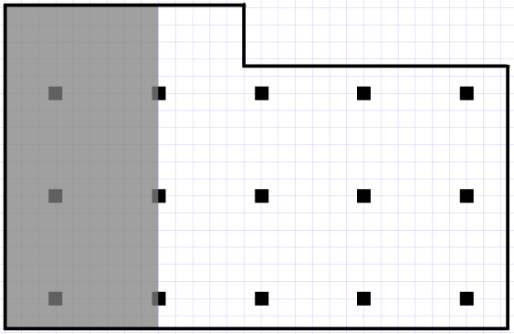
FJS
103
29.5’ x 15.5’
A = 513 sq ft
CAPACITY
10
19.5’
15.5’
29.5’
Notes:
5’ x 2.5’ tables (8)

Slide 17
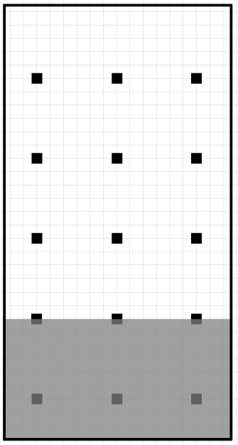
FJS
120
32.5’ x 17’
A = 553 sq ft
CAPACITY
12
17’
32.5’
Notes:
5’ x 2.5’ tables (8) -- move to rooms with circle tables

Slide 18
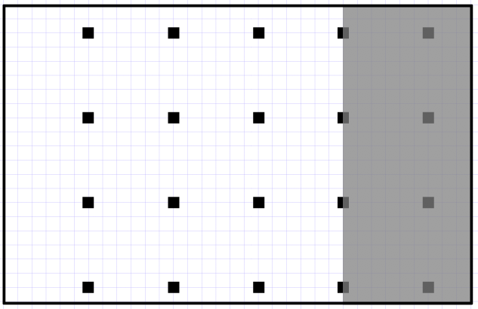
FJS
148
21’ x 33’
A = 693 sq ft
CAPACITY
16
33’
21’
Notes:
42 Desks

Slide 19
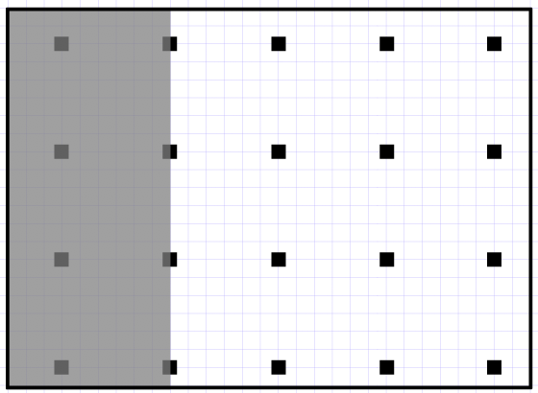
FJS
151
21’ x 29’
A = 609 sq ft
CAPACITY
15
29’
21’
Notes:
36 Desks

Slide 20
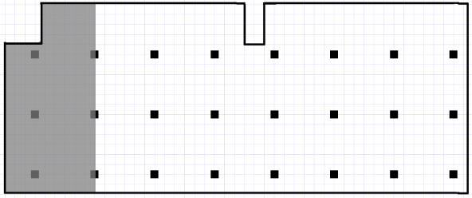
FJS
204
46.5’ x 19’
A = 883.5 sq ft
CAPACITY
20
**No projector**
19’
46.5’
Notes:
5 x 2 tables (16)

Slide 21
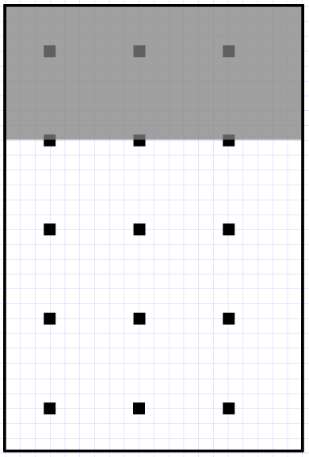
FJS
300
30’ x 20’
A = 600 sq ft
CAPACITY
12
[Outdoor Classroom]
**No projector**
20’
30’
Notes:
3.5’ circle tables (8)

Slide 22
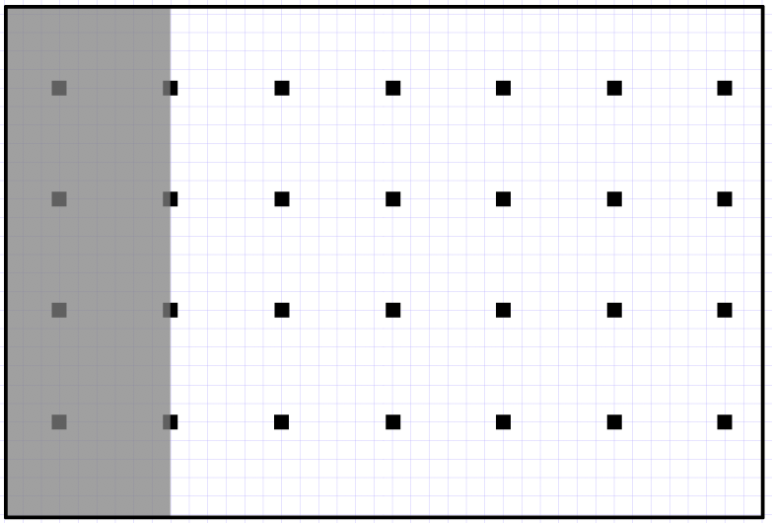
FJS
402
41’ x 27.5’
A = 1128 sq ft
CAPACITY
24
41’
27.5’
Notes:
5 x 2 tables (18)

Slide 23
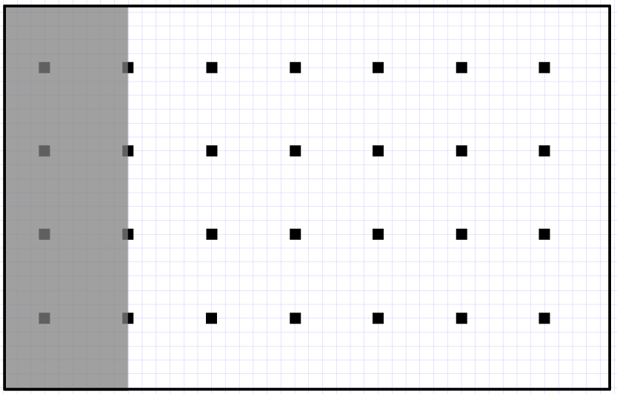
FJS
403
43.5’ x 27.5’
A = 1196 sq ft
CAPACITY
24
43.5’
27.5’
Notes:
5’ circle tables (10)

Slide 24
Mood-Bridwell Hall

Slide 25
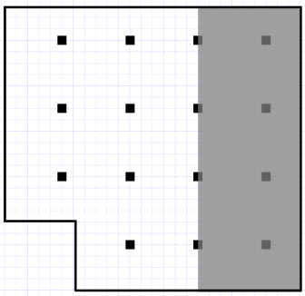
Mood
107
25’ x 26’
A = 614 sq ft
CAPACITY
11
19’
26’
20’
25’
Notes:
27 Desk

Slide 26
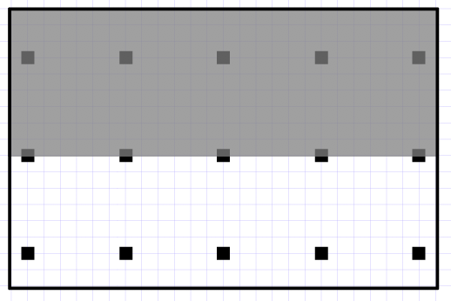
Mood
109
26’ x 17’
A = 442 sq ft
CAPACITY
10
17’
26’
Notes:
28 Desks

Slide 27
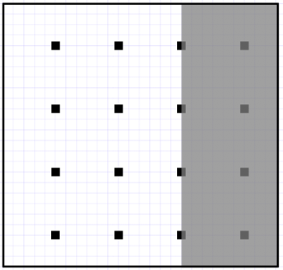
Mood
113
26’ x 25’
A = 650 sq ft
CAPACITY
12
25’
26’
Notes:
35 Desk

Slide 28
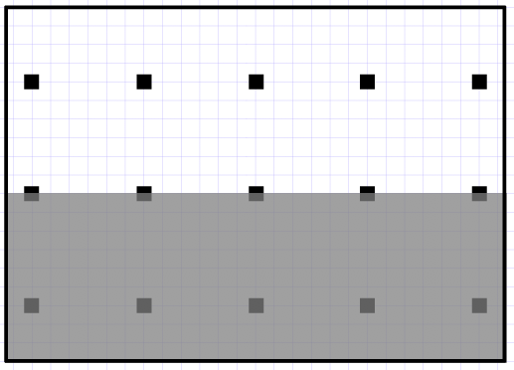
Mood
306
26.75’ x 19’
A = 508 sq ft
CAPACITY
10
**No projector**
19’
26.75’
Notes:
4x2 tables (12 -- 8 rectangles, 4 quarter circles)

Slide 29
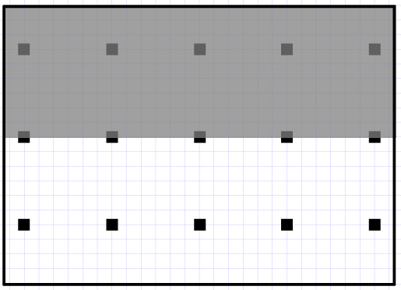
Mood
343
26.75’ x 19’
A = 508 sq ft
CAPACITY
10
19’
26.75’
Notes:
31 Desks

Slide 30
Mundy Hall

Slide 31
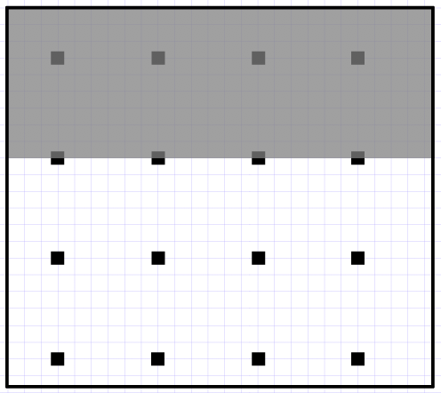
Mundy
121
25.5’ x 22.5’
A = 574 sq ft
CAPACITY
12
25.5’
22.5’
Notes:
Desks (31)

Slide 32
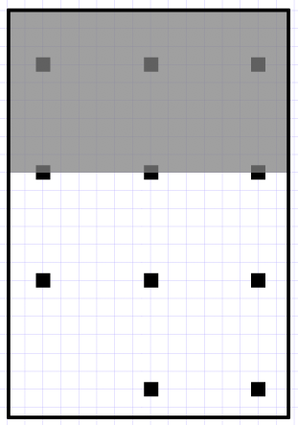
Mundy
125
15.5’ x 22.5’
A = 349 sq ft
CAPACITY
8
15.5’
22.5’
Notes:
5’ x 3’ tables (6)

Slide 33
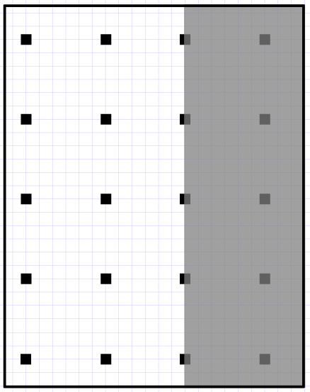
Mundy
130
28.5’ x 22.5’
A = 641 sq ft
CAPACITY
15
22.5’
28.5’
Notes:
5’ x 3’ tables (8) -- remove

Slide 34
Mundy
140
28.5’ x 22.5’
A = 641 sq ft
CAPACITY
15
22.5’
28.5’
Notes:
5.5’ x 2’ (11) -- remove

Slide 35
Olin Building

Slide 36
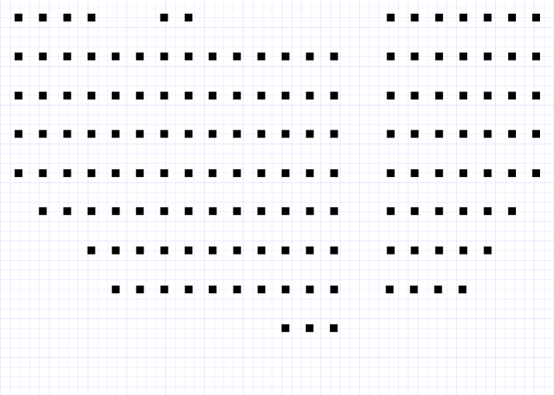
Olin
105
43’ x 37’
A = 2596 sq ft
CAPACITY
38
**Fixed Seating**

Slide 37
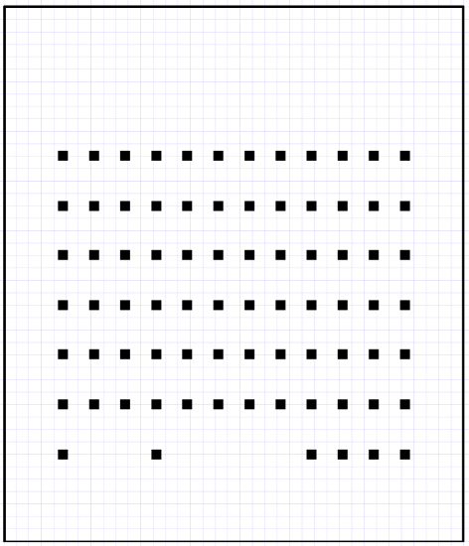
Olin
110
43’ x 37’
A = 1591 sq ft
CAPACITY
20
**Fixed Seating**
37’
43’

Slide 38
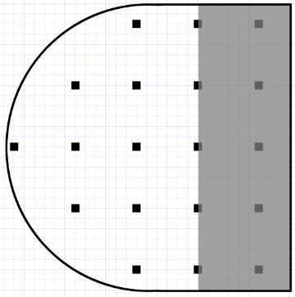
Olin
111
28’ x 28’
A = 408 sq ft
CAPACITY
14
28’
28’
Notes:
Desks (36)

Slide 39
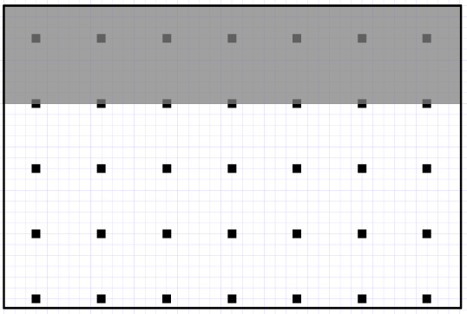
Olin
124
42’ x 28’
A = 1176 sq ft
CAPACITY
28
42’
28’
Notes:
6’x3’ Tables (14)

Slide 40
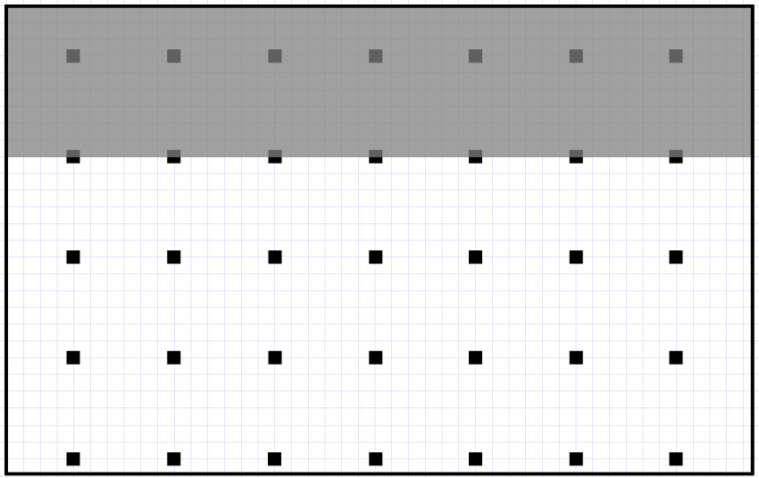
Olin
126
44.5’ x 28’
A = 1246 sq ft
CAPACITY
28
44.5’
28’
Notes:
6’x3’ Tables (12)
*need 2 more tables and 4 more chairs

Slide 41
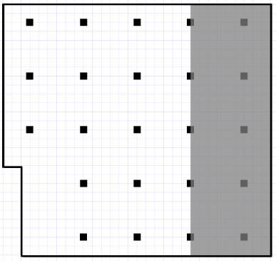
Olin
207
30’ x 28’
A = 820 sq ft
CAPACITY
18
30’
28’
Notes:
Desks (39)

Slide 42
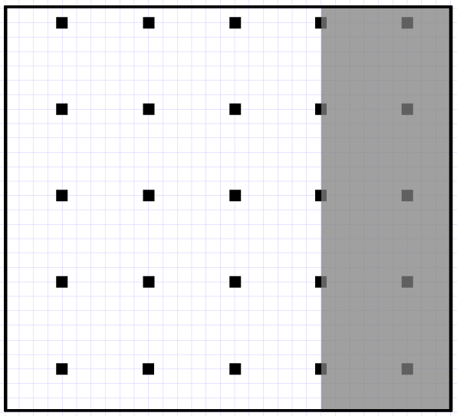
Olin
209
31’ x 28’
A = 868 sq ft
CAPACITY
19
31’
28’
Notes:
Desks (39)

Slide 43
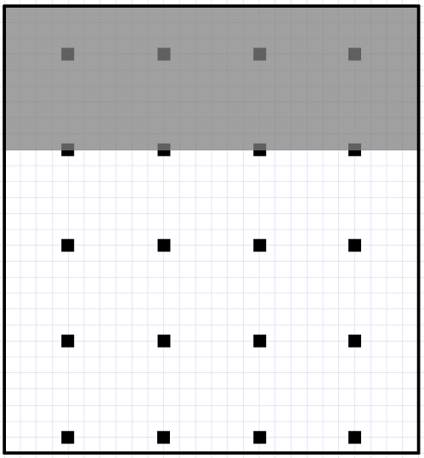
Olin
222
26’ x 28’
A = 728 sq ft
CAPACITY
16
26’
28’
Notes:
6’x3’ Tables (11) -- remove 3 tables, put 2 in 126
5’x3’ Tables (1) -- remove

Slide 44
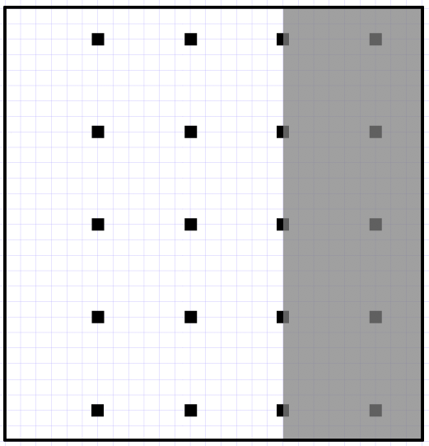
Olin
226
27’ x 28’
A = 756 sq ft
CAPACITY
15
27’
28’
Notes:
Desks (36)

Slide 45
Olin
305
30’ x 28’
A = 820 sq ft
CAPACITY
18
30’
28’
Notes:
Desks (36)
Projector status unknown

Slide 46
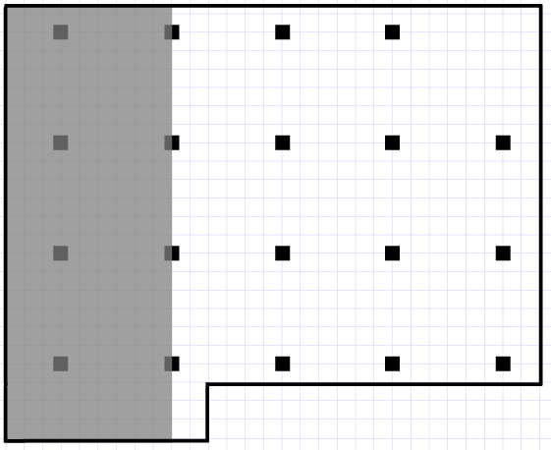
Olin
322
20.5’ x 29’
A = 628 sq ft
CAPACITY
15
29’
20.5’
Notes:
5’x3’ Tables (9) -- remove
Projector status unknown

Slide 47
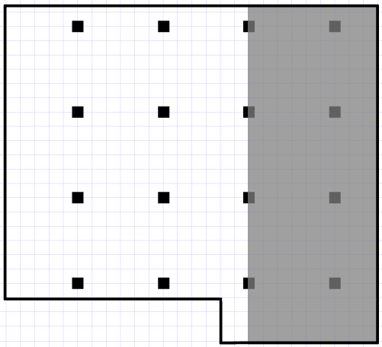
Olin
323
20.5’ x 26’
A = 566 sq ft
CAPACITY
12
26’
20.5’
Notes:
5’x3’ Tables (9)
Projector status unknown

Slide 48
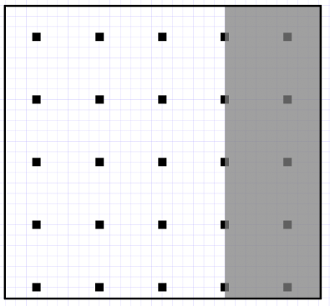
Olin
324
30’ x 28’
A = 820 sq ft
CAPACITY
19
30’
28’
Notes:
Desks (35)

Slide 49
Prothro

Slide 50
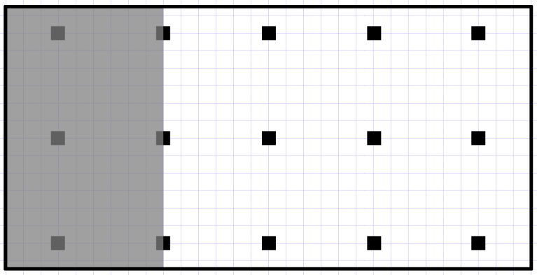
Prothro
132
30’ x 15’
A = 450 sq ft
CAPACITY
11
30’
15’
Notes:
5x2 tables (8)

Slide 51
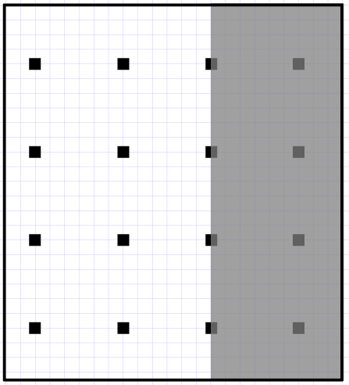
Prothro
147
25.5’ x 23’
A = 587 sq ft
CAPACITY
12
23’
25.5’
Notes:
3x2 desk (19)

Slide 52
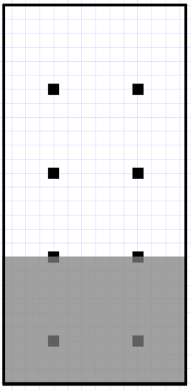
Prothro
163
27’ x 13’
A = 351 sq ft
CAPACITY
6
13’
27’
Notes:
5x2 table (7)

Slide 53
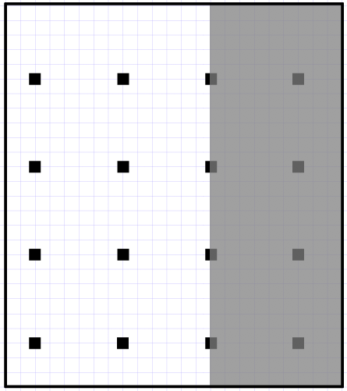
Prothro
244
26’ x 23’
A = 598 sq ft
CAPACITY
12
23’
26’
Notes:
3x2 desks (19)
Reg desk (1)

Slide 54
Robertson

Slide 55
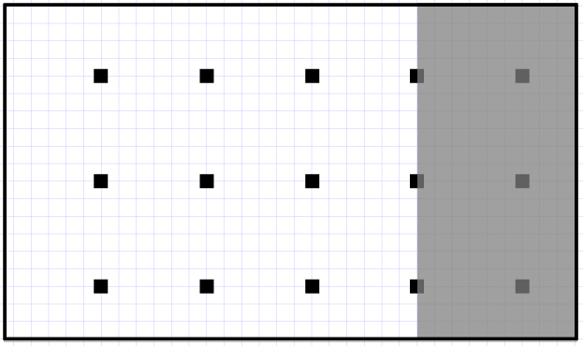
Robertson
240
19’ x 32.5’
A = 618 sq ft
CAPACITY
12
32.5’
19’
Notes:
36 Desks

Slide 56
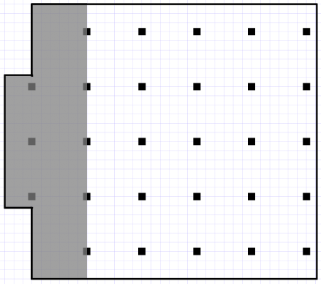
Robertson
244/245
30’ x 31’
A = 930 sq ft
CAPACITY
25
31’
30’
Notes:
40 Desks

Slide 57
Smith Library Center

Slide 58
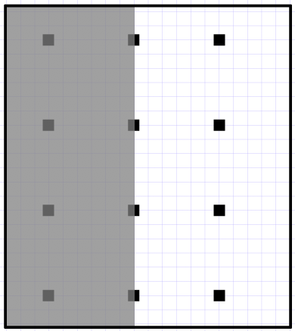
Library
114
20’ x 22.5’
A = 450 sq ft
CAPACITY
8
20’
22.5’
Notes:
25 desks
**double check projector position

Slide 59
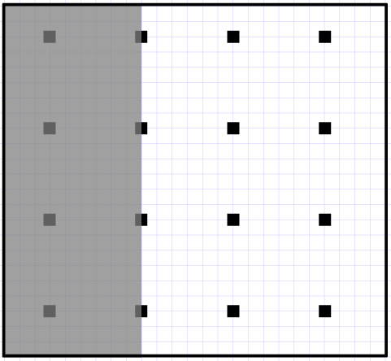
Library
115
23’ x 25’
A = 575 sq ft
CAPACITY
12
25’
23’
Notes:
37 desks

