Slide 1
Productive, Smart Buildings
Adam Gogolski
Jacob Olson
Lalit Agarwal
Rob Murchison

Slide 2
Why are we meeting today?
  Background on the Productive, Smart Buildings (PSB) initiative, why are we here?
  Framework description, what is it?
  Pilot insights and adjustments, what did we learn?
  Release date, where do we go from here?

Slide 3
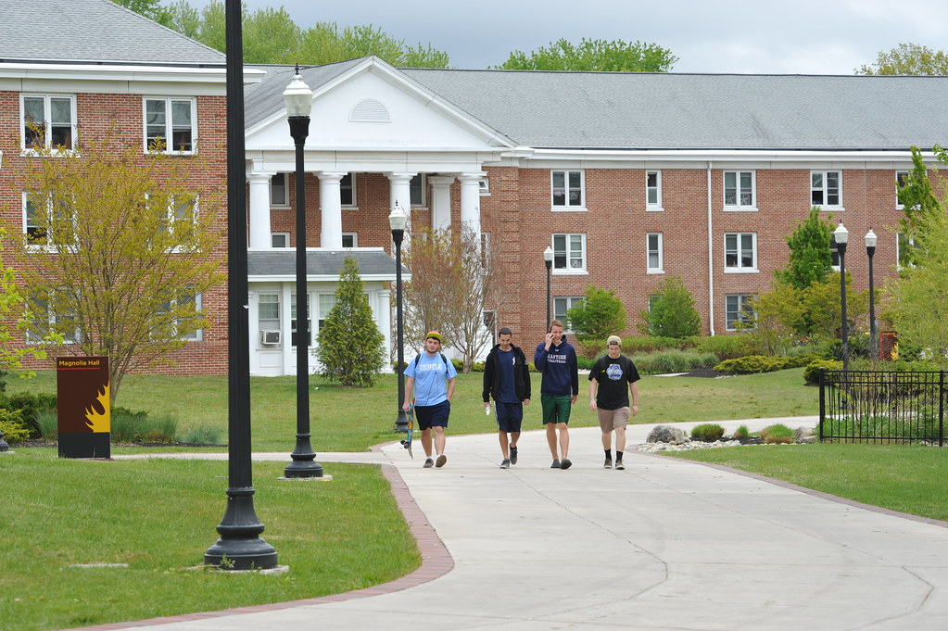
PSB Credence
People are our greatest asset.
The built environment provides a foundation for people’s highest potential and performance.
A smart building provides the capabilities for continuous improvements and efficiencies
Together, they align to enhance higher education and shape the future of knowledge.
Notes:
The big picture here is - the tools to design, build and operate facilities continue to become more digital - Digital Transformation is happening whether you. plan for it or not.
Many “for-profit” rating systems that have emerged help facilitate: LEED, WELL, REST, WiredScore…then others low/no-cost like Fitwell
Yet the many conversations over the last two years, demonstrated that asking for $$ if always a challenge, but especially when it comes to smart buildings. And in some cases, there was resentment towards the costly scoring systems, that just put more pressure on funding SMART...

Slide 4
3-30-300 Rule
Average costs per square foot per year…
$3 Utilities
$30 Rent/Buildings
$300 Payroll
Notes:
3-30-300 rule is a concept developed by JLL (Jones Lang Lasalle). Their research shows firms spend $3/sq. ft. for utility services; $30/sq. ft. on maintenance and operations/rent; and $300/sq. ft. on payroll.
Historically, FM focus has been on reducing the cost of utility services and rent/built space.
By increasing our focus on creating a better indoor environment that improves human health and performance, the financial benefit to our organizations will be 10 times greater than a saving in rent and 100 times greater than savings on utility services.
It isn’t necessary to compromise energy savings to achieve healthy, productive work and learning environments.

Slide 5
Again, why Productive, Smart Buildings?
What do we want?
Maximize Occupant Productivity
How do we do that?
Ensure our buildings have the foundations that promote the highest occupant productivity
Yeah but… how do we do that effectively?
Enlist the use of smart technology to monitor/measure/control/identify these foundations

Slide 6

APPA’s Productive, Smart Buildings
A self-assessment decision-making framework to Optimize human productivity by investing in the built environment and smart technologies

Slide 7
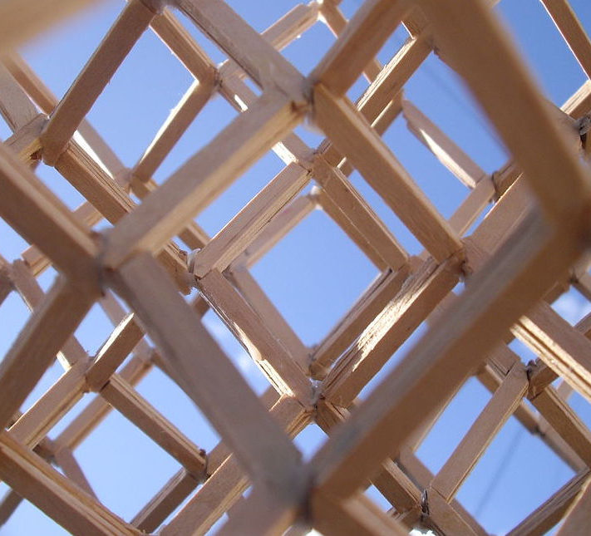
The PSB Framework
This Photo by Unknown Author is licensed under CC BY-SA

Slide 8

What makes a building productive?
Notes:
Process began with numerous brainstorming sessions listing out all the topics the committee members wanted to see in the PSB framework. After much debate, we decided it was best to start from pre-existing research. This led us to …(next slide)

Slide 9

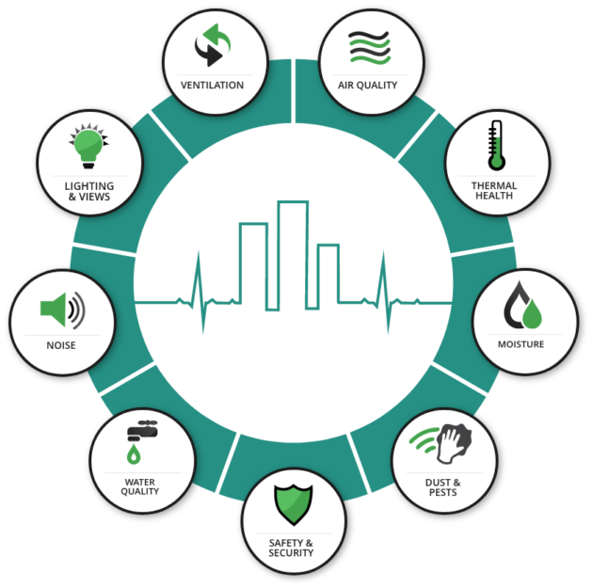
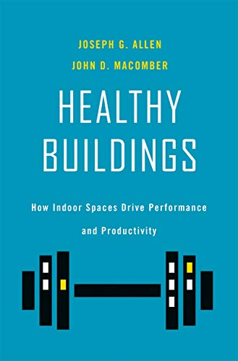

The 9 Foundations of a Healthy Building
Notes:
Began with the 9 foundations as defined by the Harvard T.H. Chan School of Public Health

Slide 10

PSB Foundations
Ventilation
Air Quality
Thermal Health
Water Quality
Moisture
Dusts and Pests
Acoustics and Noise
Lighting & Views
Safety & Security
Inclusivity
APPA’s Productive, Smart Buildings framework has 10 FOUNDATIONS

Slide 11
FOUNDATION
PSB Foundations
Most of the foundations can be broken down into two parts:
BUILT ENVIRONMENT
The physical element of the building attributed to improved productivity.
SMART TECHNOLOGY
The technology used to measure/identify the physical element

Slide 12
Foundations & Productivity Impact
Potential impact:
Up to 8% with proper ventilation
2% loss for each degree outside of 67 to 82 degrees
Up to 8% with proper filtration
Ventilation
Does the building meet ventilation requirements?
Is the ventilation being monitored?
Air Quality
Is the air filtered appropriately?
Are the air filters being monitored?
Thermal Health
Does the building maintain appropriate temperatures? Individual setpoint control?
Is each thermal zone monitored?

Slide 13
Foundations & Productivity Impact
Potential impact:
Access to clean, drinkable water is essential for building function
Reduction in allergens and leave time taken
Reduction in respiratory ailments and leave time
Water Quality
Does the building have high quality water? And is it accessible?
Is the water quality monitored?
Moisture
Are there water intrusion issues?
Are there water sensors in the high-risk areas? Or are spaces inspected for water intrusion?
Dusts & Pests
What is the APPA cleanliness level of the building?
Does the facility have an integrated pest management?
Are spaces inspected?

Slide 14
Foundations & Productivity Impact
Potential impact:
Acoustics & Noise
Does the building maintain appropriate sound levels? (maximum sound levels)
Are there distracting noises present? (e.g., rattling walls/ceilings due to equipment vibration, noisy water coolers)
Lighting & Views
Are spaces lit appropriately? Are light levels adjustable?
Do workspaces have windows? Is daylight harvesting used?
Up to 33% improved performance through reduction of distracting noises
Feeling of ‘gloom’ reduced in as many as 45% of individuals when proper lighting is introduced

Slide 15
Foundations & Productivity Impact
Potential impact:
Safety & Security
Are safety systems in place and in compliance?
Fire Detection
Electronic Access Control
Emergency Action Plans
Inclusivity
Does the facility have inclusive elements?
Are the spaces identified and navigable for occupant knowledge?
(Lactation Spaces, Gender Neutral Restrooms, ADA Accessibility, Mindful Spaces)
Up to 12% improvement in productivity when occupants feel ‘safe’
Hard to measure; however, political capital gained is significant

Slide 16
THERMAL HEALTH
Example Question
Q3.1 – TEMPERATURE (Built Environment)
Each space is maintained at levels for optimal performance. ASHRAE standard 55 provides baseline comfort levels from 67 to 82 degrees F, however everyone may not perform well at certain temperatures throughout the standard's range. Providing individual room control may have higher initial and maintenance costs, but an individual's ability to control their space temperature increases their personal comfort and productivity.
(A) Not all spaces meet minimum ASHRAE standard 55 for temperature control.
(B) All occupied spaces meet ASHRAE standard 55 for thermal comfort
(C) All occupied spaces have individual occupant adjustable setpoints

Slide 17
THERMAL HEALTH
Example Question
Q3.2 – TEMPERATURE (Smart Technology)
Are spaces continuously maintained/monitored at optimal temperatures during occupancy?
(A) No/minimal thermal measurement (e.g., pneumatic)
(B) Central (air handler) temperature monitoring only
(C) Distributed/Space monitoring in place for over 50% of spaces

Slide 18
PSB Framework

Slide 20
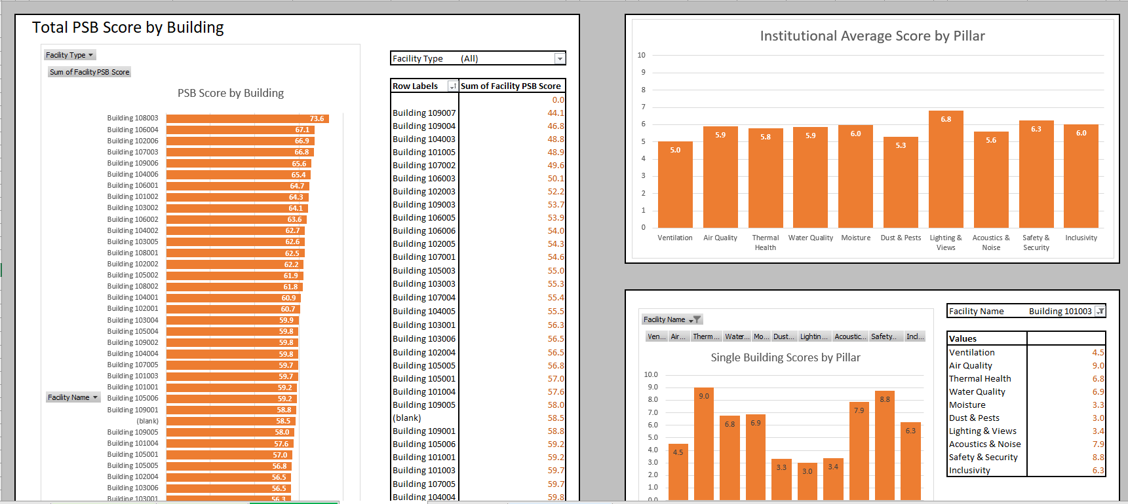
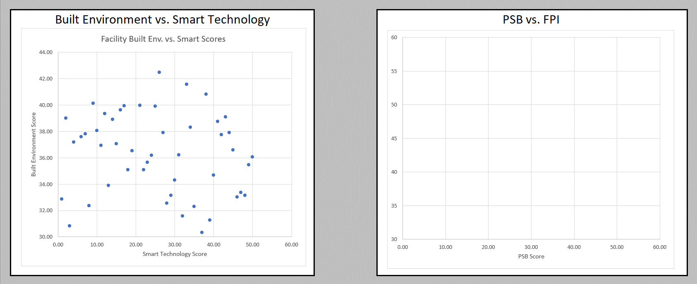

Slide 21
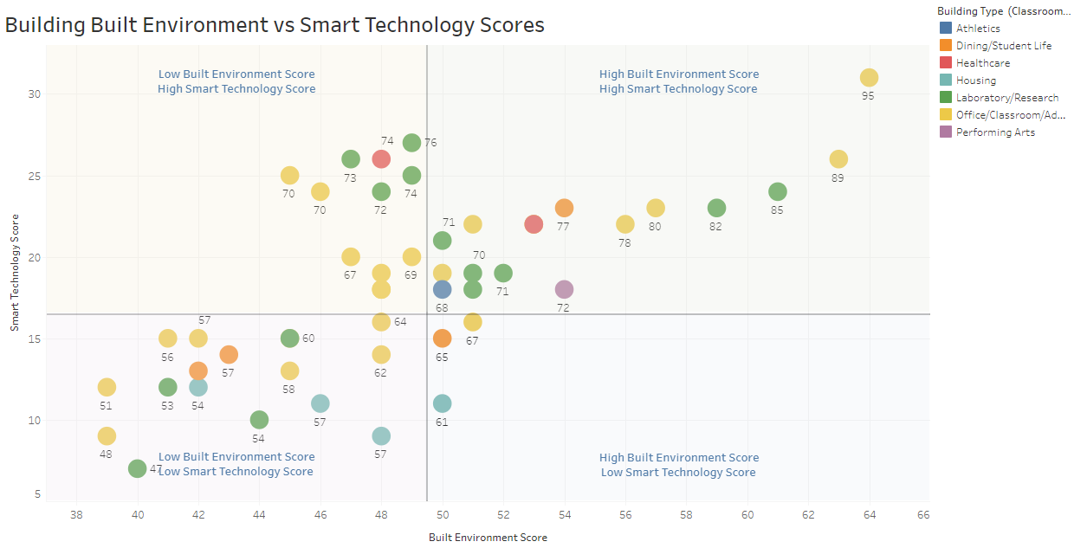

Slide 22
Technologically Enabled
Productivity Enhancing
Performance Neutral
Opportunity for Investment

Slide 23
What the zones mean
Productivity Enhancing
Technologically Enabled
Opportunity for Investment
Performance Neutral
Building has both the structural and technological elements to support the ongoing health and wellbeing of the occupants
Buildings in this zone should be primary candidates for Capital Stewardship and Preventive Maintenance focus
Building has smart technology, but was not built to modern human performance standards
Buildings in this zone should be candidates for space utilization assessments to understand in more detail which spaces within the building are best suited for human performance and which should be repurposed
Building was constructed to modern human performance standards, but lacks the smart technology to ensure the environment is being optimized
Buildings in this zone should be candidates for smart technology upgrade projects such as improved monitoring and digitalization
Building was not built to modern human performance standards and lacks monitoring to assess quality of spaces
Buildings in this zone should be candidates for renovation or removal as small-scale projects are unlikely to have a significant impact on how the building supports human performance

Slide 24


PSB Score Comparisons
PSB Scores do not need to stand alone. It can be compared against a large list of other important aspects of buildings:
APPA Facilities Performance Indicators (FPI) metrics
Facility Condition Index (FCI)
Energy Use Intensity (EUI)
Carbon Footprint (MTCO2)
Occupant Density
Space Utilization
Etc.

Slide 25
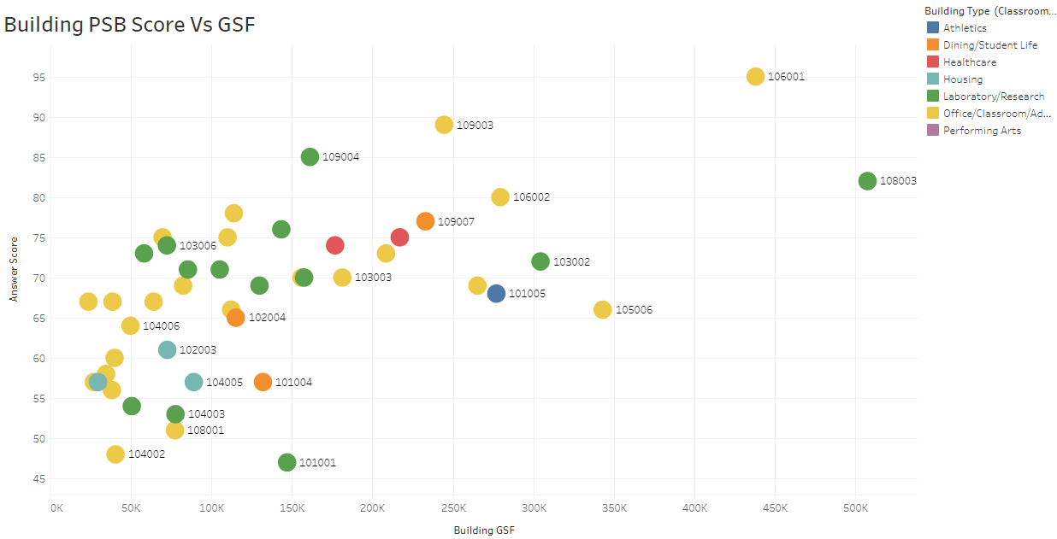

Slide 26
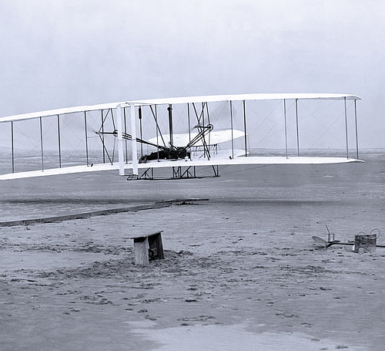
PSB Framework Pilot

Slide 27
Pilot Buildings Statistics
Special Thanks to:
University of Georgia
Auburn University
New Mexico State University
University of Kentucky
Clemson University
Villanova University
Florida State University
University of Wisconsin
University of Nebraska-Lincoln
9 Institutions with varying enrollment size
50 Buildings of varying types & sizes
  Classroom/Office/Admin
  Research/Laboratories
  Student Life/Dining
  Housing
  Healthcare
  Performing Arts
  Athletic Arena
  Building GSF from 23,000 to over 500,000 square feet

Slide 28
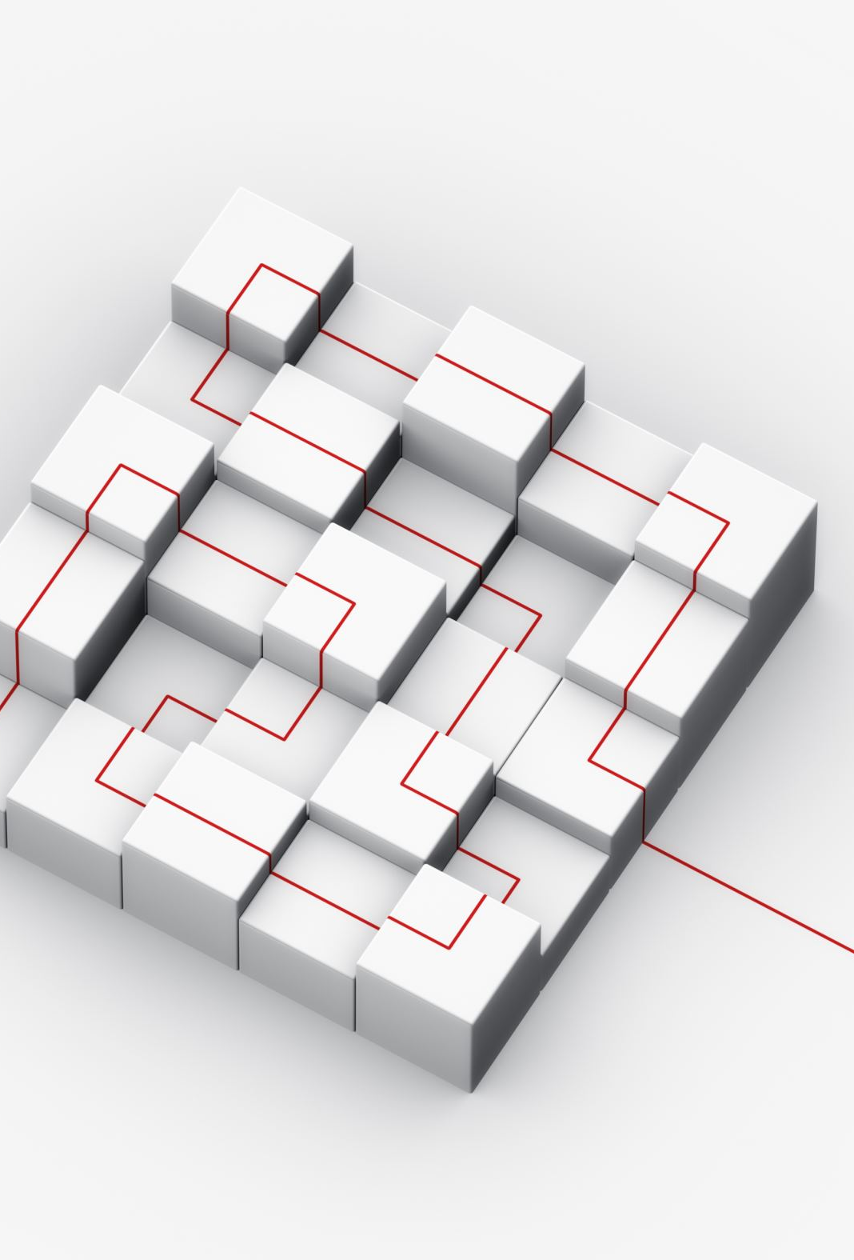
Pilot parameters
Identify 3-10 diverse-use buildings
Complete the framework in its entirety for each building
Return the framework spreadsheet to the co-chairs
Ensure to provide feedback for each element in the framework

Slide 29

Framework feedback
Wordsmith questions to reduce/eliminate ambiguity
Unlocked Excel format led to non-conforming responses
Respondents wanted ties back to local or regional standards that their school follows
Need for a glossary of terms

Slide 30
Insights
Balancing the foundations – Add weights and understand how the standards are balanced
Ease of Use – All respondents commented that the survey, in both format and length, was likely to be completed at their institutions
Value – All respondents said that the survey had some value for them, whether it was in evaluating what matters, or in having a communication tool for the community. This bi-directional value indicates that we've hit on something that's useful both inside and outside the APPA community.

Slide 31
Opportunity
Pilot
9 institutions
50 buildings
2,200 data points
Potential
1,500+ institutions
240,000 buildings
10,000,000+ data points per year

Slide 32

General Release
January 2023

Slide 33


