Slide 1
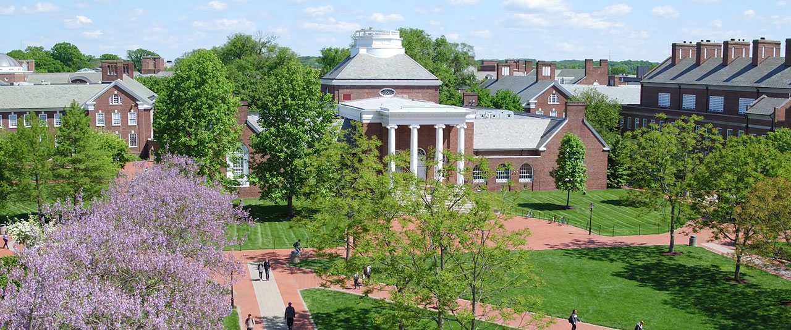

Trees in the Campus Landscape
Tom Flood, MBA, CEFP, ASLA
AVP for Facilities Operations
University of Delaware

Slide 2
Trees in the Campus Landscape
Agenda
Design & Selection
Purchasing & Planting
Tree Protection
Tree Management
Plans, Programs & Inventories

Slide 3
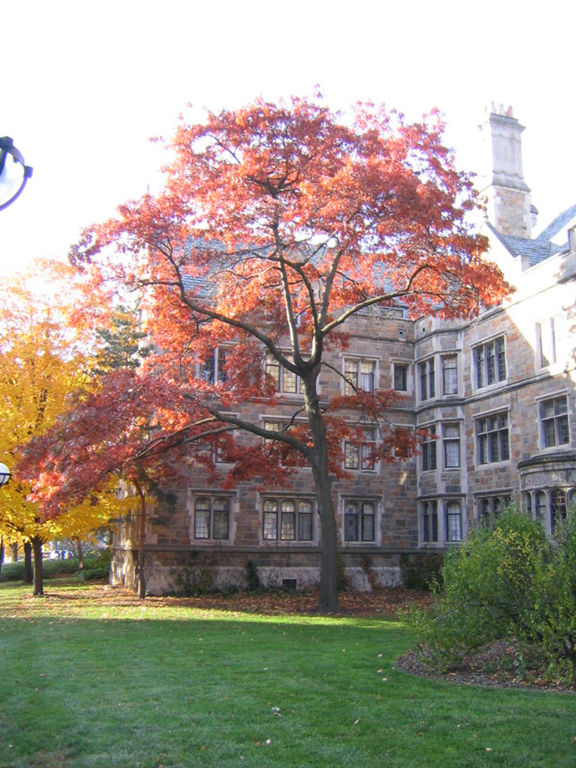
Campus Trees
  WHY TREES?
  Create habitat
  Protect & improve soils
  Reduce erosion &
  storm water run off
  Reduces heat
  Improves air quality

Slide 4
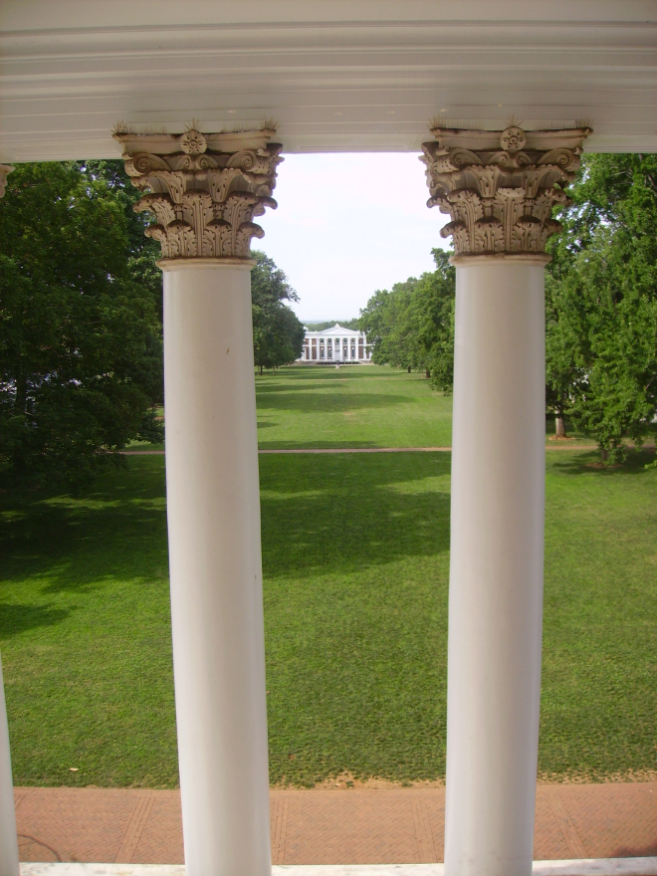
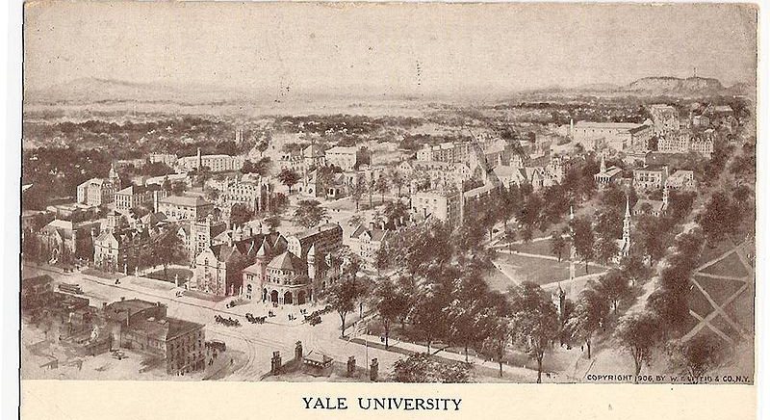
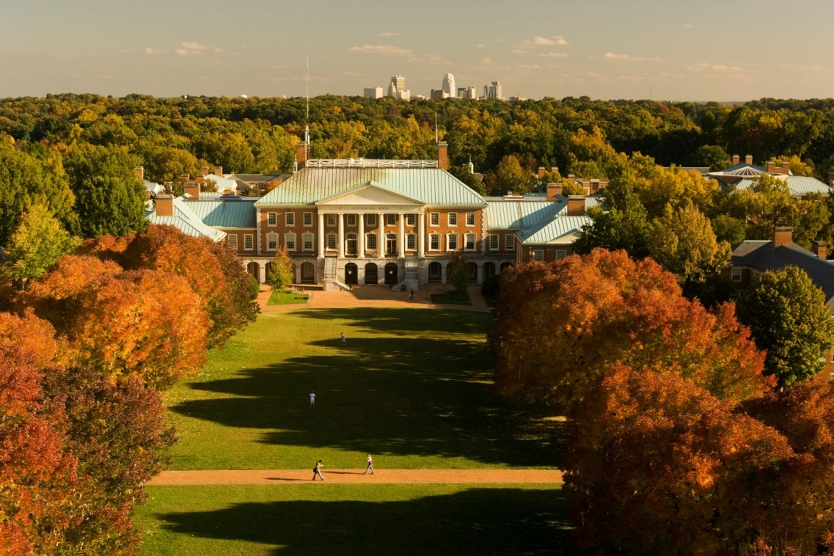
Campus Trees
  Create a sense of place
                Livable campus

Slide 5
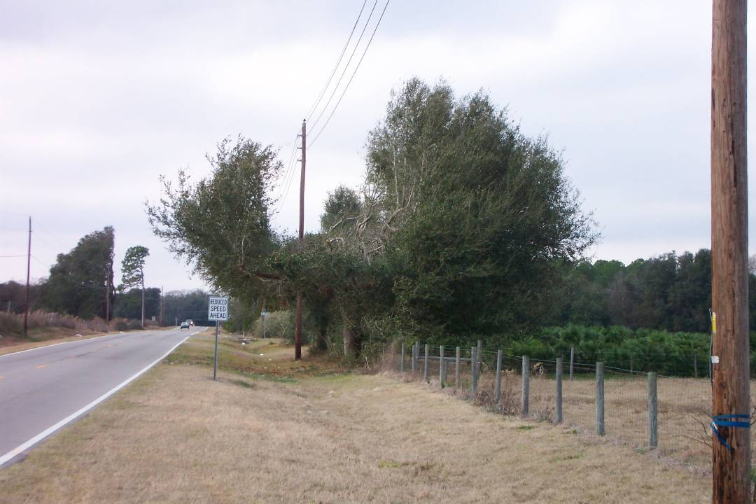
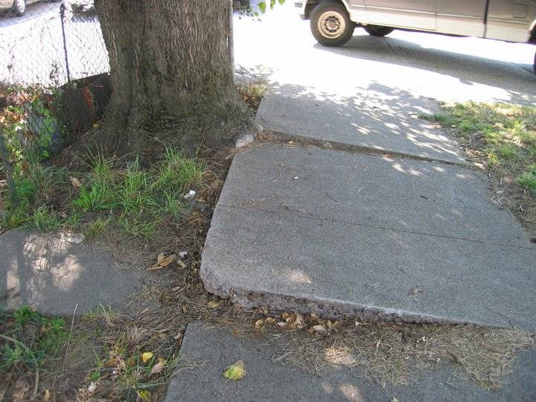
Design & Selection
Right plant, Right place

Slide 6
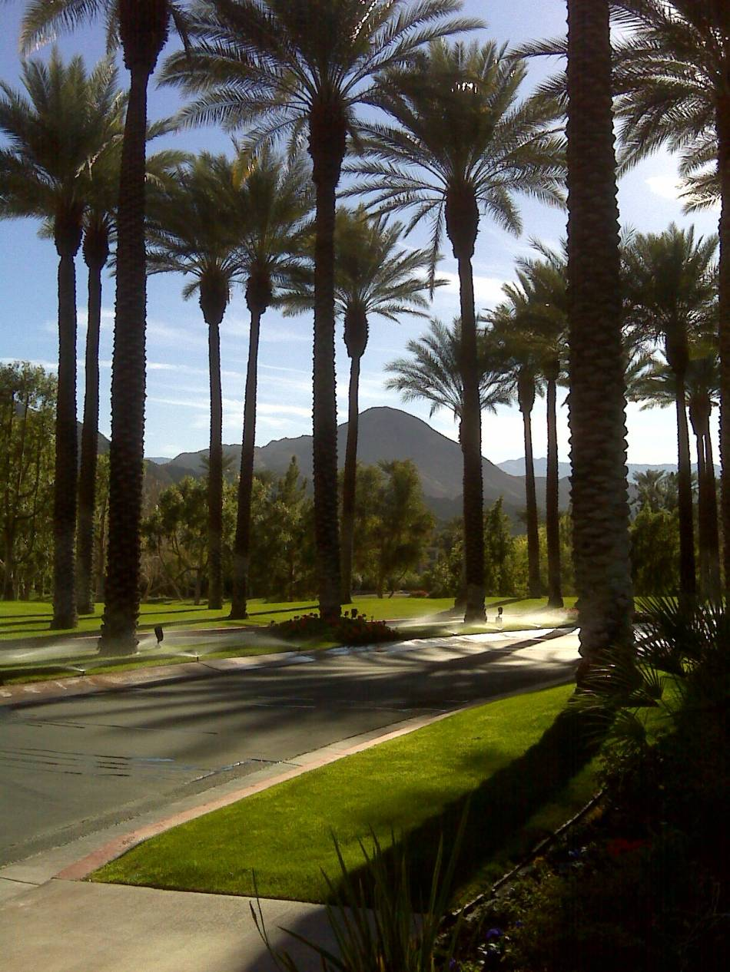
Design & Selection
Site evaluation
  Soil type
  Soil moisture
  Sun exposure
  Available space
  Maintenance practices

Slide 7
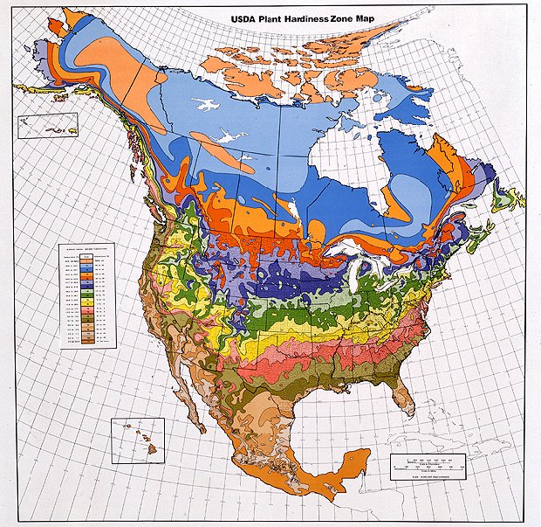
Design & Selection
Tree attributes
  Hardiness zone
  Heat zone

Slide 8
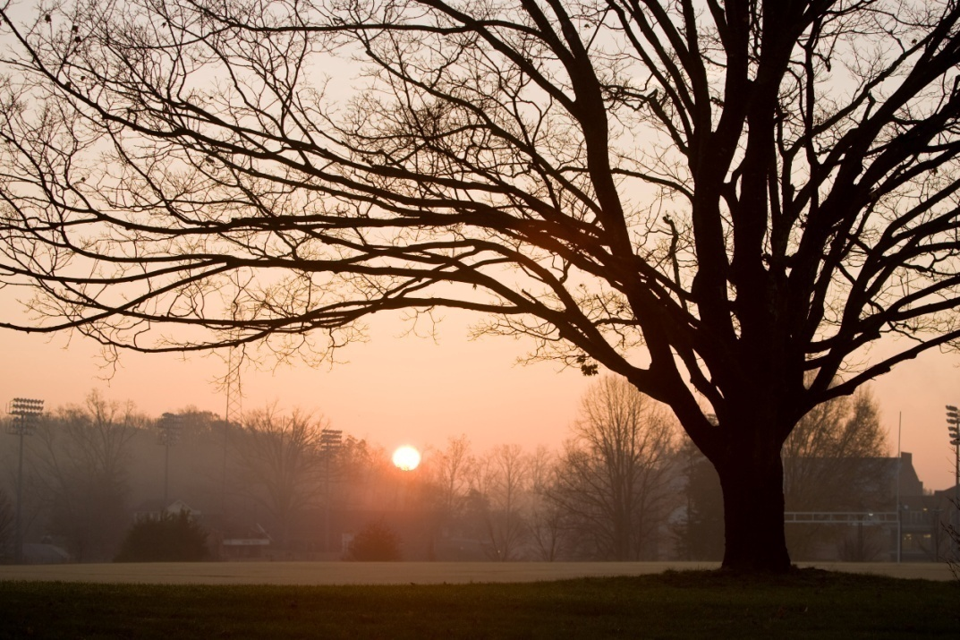
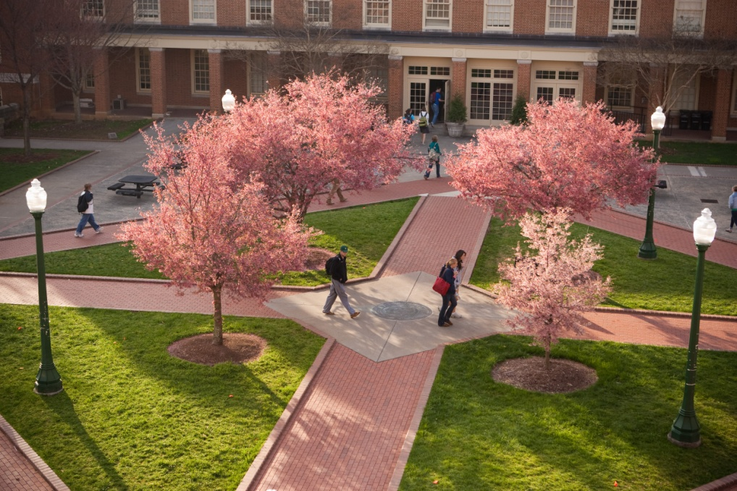
Design & Selection
Tree attributes
  Mature size
  Cultural requirements
  (moisture, light, soil)

Slide 9
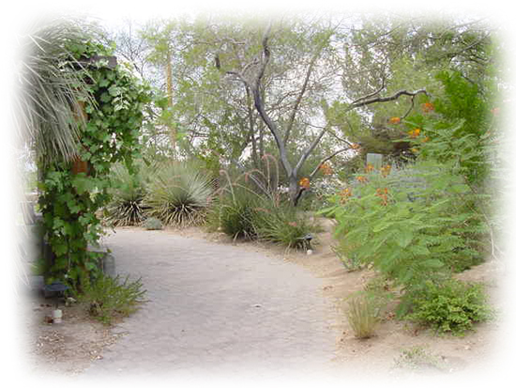
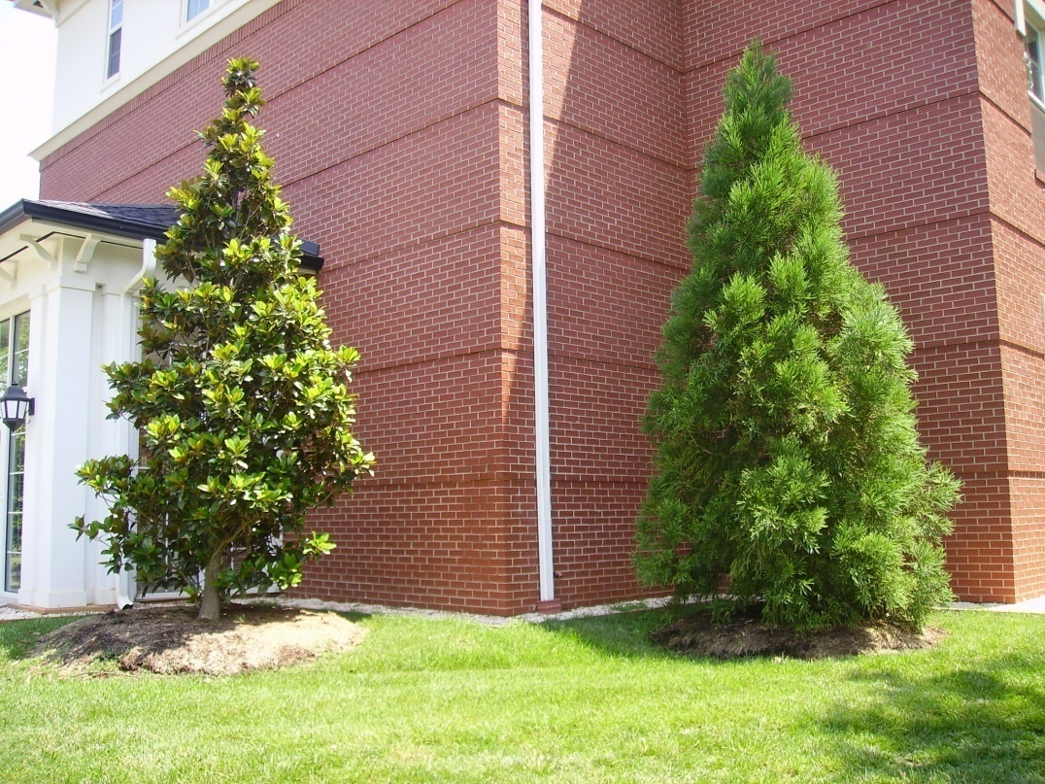
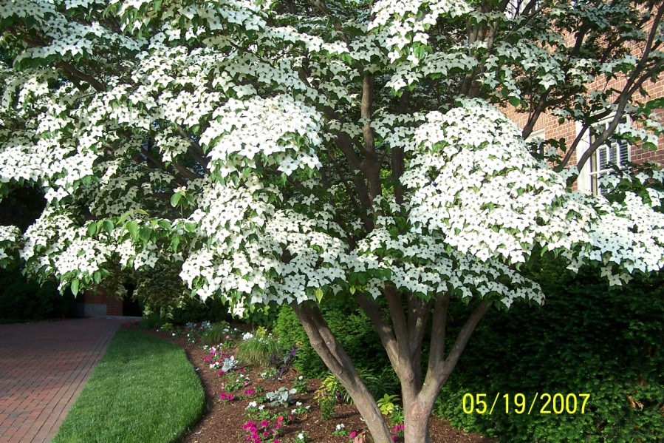
Design & Selection
Tree attributes
  Maintenance requirements
  Ornamental qualities

Slide 10
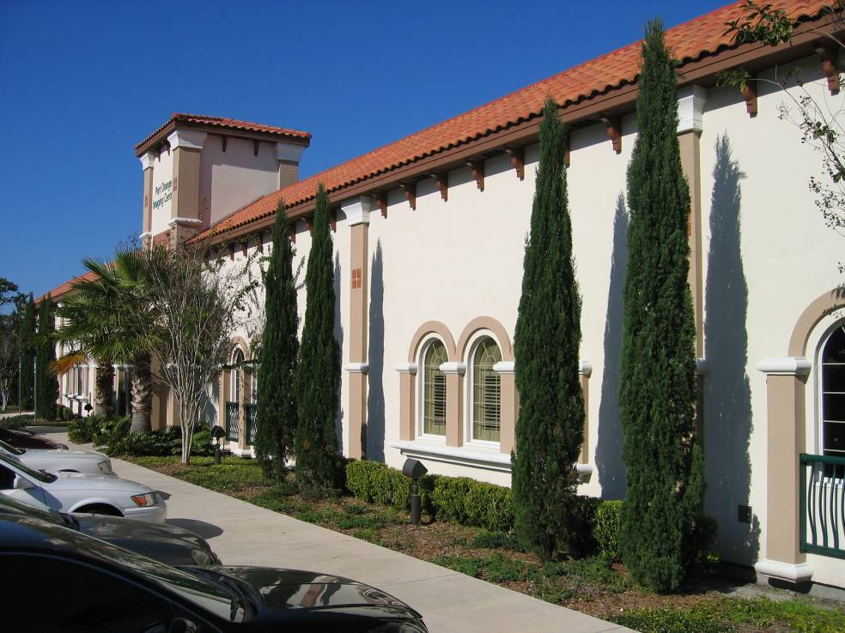
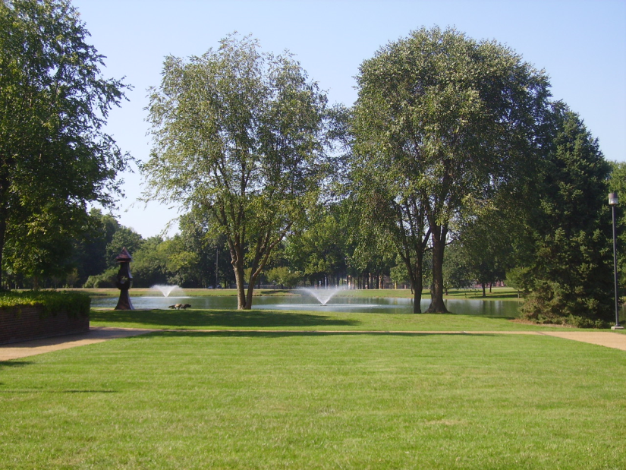
Design & Selection
Design Requirements
  Type
  Form & Texture
  Size & Scale
  Ornamental
  Qualities
  Site Aesthetics
    views
    architecture, etc

Slide 11


Design & Selection
Native vs, Non-Native
Eliminate the use of invasive plants.
An invasive species is defined as “an alien species whose introduction does or is likely to cause economic or environmental harm or harm to human health.”
This is not the same as non-native!

Slide 12
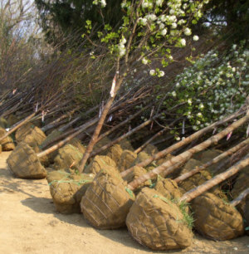
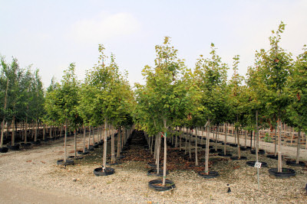
Purchasing & Planting
ANLA – Standard for Nursery Stock
Condition – container, B&B or bare root?

Slide 13
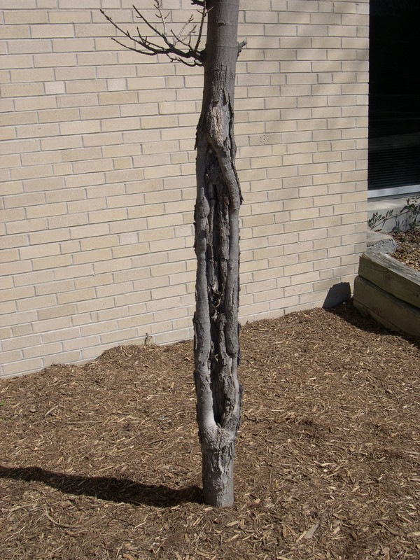
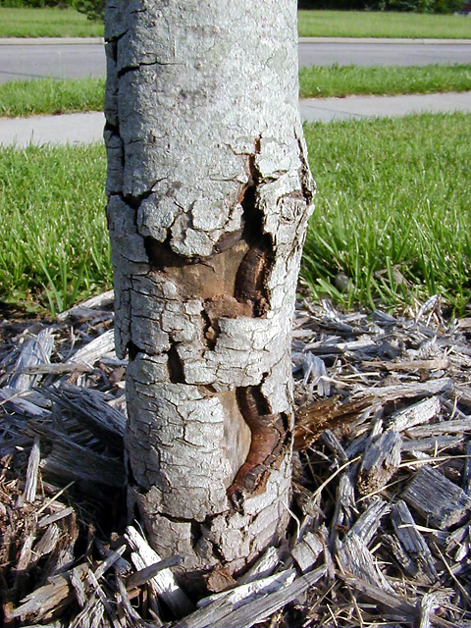
Purchasing & Planting
Field Tag Trees
Look for:
  Branch structure
  Trunk damage

Slide 14
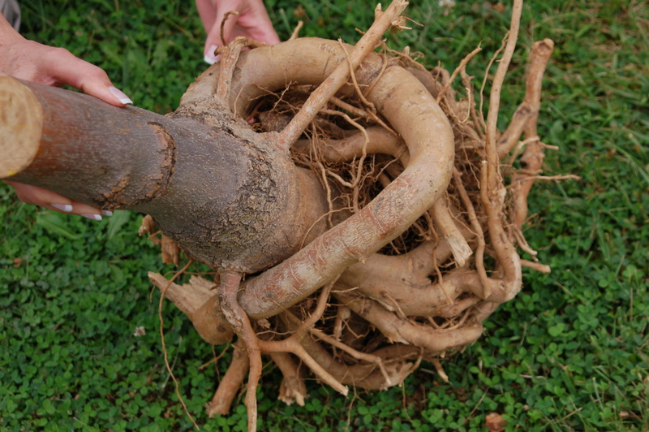
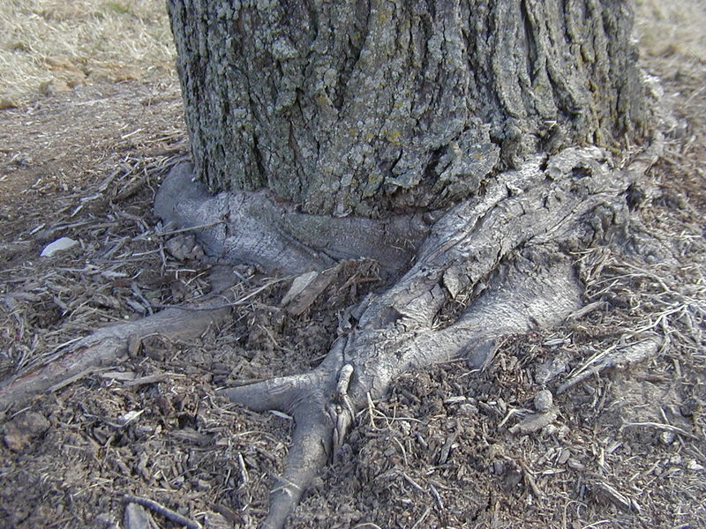
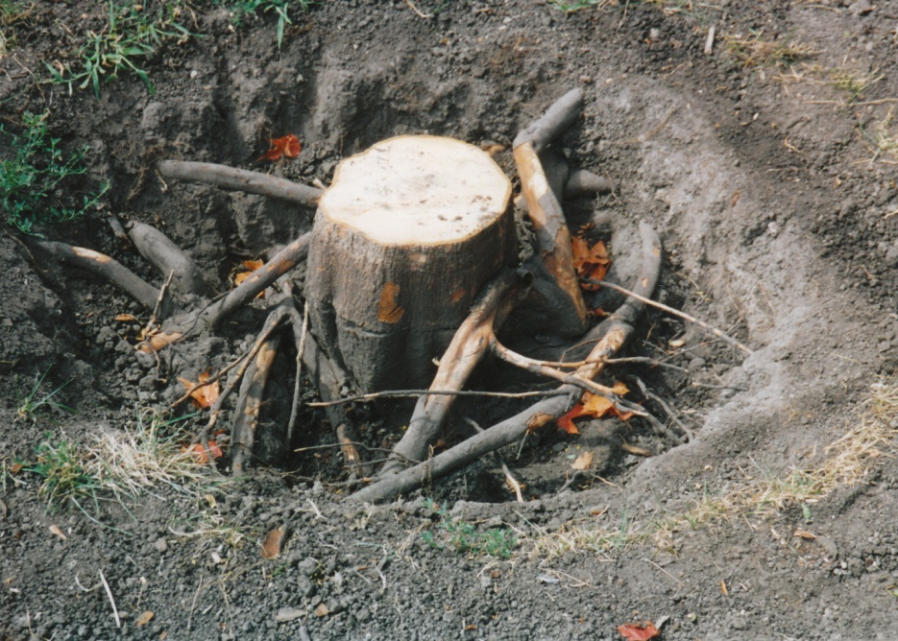
Purchasing & Planting
Field Tag Trees
Look for:
  Proper rooting

Slide 15
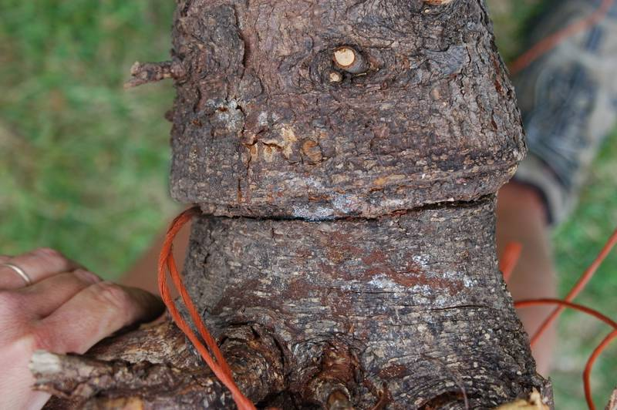
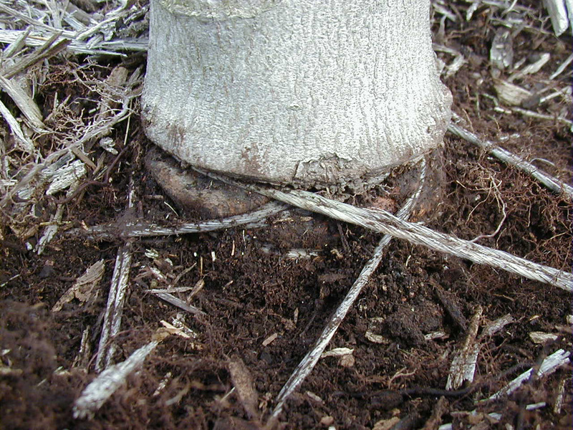
Purchasing & Planting
Field Tag Trees
Look for:
  Holding & transport
  Nursery management quality

Slide 16
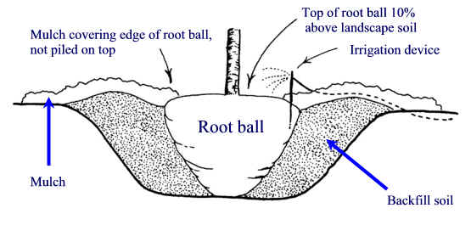
Purchasing & Planting
Site Prep – Deep Rip
Planting Hole
  $10 hole for a $5 tree

Slide 17
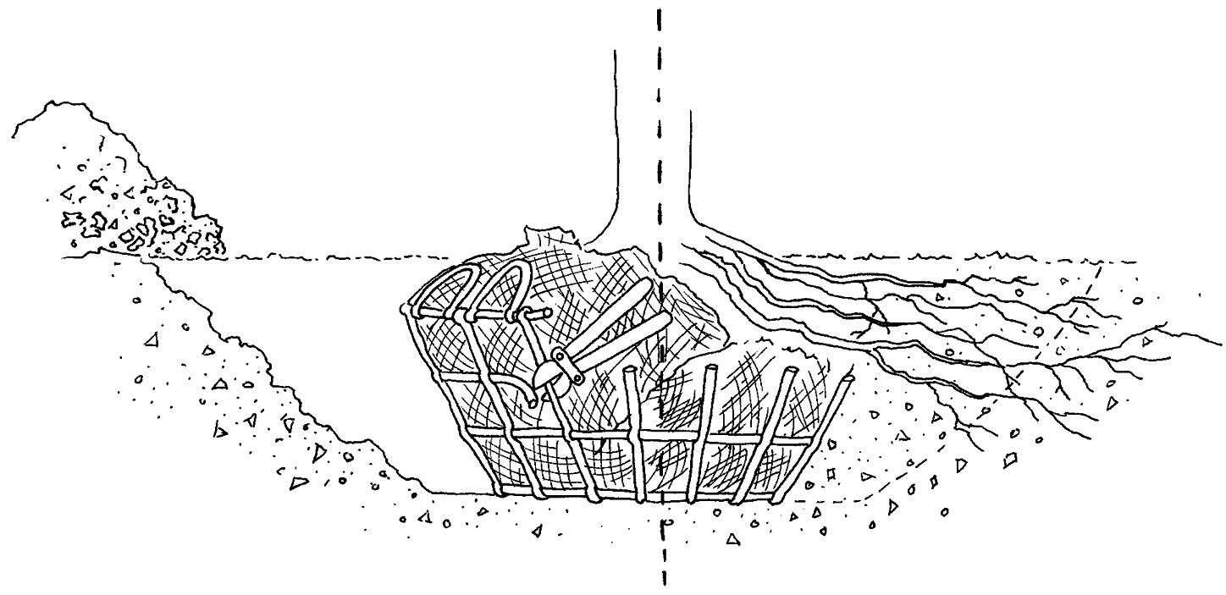
Purchasing & Planting
Planting depth

Slide 18
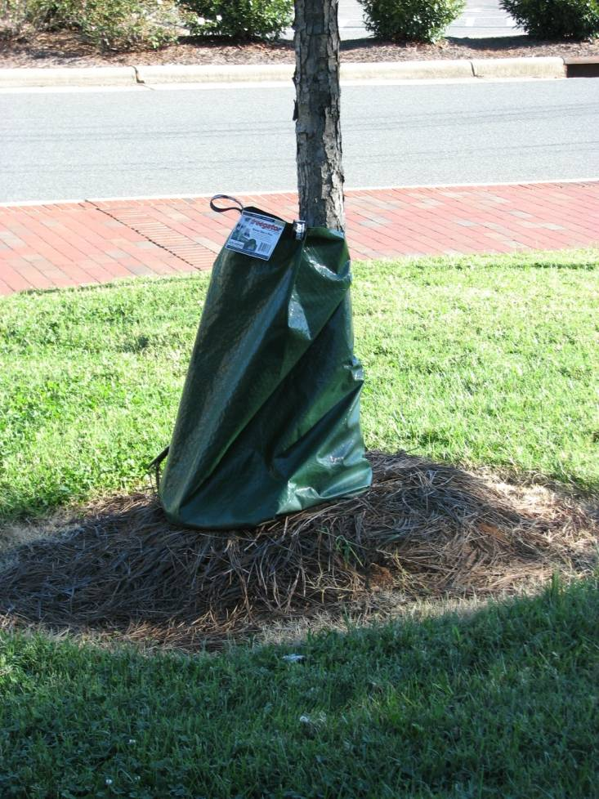
Purchasing & Planting
Establishment period
Staking
Pruning
Watering

Slide 19
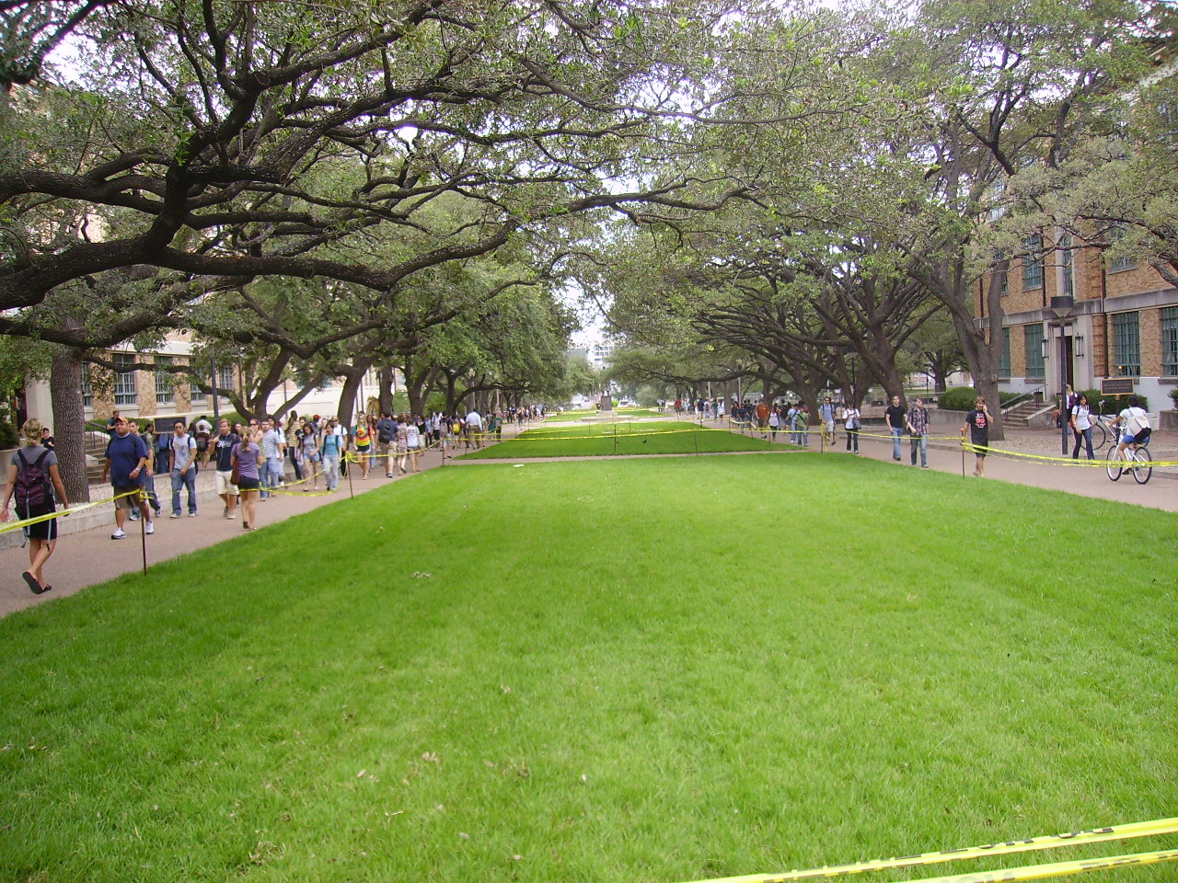
Tree Protection
Grass in weeks
Shrubs in years
Trees in a lifetime

Slide 20
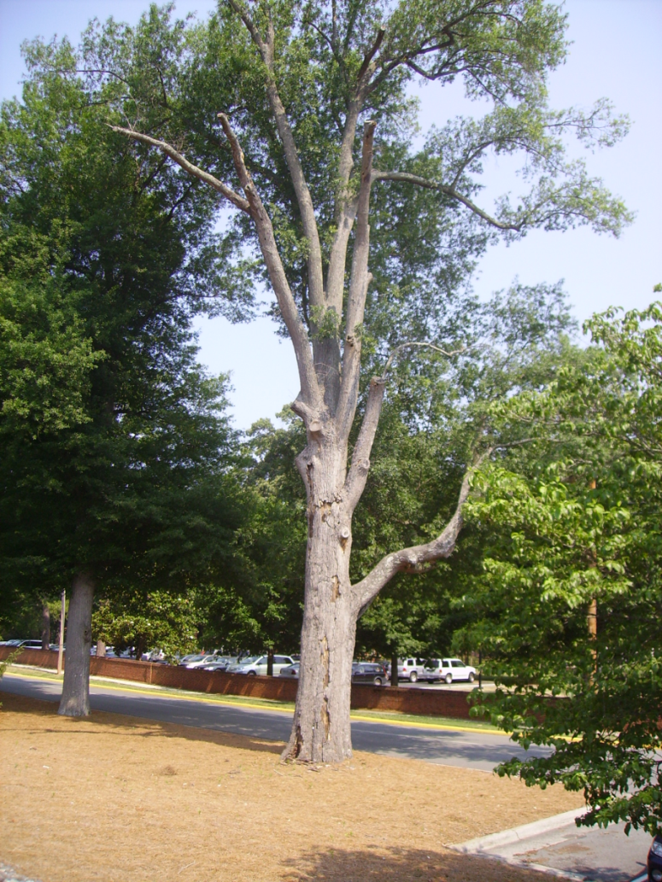
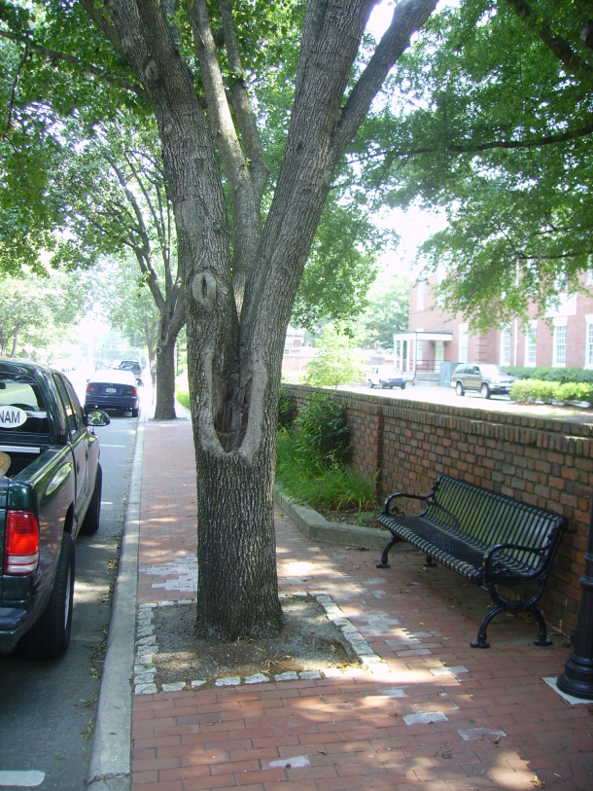
Tree Protection
Starts at preliminary design
Include protection and damages in general conditions
Show locations on plans
Be realistic about what
should be saved

Slide 21
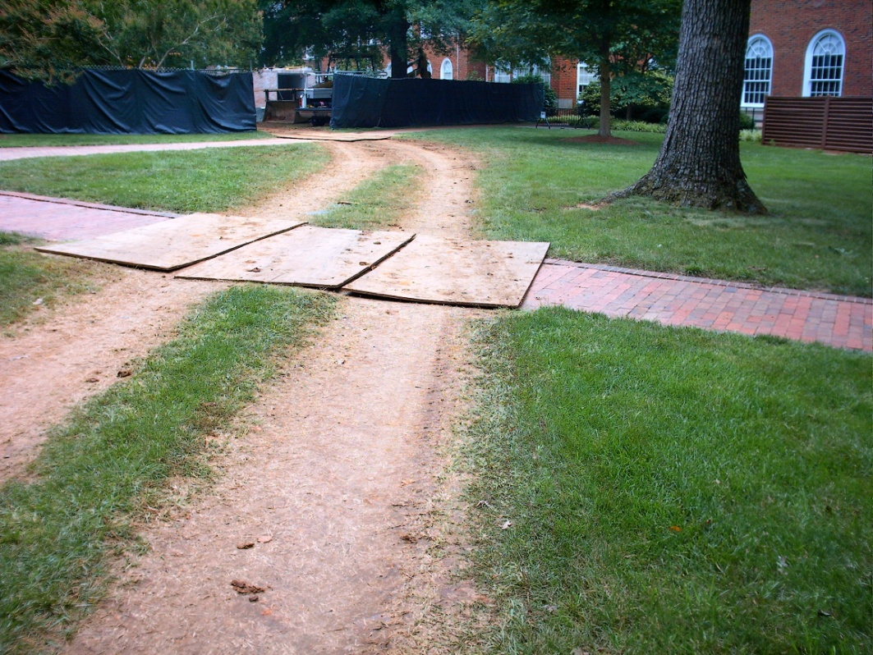
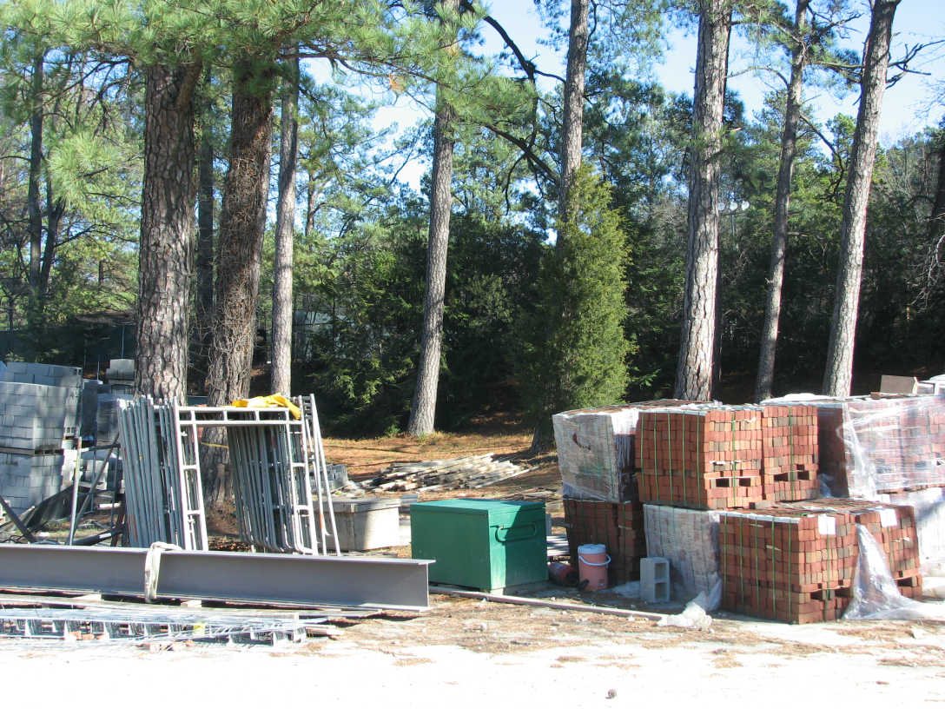
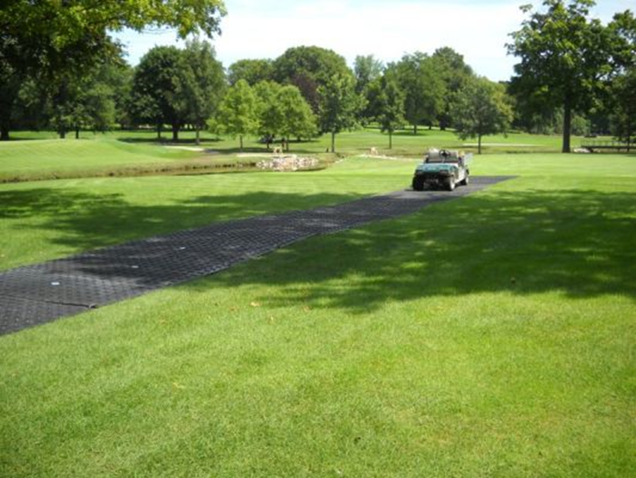
Tree Protection
Compaction reduces spaces for oxygen and water in the soil, reduces root growth and access to water and nutrients.

Slide 22
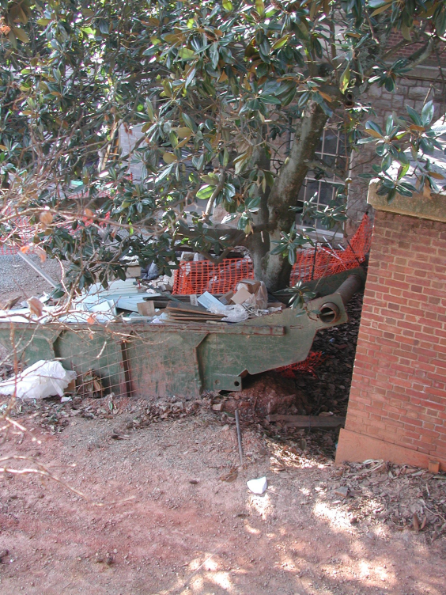
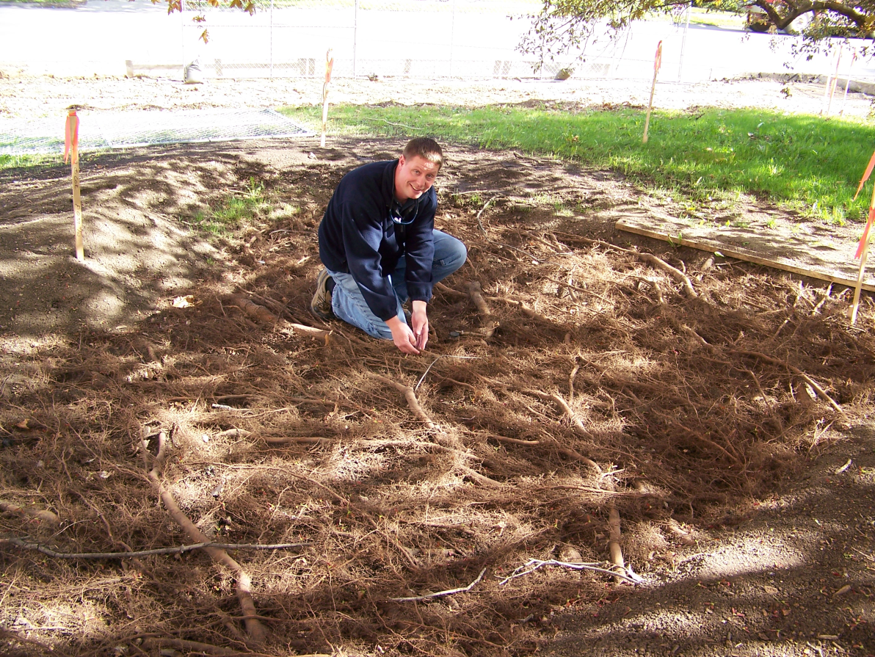
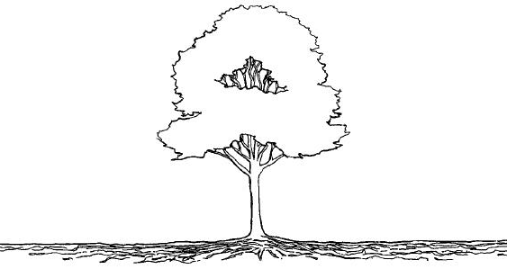
Tree Protection
Fencing
  Minimum location
    At drip line
    1.5 x drip line
    1 foot radius / 1inch diameter

Slide 23
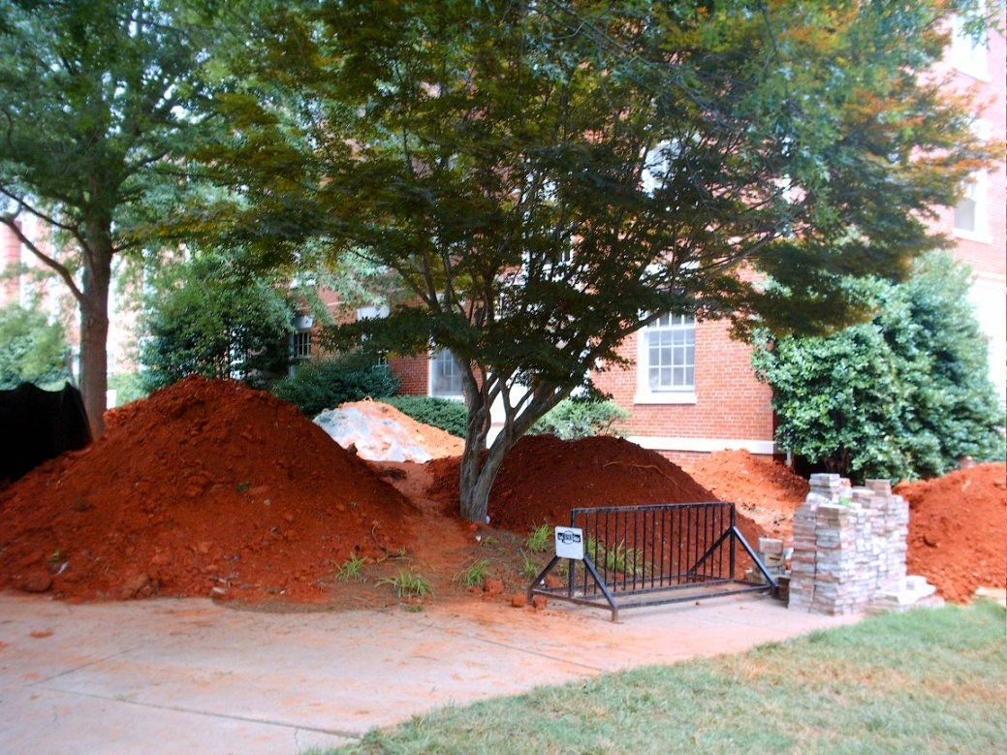
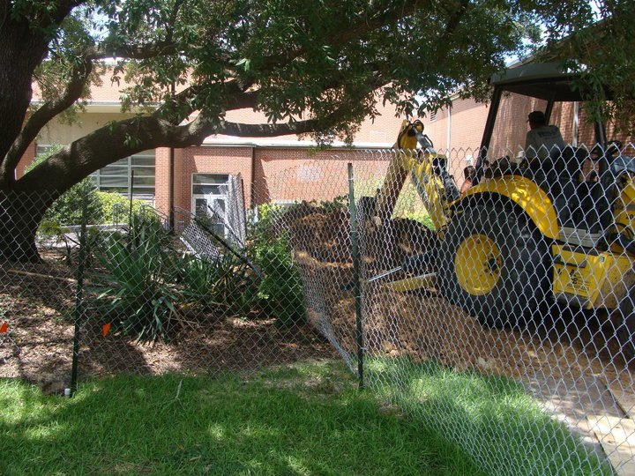
Tree Protection
Fencing
  Installation & maintenance by ____?

Slide 24
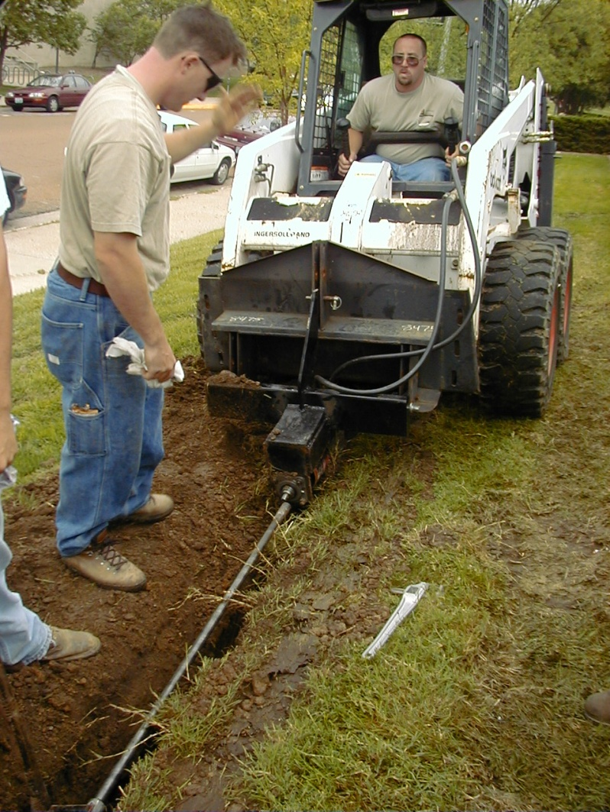
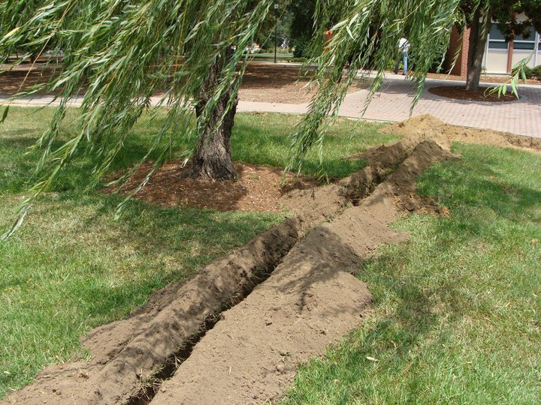
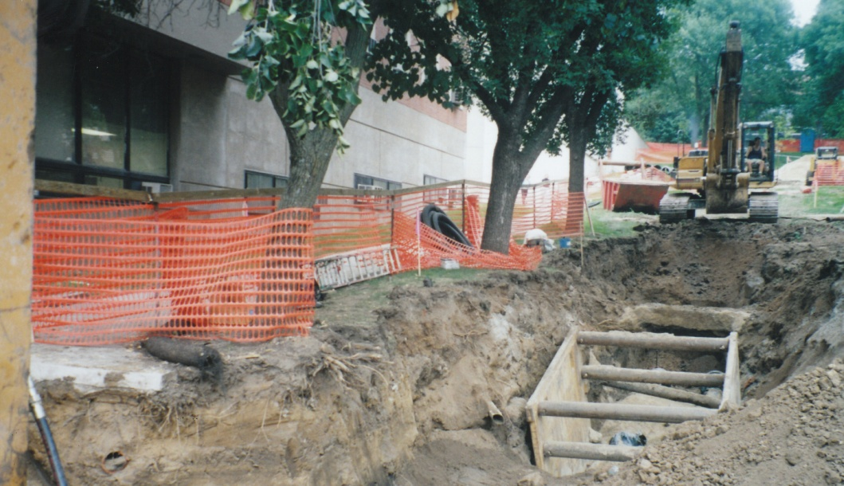
Tree Protection
Root protection
  Trenching vs. boring

Slide 25
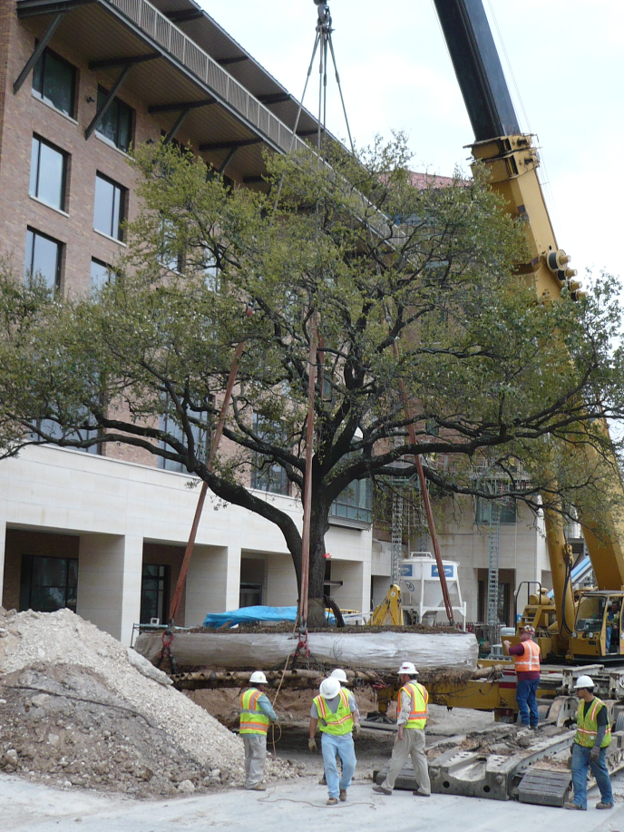
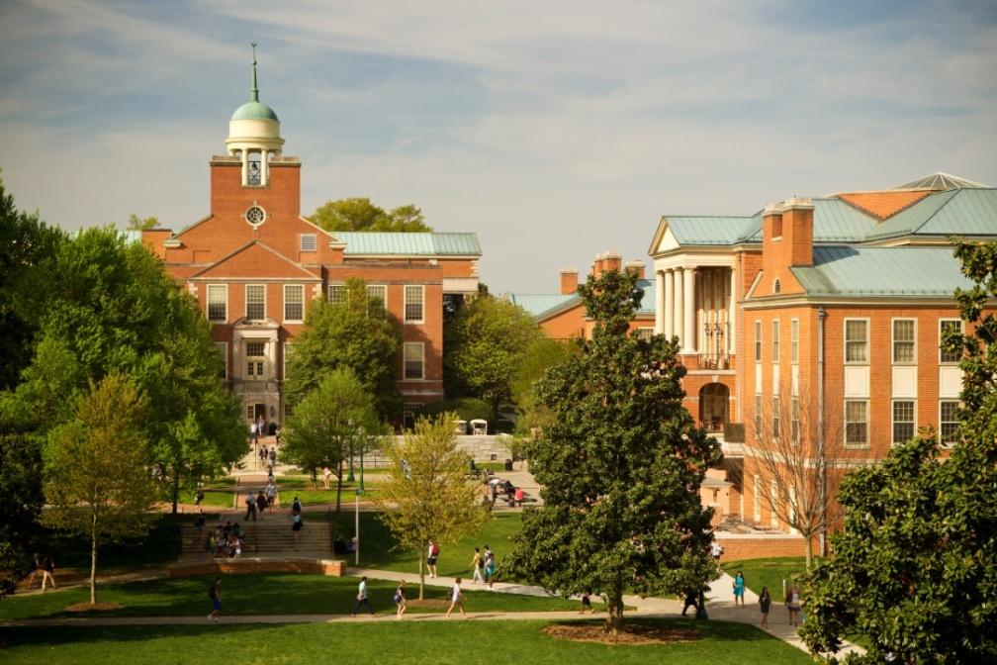
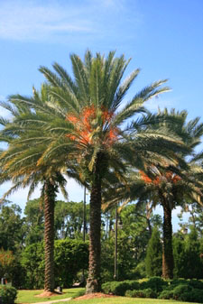
Tree Protection
Relocations – to move or not to move
  Species
  Size 4”-6”
  Schedule
  Cost

Slide 26
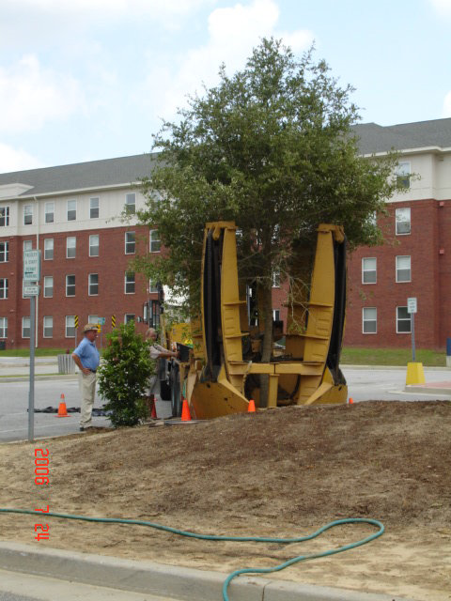
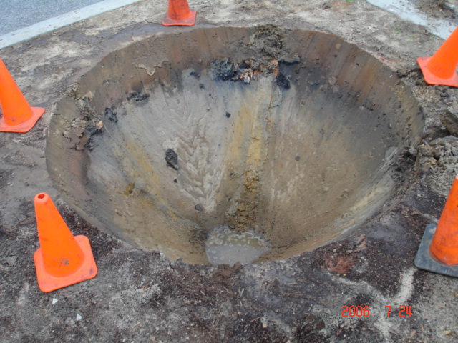
Tree Protection
Relocations
  Tree spade

Slide 27
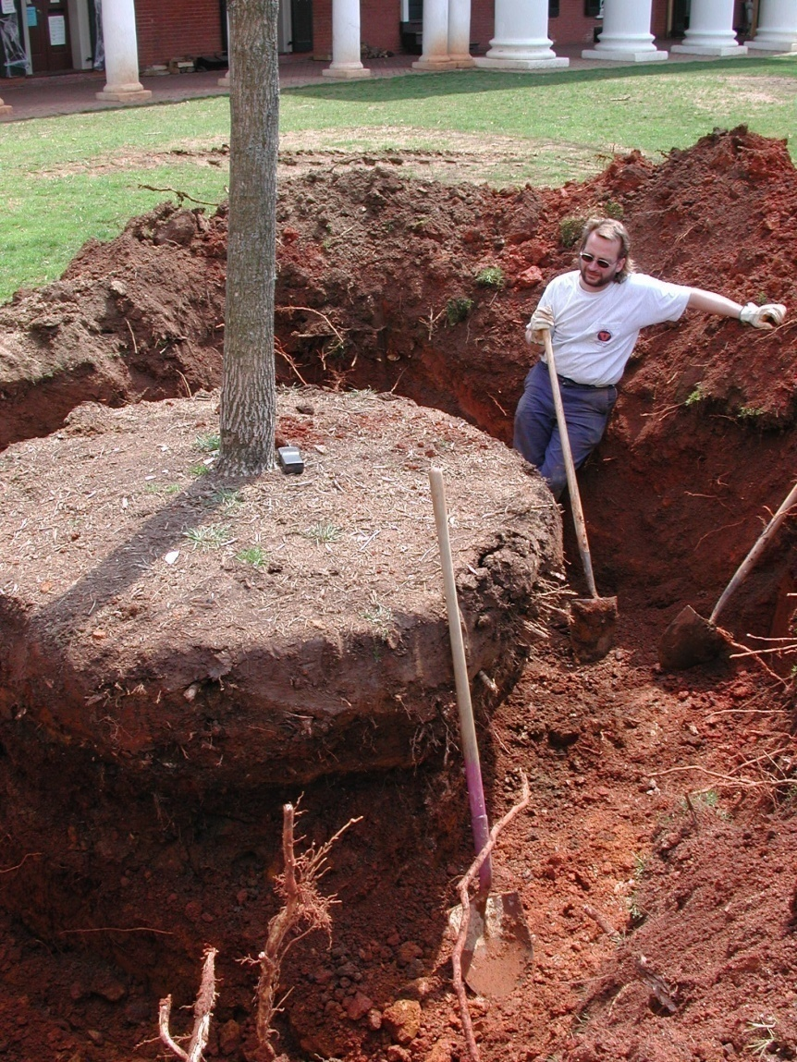
Tree Protection
Relocations
  Hand dig

Slide 28
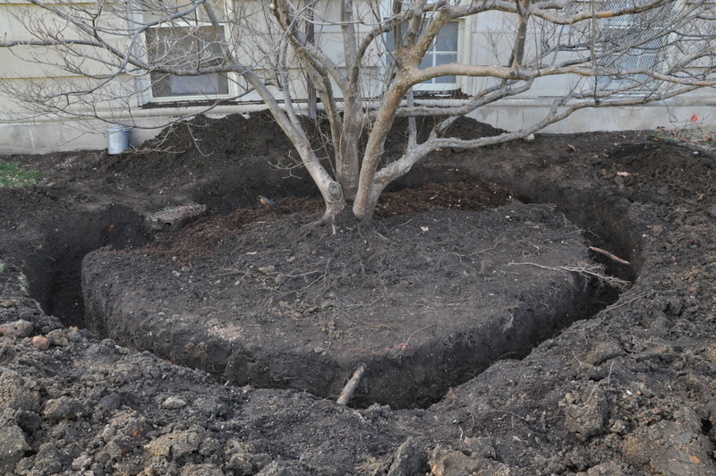
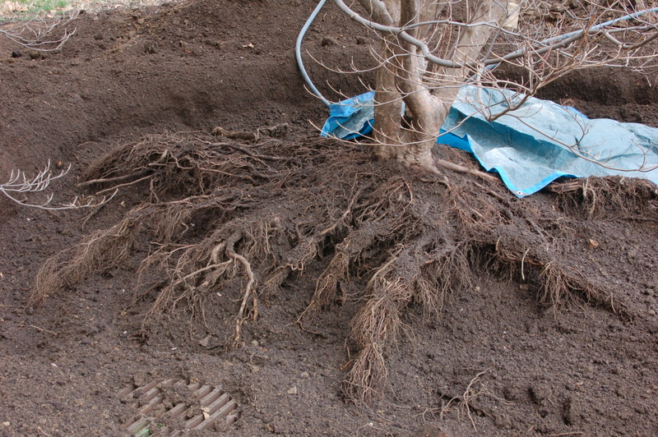
Tree Protection
Relocations
  Air spade & bare root

Slide 29

Tree Protection
Relocations

Slide 30


Tree Protection
Relocations

Slide 31




Tree Management
Why Prune?
  Eliminate dead, diseased or damaged wood.
  Clearance for vehicles, people &views.
  Correct structural problems

Slide 32

Tree Management
How to Prune?
  Flush cut vs.
  natural target pruning

Slide 33



Tree Management
How & What to Prune?
  Young trees 2 years
  Mid-sized 3-5 years
  Mature trees 5+ years
When’s the best time to prune?

Slide 34



Tree Management
Don’t Pollard Trees (generally)

Slide 35


Tree Management
Arborist Staffing
  Contract vs. in-house
  International Society of Arboriculture
  (ISA) certification

Slide 36


Tree Management
Mulching
  Why?
    Weed suppression
    Moisture infiltration & retention
    Soil improvement
    Nutrients
    Trunk & root protection

Slide 37




Tree Management
Mulching
  Mulch materials

Slide 38



Tree Management
Mulching
  How & how much?

Slide 39




Plans, Programs & Inventories
Tree Campus USA – Arbor Day Foundation
Tree Management Plan
Tree Inventories & Valuation
Tree Replacement Plan
Memorial Trees
Arboretum

Slide 40

Questions?
Tom Flood
tflood@udel.edu
University of Delaware

