Slide 1

Grounds Maintenance Programs
APPA Institute for Facilities Management
Tom Flood, ASLA, CEFP, MBA
Assoc. VP Facilities Operations
University of Delaware

Slide 2
Learning Objectives
  1. Purpose & Organizational Goals
  2. Maintenance Levels, Parts & Priorities
  3. Organizational Structures
  4. Resources - Facilities, Equipment, Financial
  5. Staffing
  6. Snow Removal

Slide 3
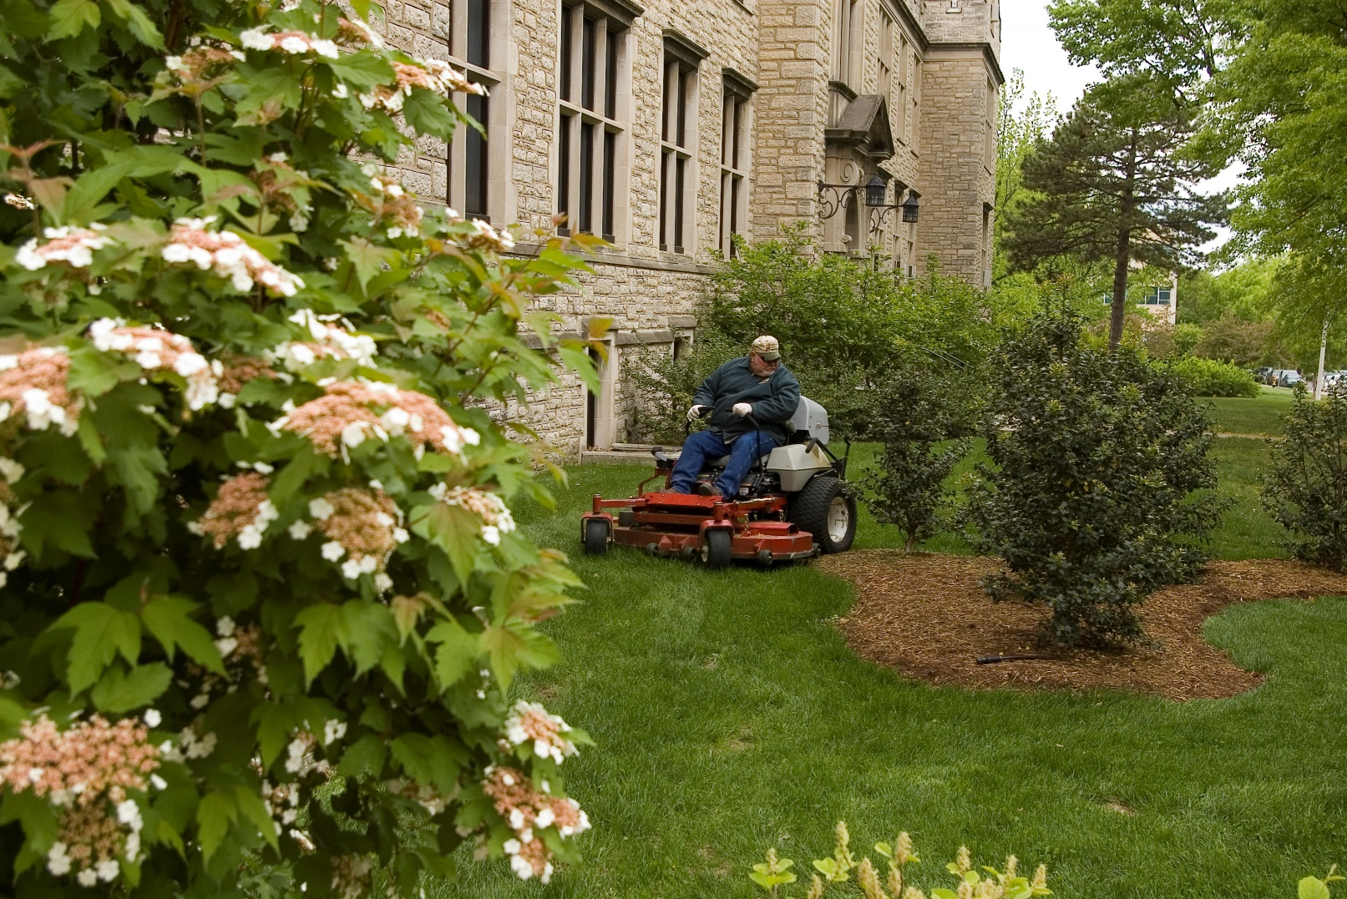
Purpose of Grounds Management

Slide 4
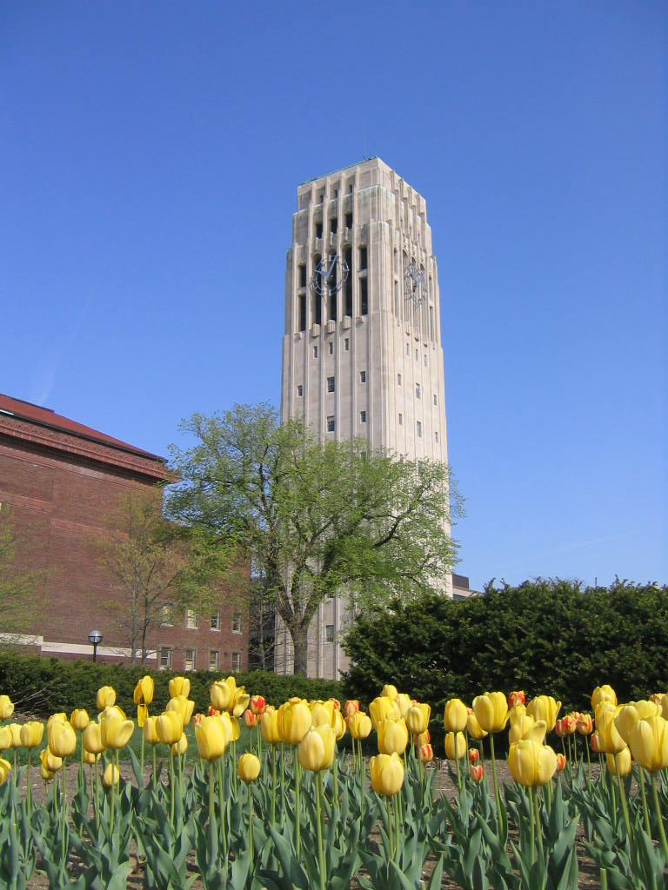
Organizational Goals/Mission
  Attractive
  Marketing
  Safe
  Functional
  Low Cost
  Educational Resource

Slide 5
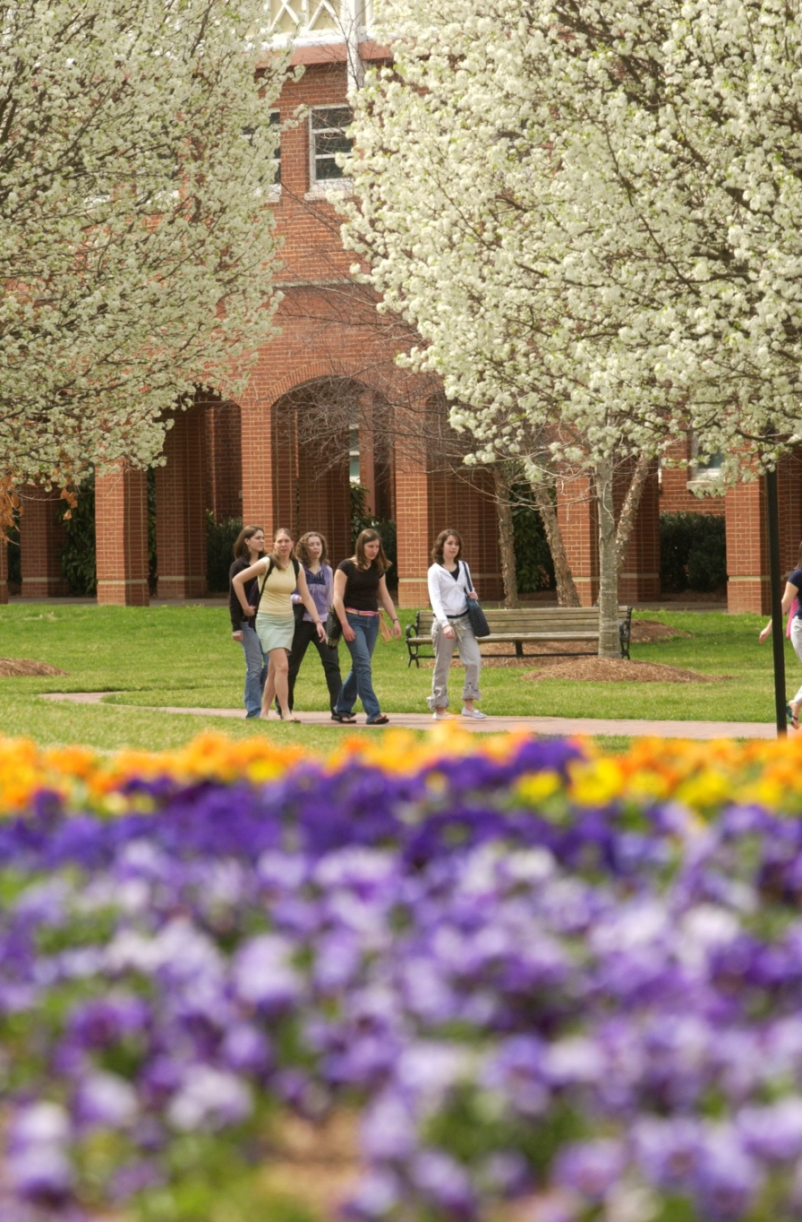
62% of high school seniors were most influence by the appearance of the building and grounds during their visit to college campus.
How Do Students Choose a College,1986, Carnegie Foundation for the Advancement of Teaching

Slide 6
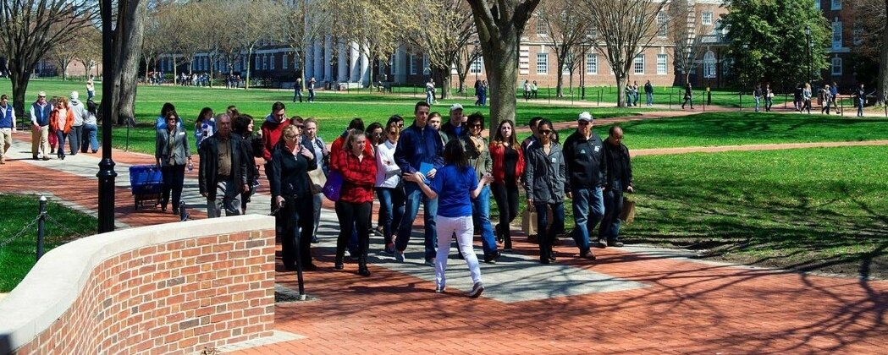
Students visit an average of 10 college campuses.
National Association of College Admissions Counselors
47 % of students said the campus visit was the most influential factor in their college selection.
2009, How Students Really Decide; College Selection From the Inside. Zinch.com

Slide 7
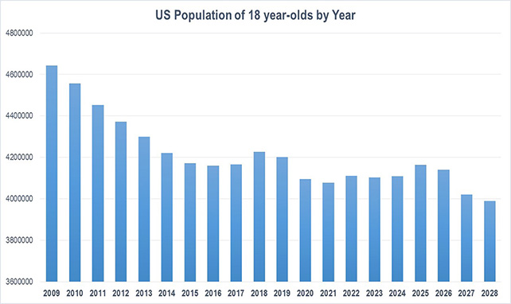

Slide 8
  APPA Grounds Maintenance Levels
  Level 6 – Natural areas
  Level 5 – Minimum-level
  Level 4 – Moderately low-level
  Level 3 – Moderate-level
  Level 2 – High-level
  Level 1 – State-of-the-art
  What level is your school?

Slide 9
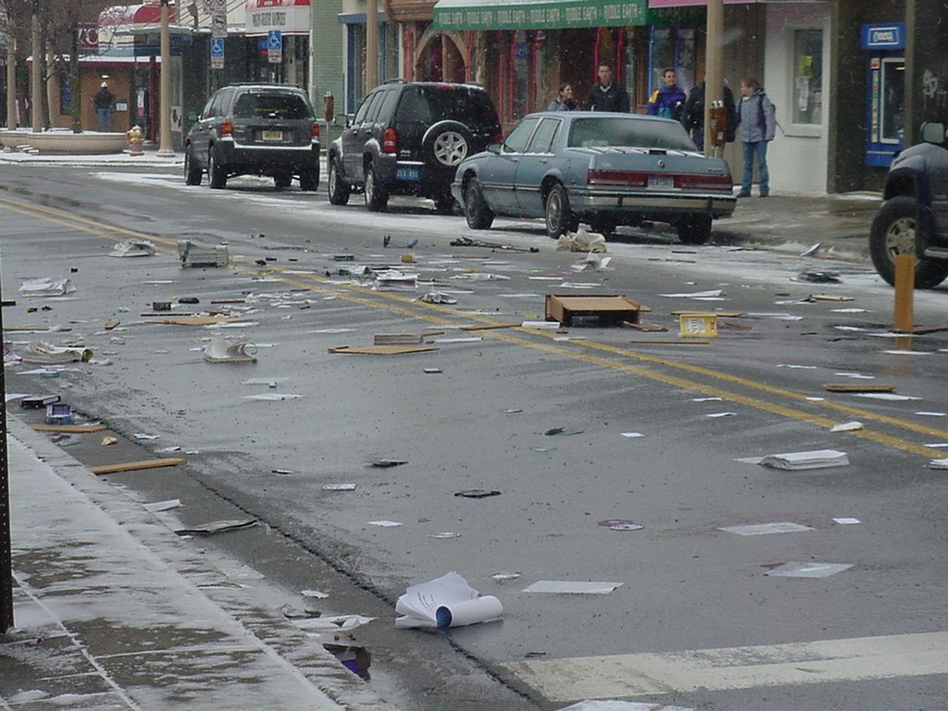
Parts & Priorities
APPA Level 3 - ‘Clean & Green’
  Litter Collection
    2-3 /wk

Slide 10
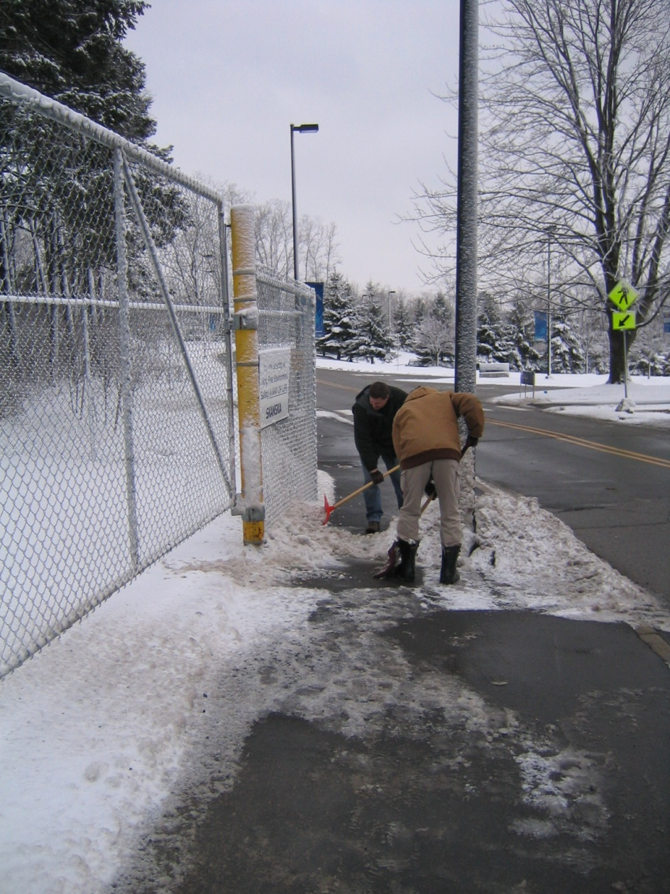
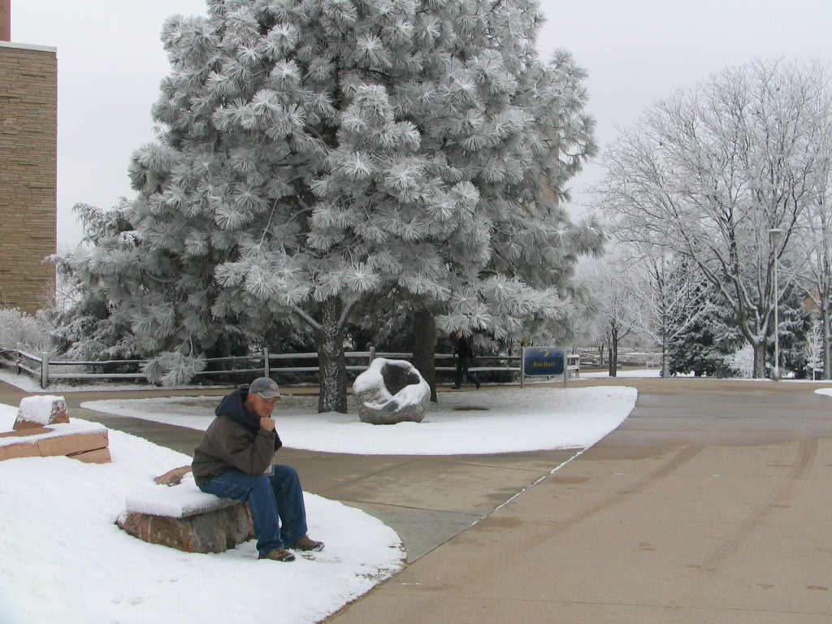
Parts & Priorities
Level 3 - ‘Clean & Green’
  Snow Removal

Slide 11
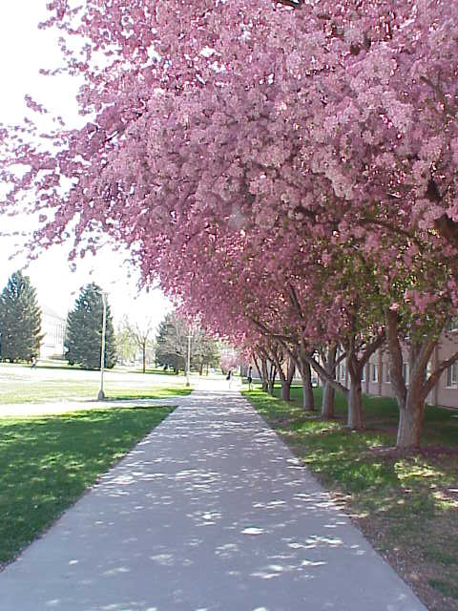
Parts & Priorities
Level 3 - ‘Clean & Green’
  Mow,Trim, Blow & Go
    Mow1 / 7-10 days
    Fertilize 1/yr
    Litter 3 /wk

Slide 12
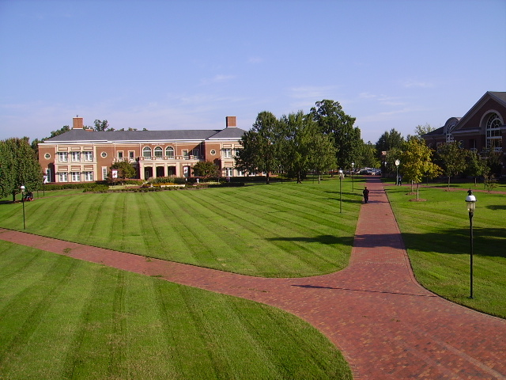
Parts & Priorities
APPA Level 2 – ‘The Academic Village’
  Turf Management
    Mow 1/wk
    Fertilize 1+/yr
    Irrigation
    Weed Control
    Aerate
    Overseed

Slide 13
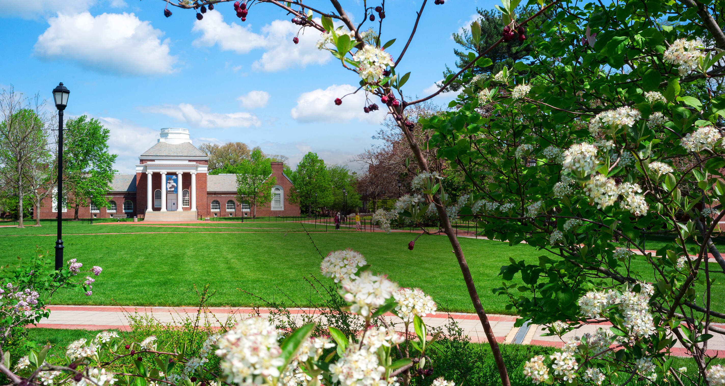
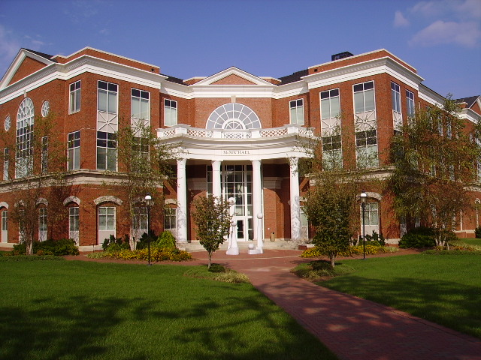
Parts & Priorities
Level 2 – ‘The Academic Village’
  Tree management
  Shrub plantings
  Litter, 5+ days/wk

Slide 14
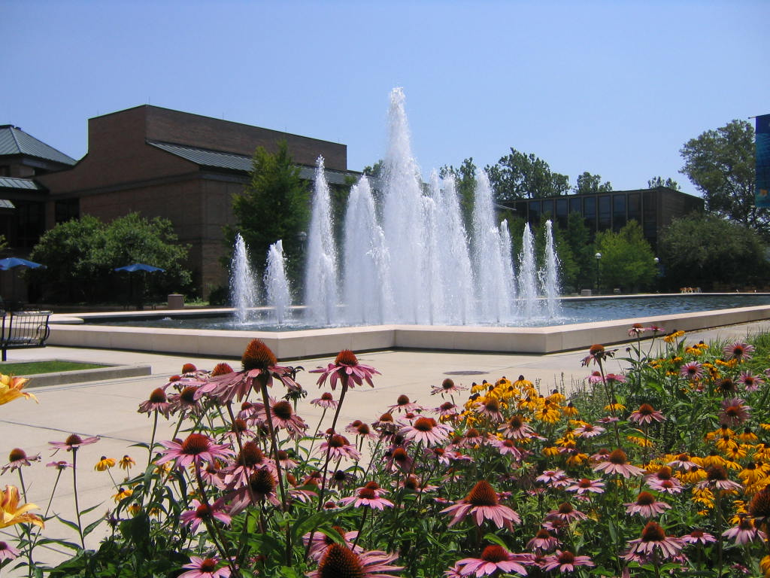
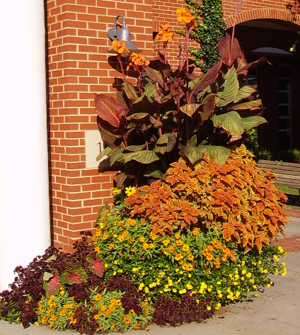
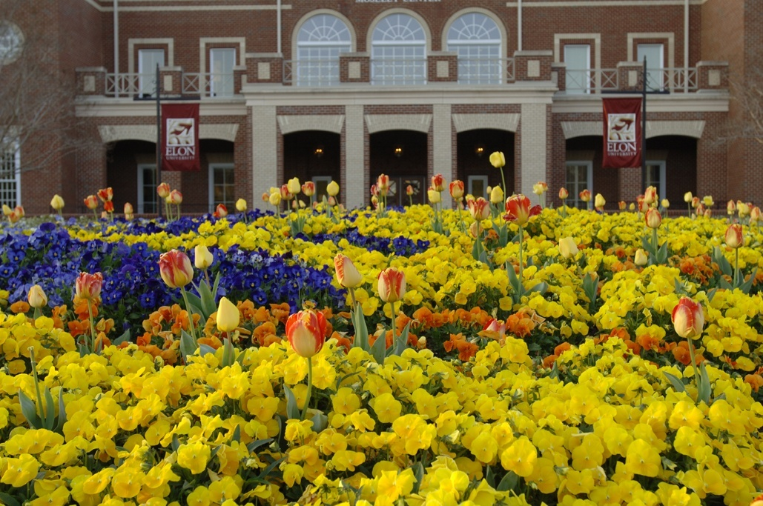
Parts & Priorities
APPA Level 1 – ‘The Campus Garden’
Annual & Perennial Flowers

Slide 15

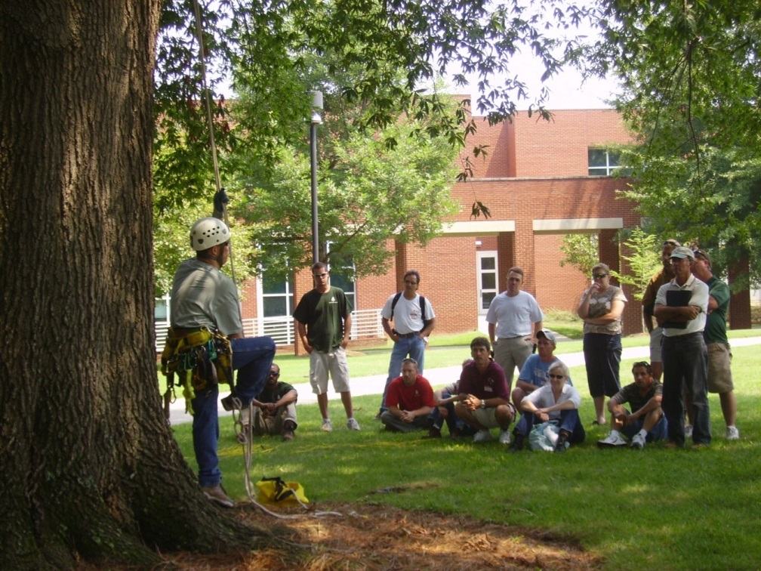
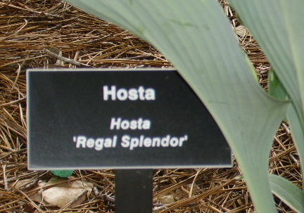
Parts & Priorities
APPA Level 1 – ‘The Campus Garden’
  - Botanical Gardens & Arboreta

Slide 16
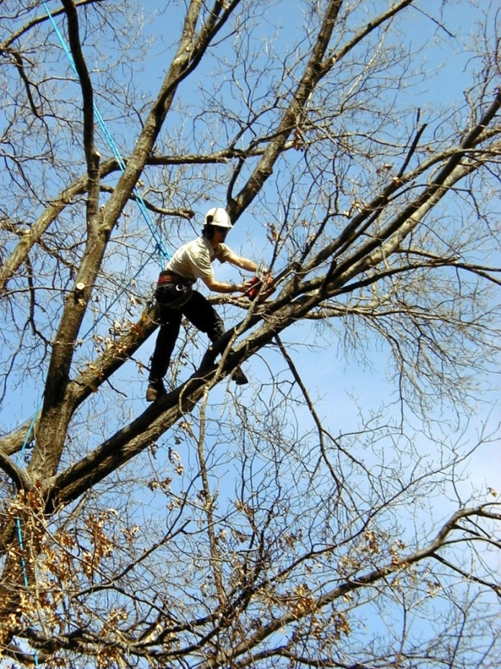
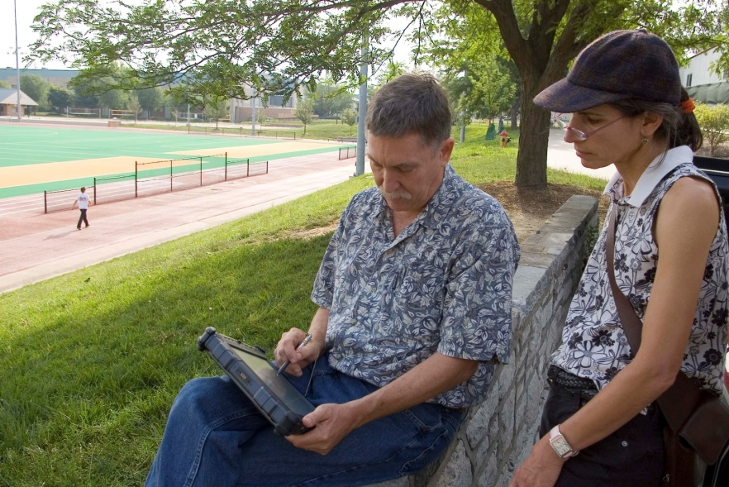
Parts & Priorities
APPA Level 1 – ‘The Campus Garden’
  Arboriculture
  Tree inventory &
  appraisal

Slide 17
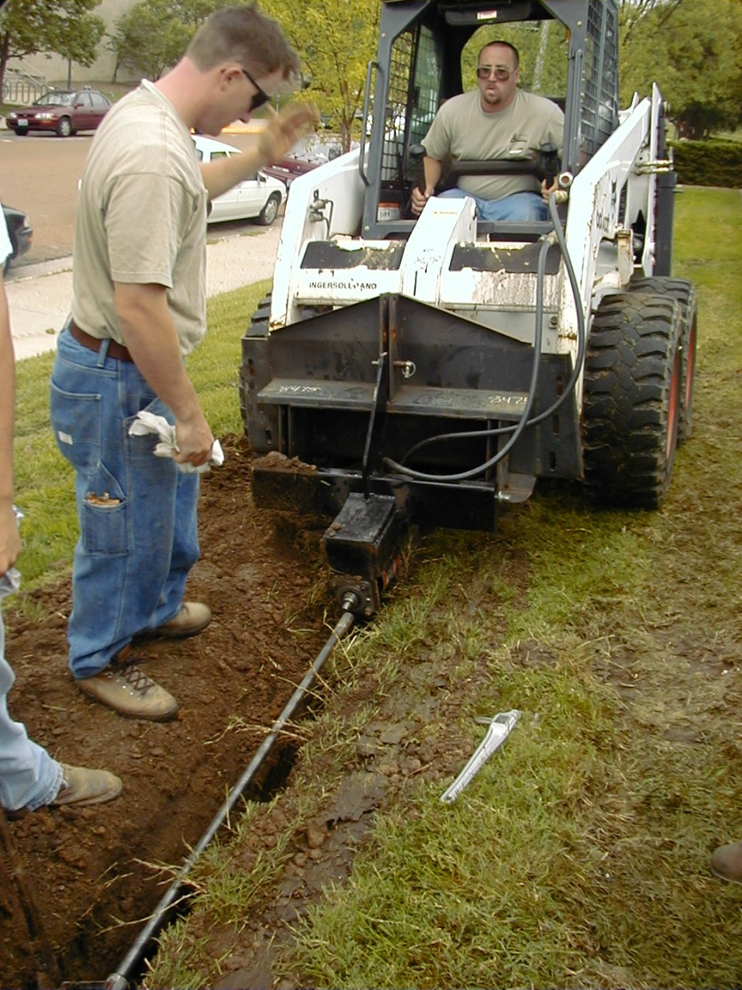
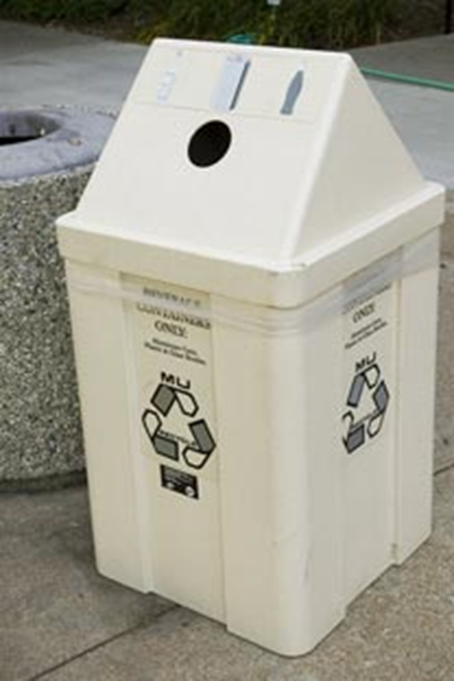
Miscellaneous Services
  Pavement Management
  Waste & Recycling
  Composting
  Site Furnishings
  Landscape Construction
  Landscape Architecture

Slide 18
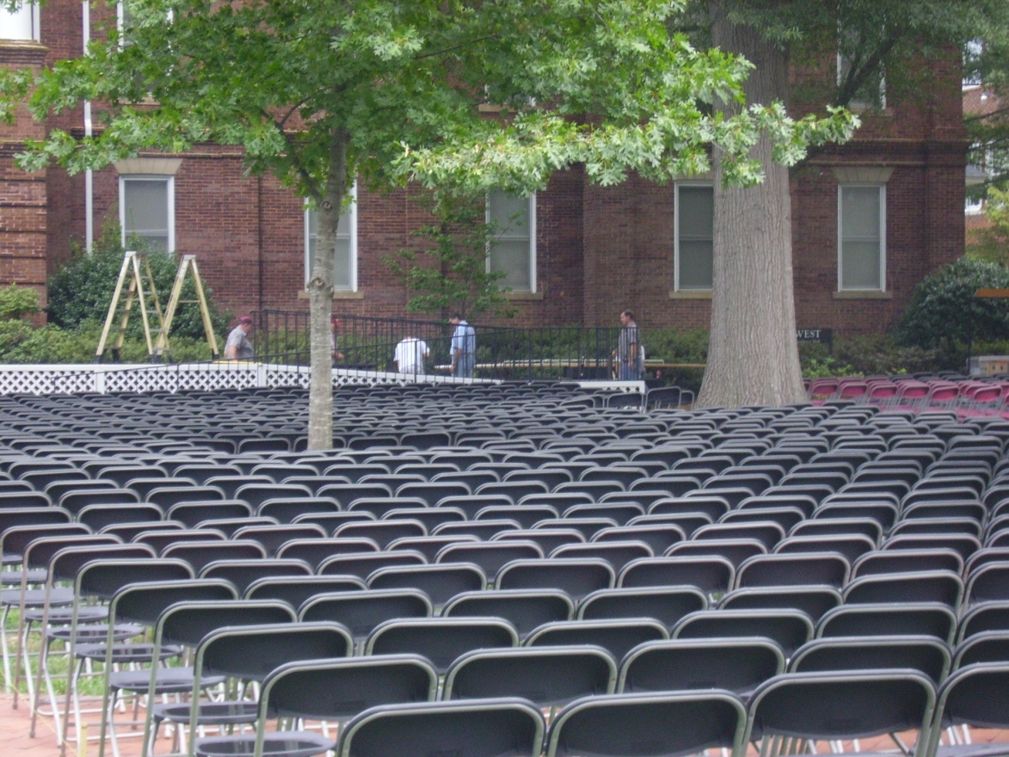
Conflicting Services
  Moving & Setups
  Labor Shop
  ~The tyranny of the urgent trumps the completion of the important.

Slide 19
Organizational Structure – task based
Landscape Services
Superintendent
Athletics
Sports Turf
Manager
Turf Crew
Lead Groundskeeper
Horticulture
Lead Gardener
Landscape Const.
Supervisor
Irrigation Technician
Lead Groundskeeper
Groundskeeper
Gardener
Groundskeeper
Groundskeeper
Gardener
Groundskeeper
Small Engine Mechanic
Arborist
Seasonal
Groundskeepers

Slide 20
Organizational Structure – zone based
Landscape Services
Superintendent
Athletics
Sports Turf
Manager
Center Campus
Supervisor
North Campus
Supervisor
Research Campus
Landscape Gardener
Irrigation Technician
Lead Groundskeeper
Landscape Gardener
Lead Groundskeeper
Groundskeeper
Groundskeeper
Gardener
Groundskeeper
Groundskeeper
Groundskeeper II
Groundskeeper
Gardener
Groundskeeper
Gardener
Temporary
Groundskeeper
Groundskeeper
Small Engine Mechanic

Slide 21
Organizational Structures
Task
More efficient use of labor
More efficient use of equipment
Less ownership
May be less pride
Easier to train employees
More monotony
Zone
Less efficient use of labor
More equipment required
More ownership = pride
More accountability
May create silos
More training required
Greater job satisfaction

Slide 22
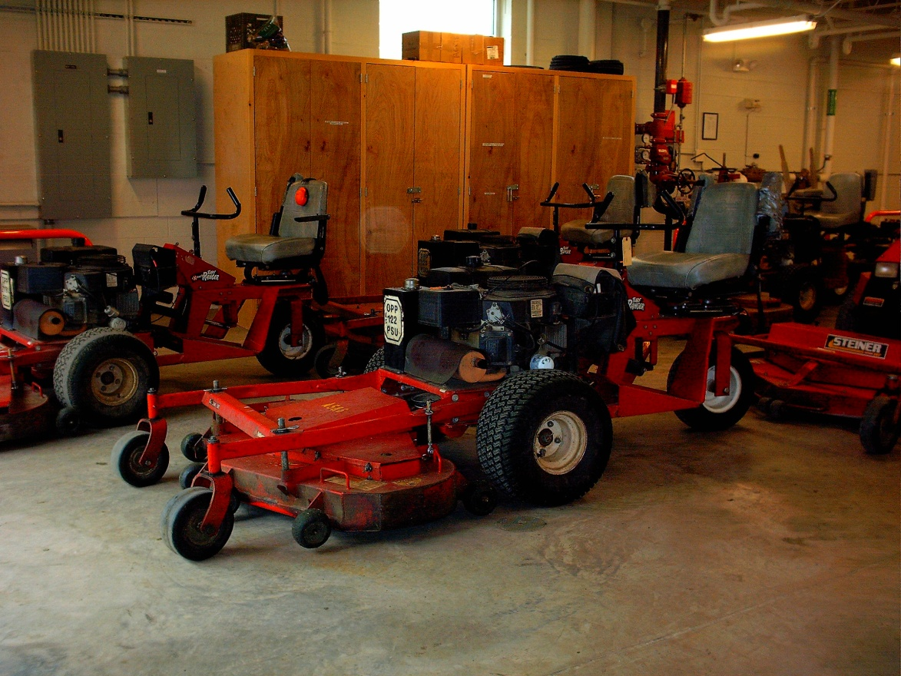
Resource Requirements
Facilities
- Equipment shop
- Covered storage
- Bulk materials
storage
- Holding nursery

Slide 23
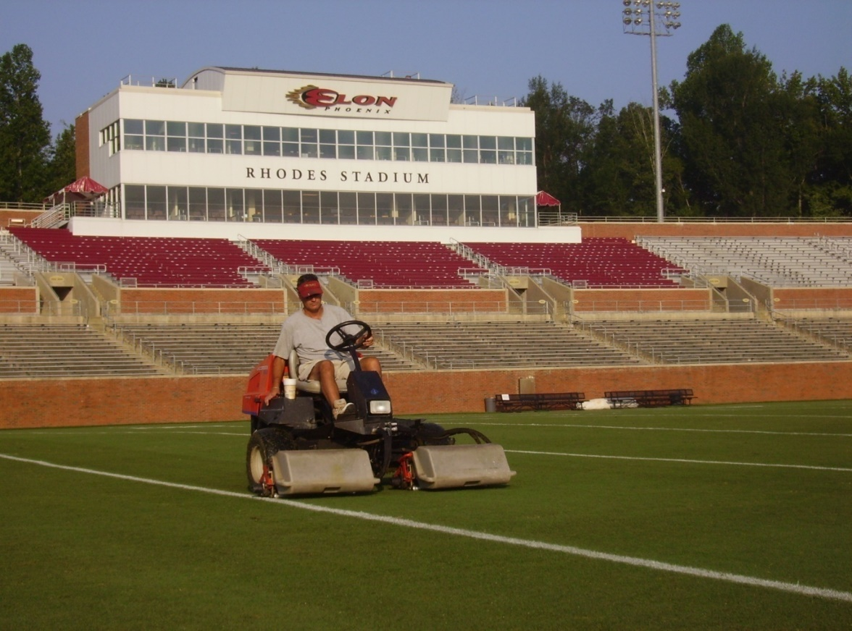
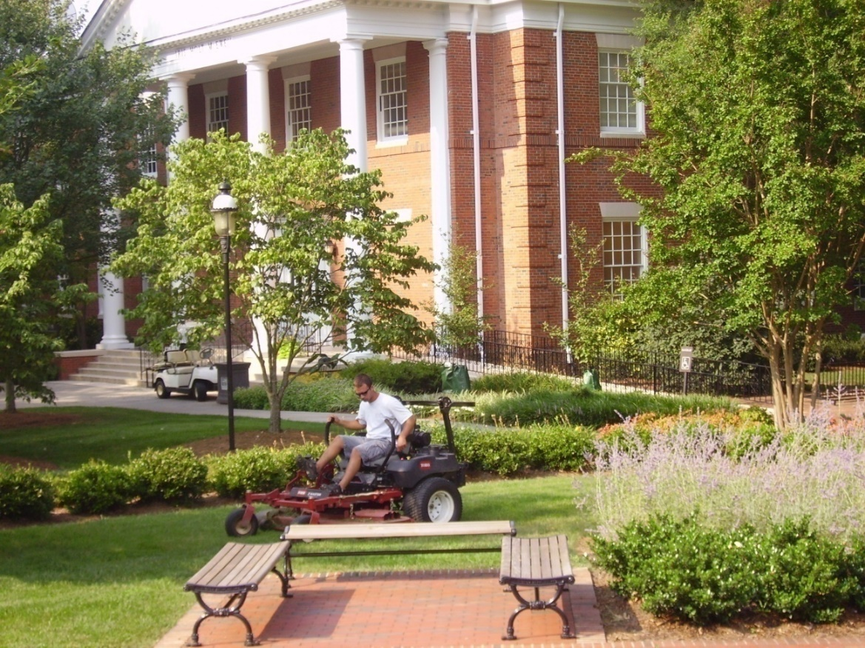
Resource Requirements
Equipment
- Reel & Rotary Mowers

Slide 24
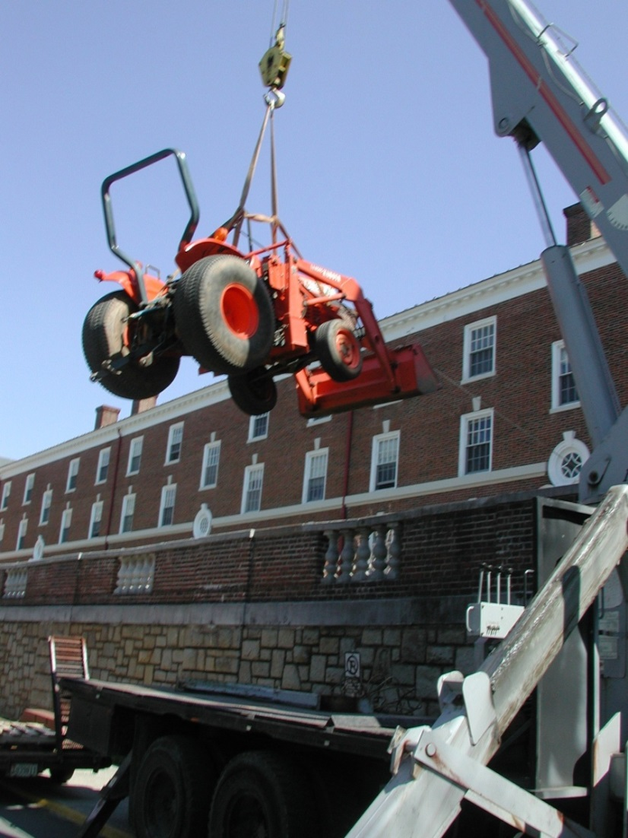
Resource Requirements
Equipment
- Blowers, edgers, etc
- Tractors
- Spreaders / sprayers
- Miscellaneous
  ~ 5%-10% of op. budget
  in capital equipment
  annually

Slide 25
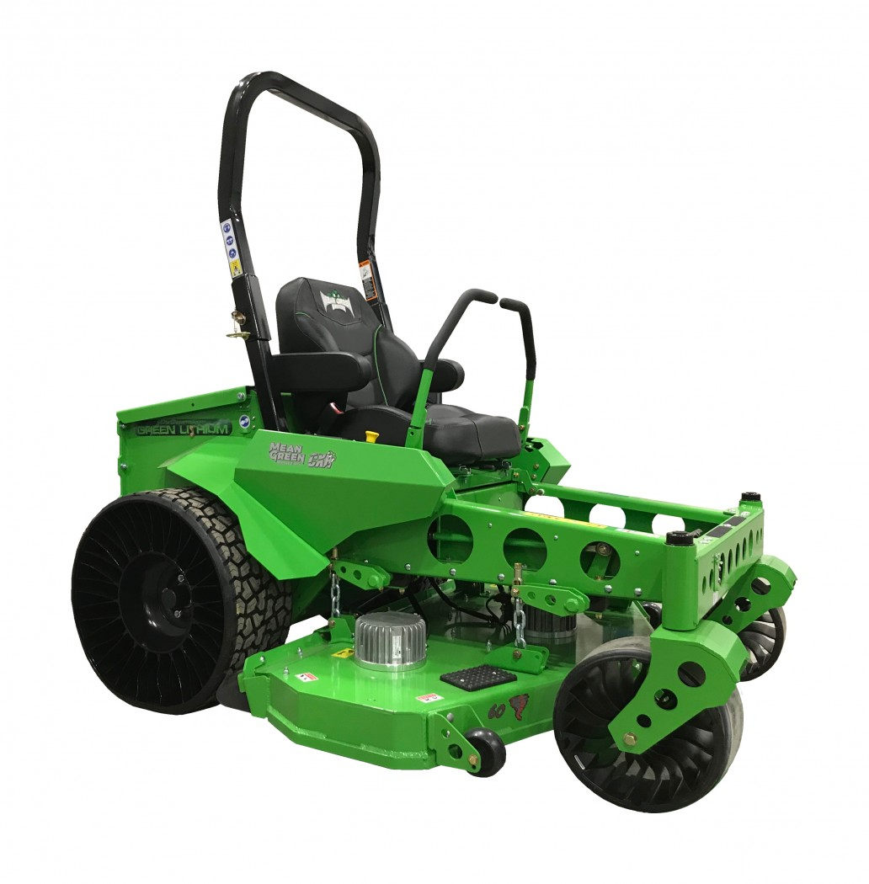
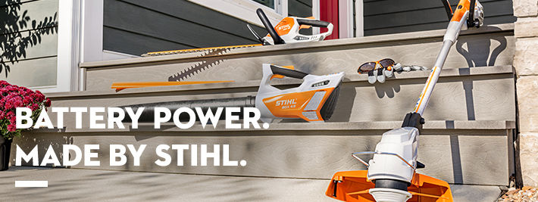
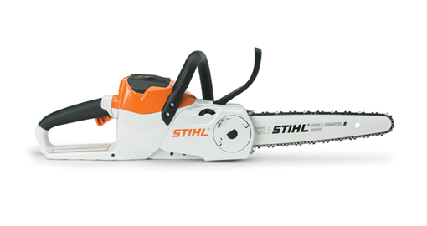

Electric Equipment options

Slide 26
Resource Requirements - Financial

Slide 27
Resource Requirements - Financial

Slide 28
Resource Requirements - Financial
The 95/5 rule
  95 % of the grounds budget is taken by tasks that only 5% of the customers notice.
  But 95% of the customers notice what we spend only 5% of the grounds budget on.

Slide 29
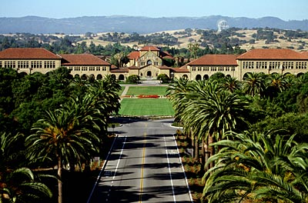
Resource Requirements
Staffing ‘The Holy Grail’
- Comparative issues
  Climate
  Quality & expectations
  Landscape style
  Volume of use
  Campus setting
  Area measurements

Slide 30
Staffing
Data Sources
  Institutional History
  APPA Facilities Performance Indicators (FPI)
  Operational Guidelines for Grounds Management - APPA

Slide 31
APPA FPI

Slide 33
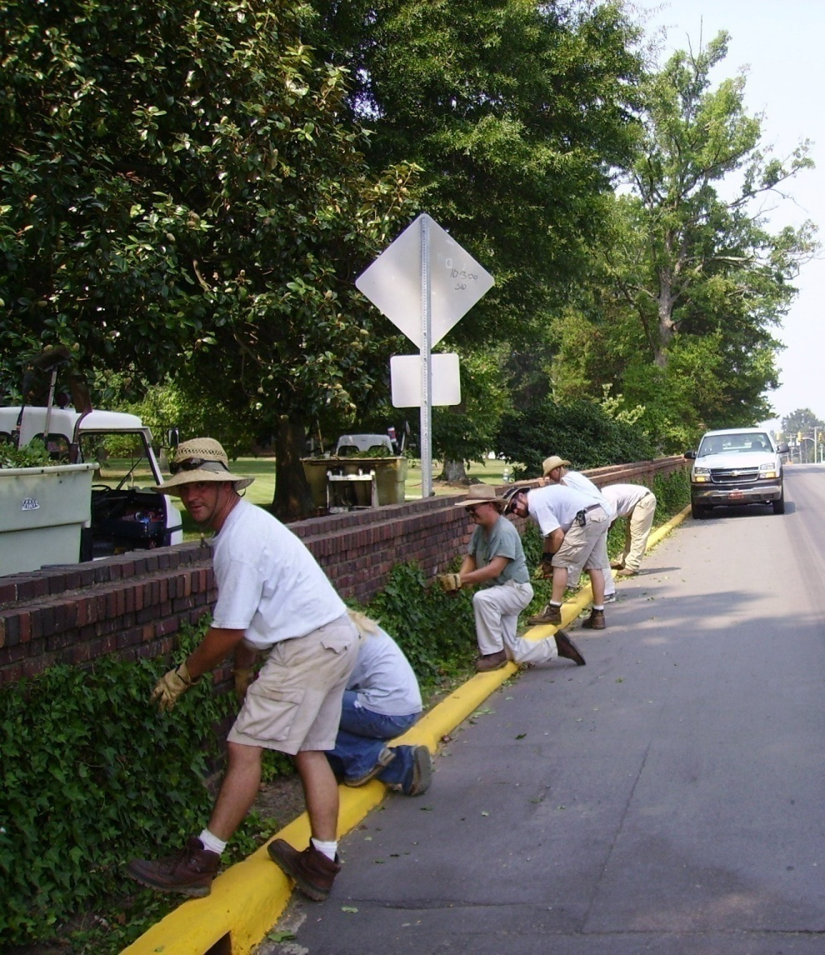
Resource Requirements
APPA Staffing Level 1
  High use/
  high visibility areas,
  3 – 7 Acres / FTE

Slide 34
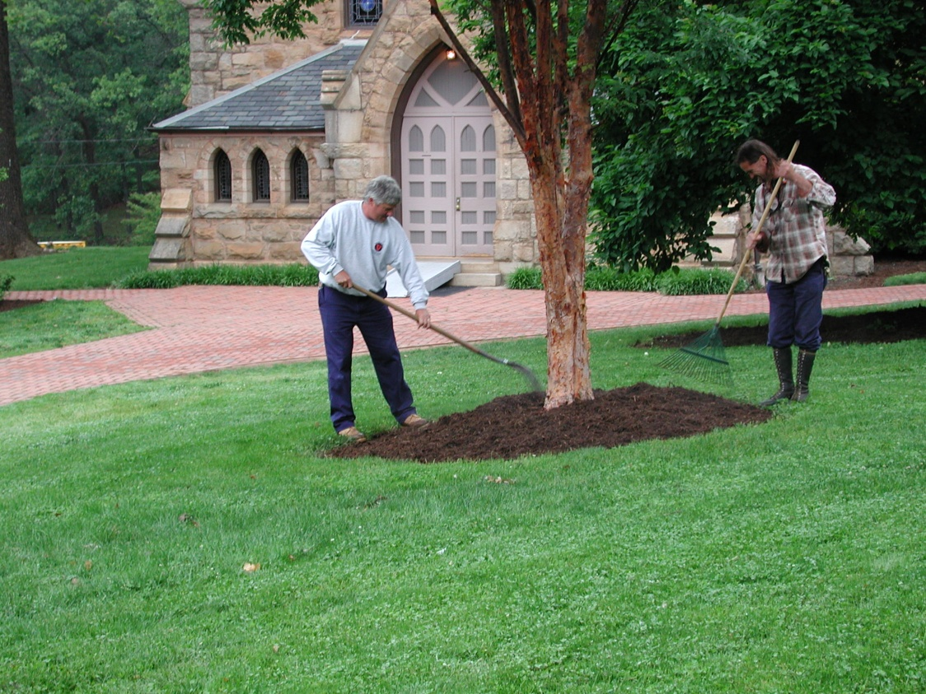
Resource Requirements
APPA Staffing Level 2
  Medium use & visibility areas,
  7 - 14 Acres / FTE

Slide 35
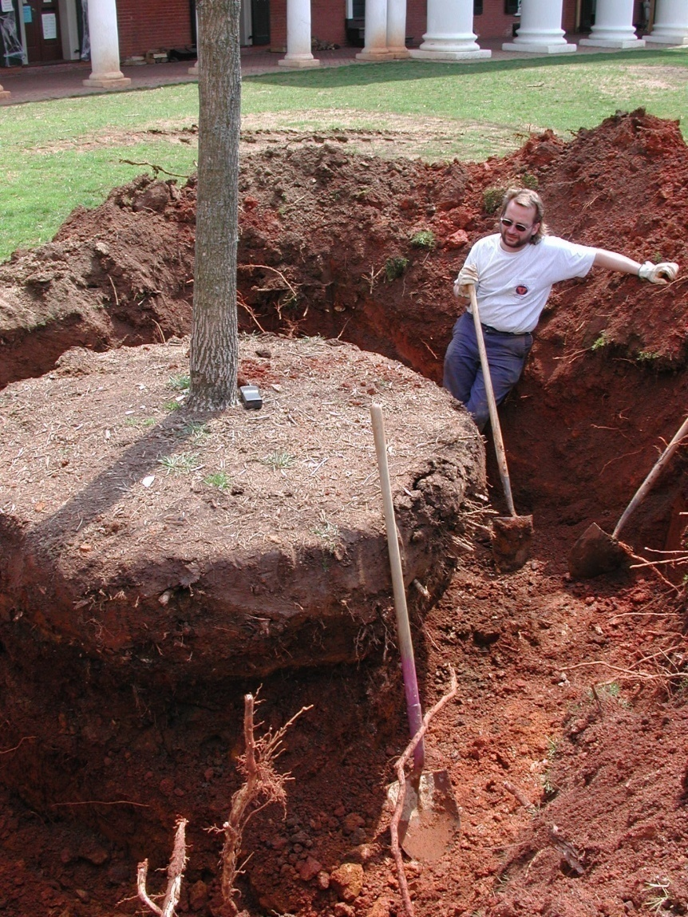
Resource Requirements
APPA Staffing Level 3-4
  Low use areas,
  14- 100 Acres / FTE

Slide 36
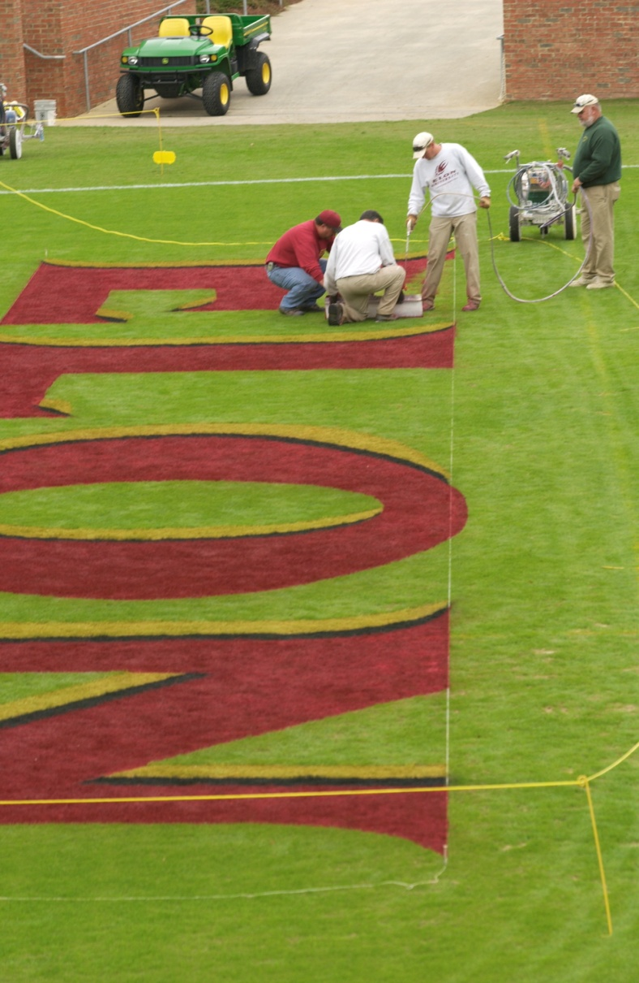
Resource Requirements
Staffing
  Athletic fields – NCAA
    1 – 3 Fields/ FTE

Slide 37
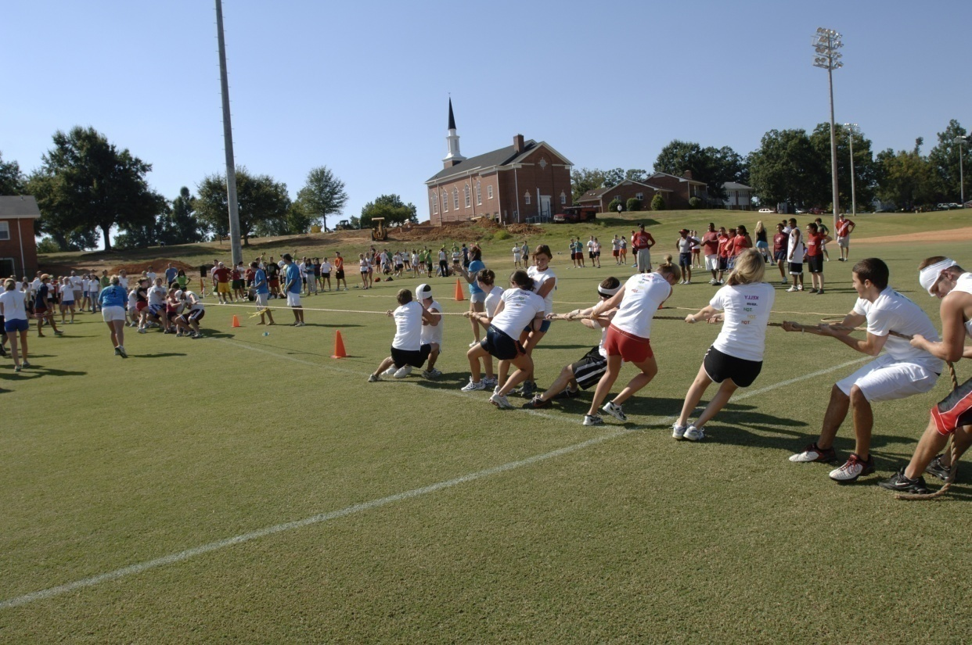
Resource Requirements
Staffing
  Athletic fields – Recreational
  3 - 6 Fields/ FTE

Slide 38
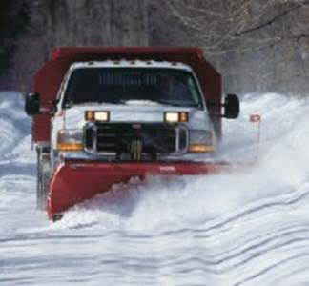
Snow Removal

Slide 39
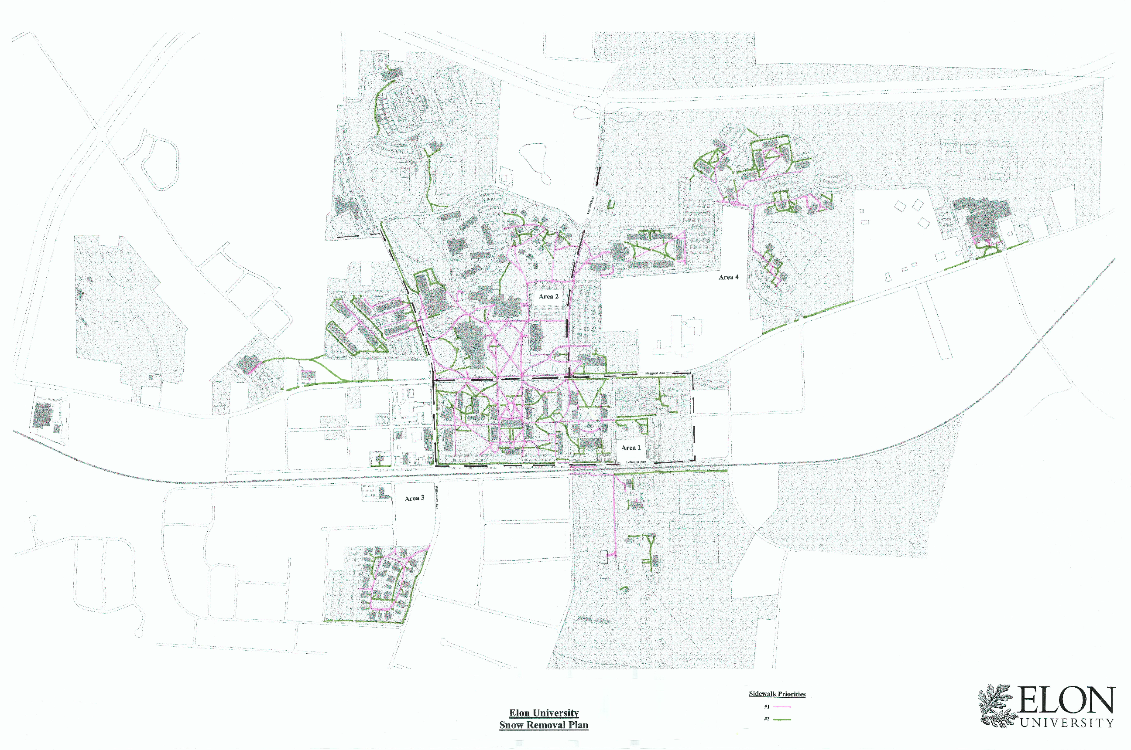
Snow Removal - Response Plans
By Priority
By Zone
By Equipment Assignment
  Reasonable and Defendable

Slide 40
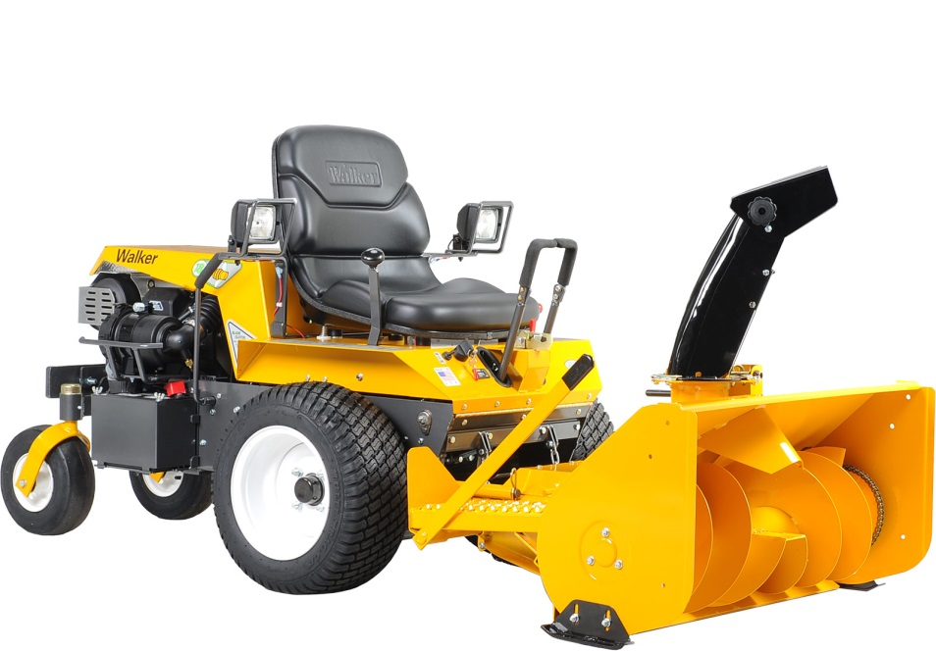
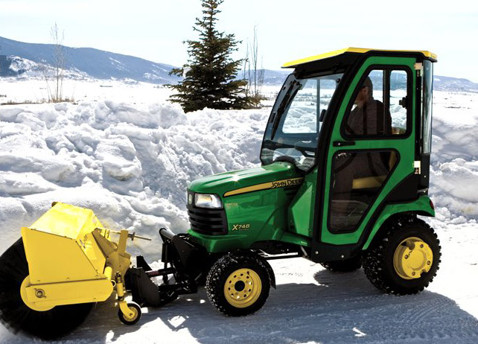
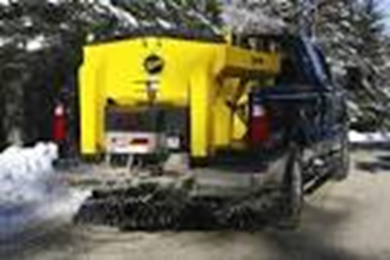
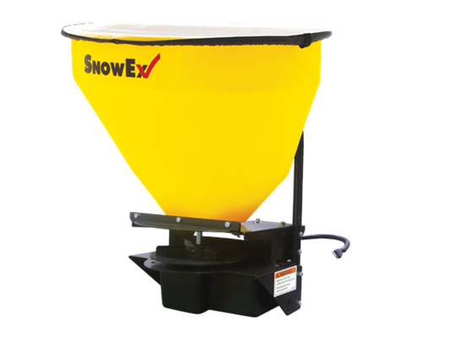
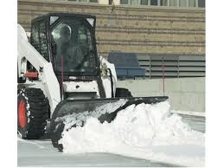
Snow Removal
  - Equipment
  cost ranges 0-50% of operating budget

Slide 41
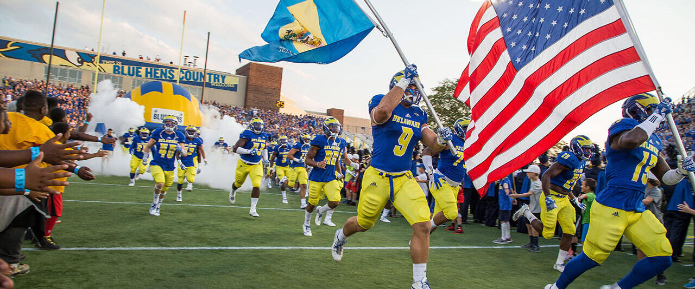
Athletics & Synthetic Turf
Professional Sports Field Management
Manage for Student Athlete Safety
(it’s not just grass)

Slide 42
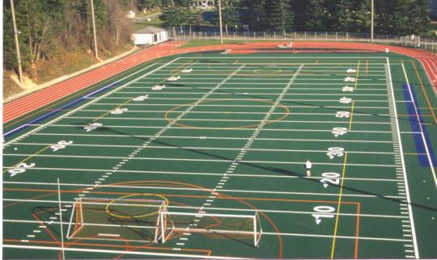
Professional Sports Field Management
Natural vs. Synthetic
Considerations
Capital cost
Life cycle cost
Maintenance needs
Number of sports
Multiple lines
All weather use
Surface temperature
Painting and scrubbing
Injury & playability
Coach preferences

Slide 43
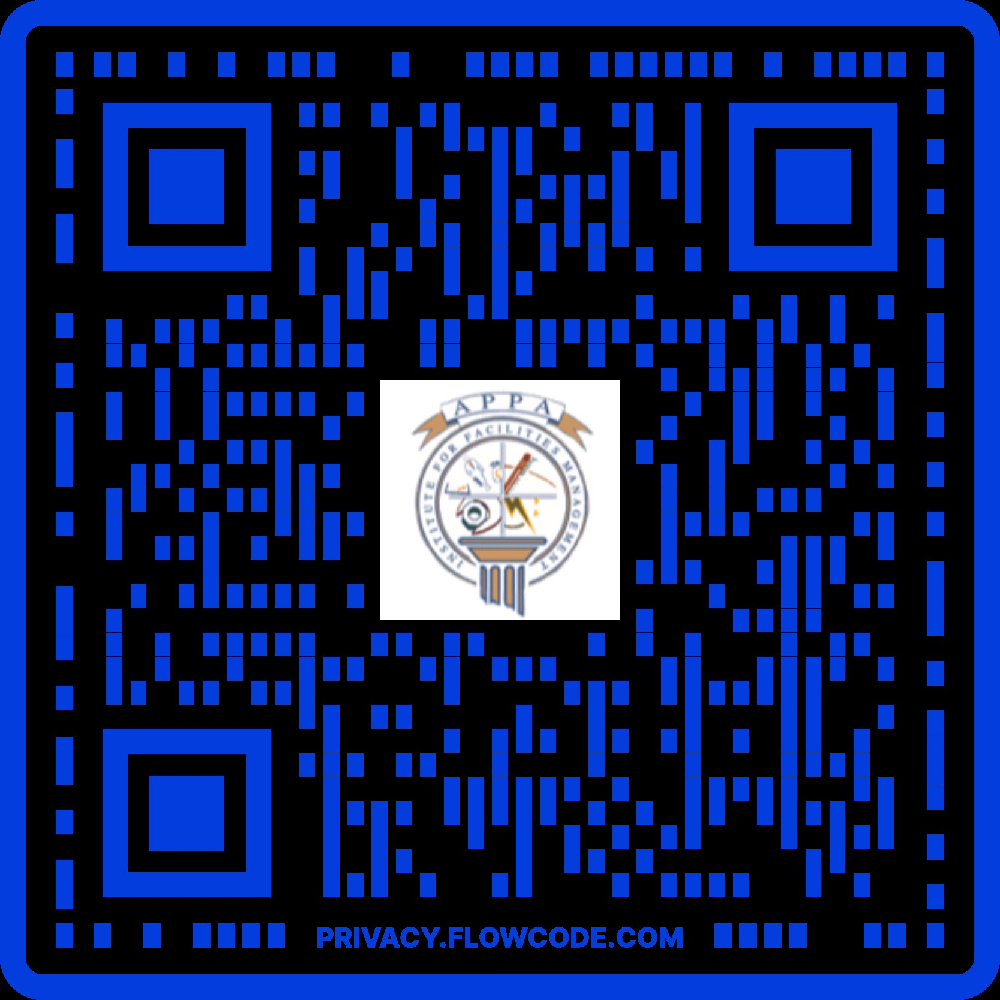
QUESTIONS?
Tom Flood tflood@udel.edu
University of Delaware
This concludes The American Institute of Architects Continuing Education Systems Course

